Slide 1
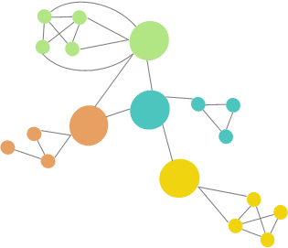
Graph Learning: Principles, Challenges, and Open Directions
Adrián Arnaiz-Rodríguez and Ameya Velingker
ICML 2024
Vienna, Austria
22/07/2024
https://icml2024graphs.ameyavelingker.com/

Slide 2
Intro to GNNs and relevant concepts
Early Graph embedding methods
GNNs
Spectral Graph Theory
Transformers
Expressiveness
Generalizability
GNN Challenges
Under-reaching
Over-smoothing
Over-squashing
Open questions
Panel Discussion

Slide 3
Panel Discussion Open questions and challenges on GNNs Graphs + LLMs Graph Foundation Models
Graph Learning: Principles, Challenges, and Open Directions
ICML 2024 - 22/07/2024
Michael Bronstein DeepMind Professor of Artificial Intelligence
Michael Galkin
AI Research Scientist at Intel Labs
Christopher Morris
Assistant Professor at RWTH Aachen University
Bryan Perozzi
Research Scientist at Google Research

Slide 4
INTRODUCTION

Slide 5
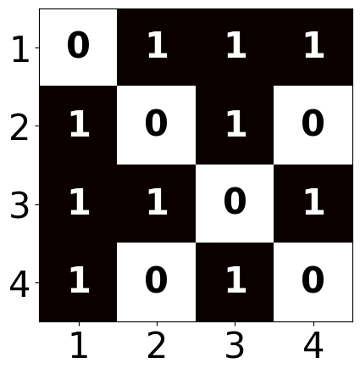
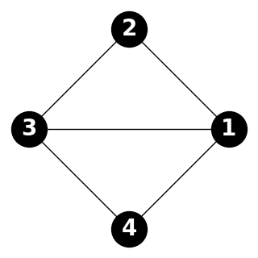
Graphs
$$\{$$
$$,$$
$$,…\}$$
Set of Nodes = $V$
Optionally with features $X$
Set of Edges = $E$
Adjacency Matrix = $A$
$$\{$$
$$,$$
$$,…\}$$

Slide 6
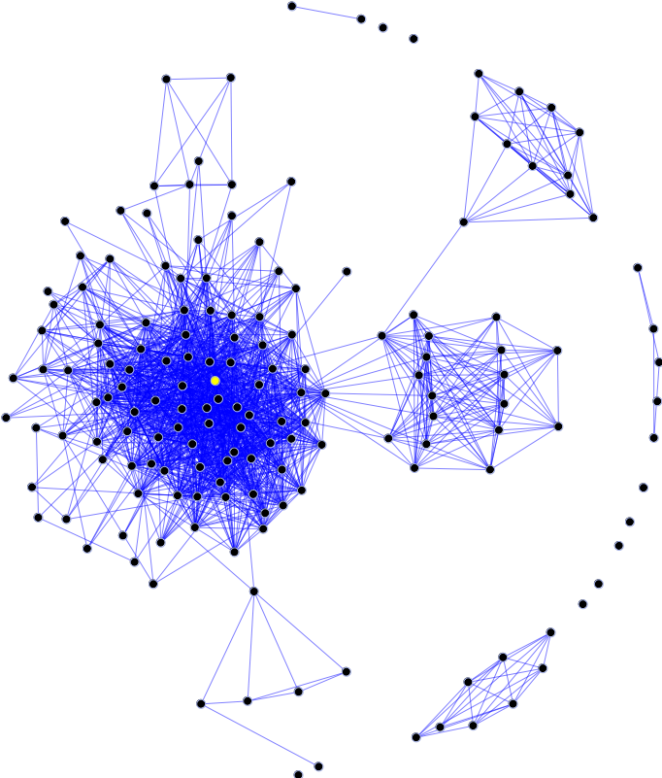
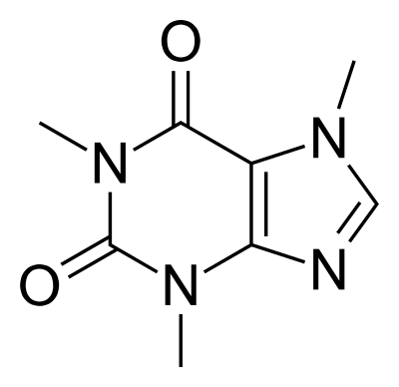
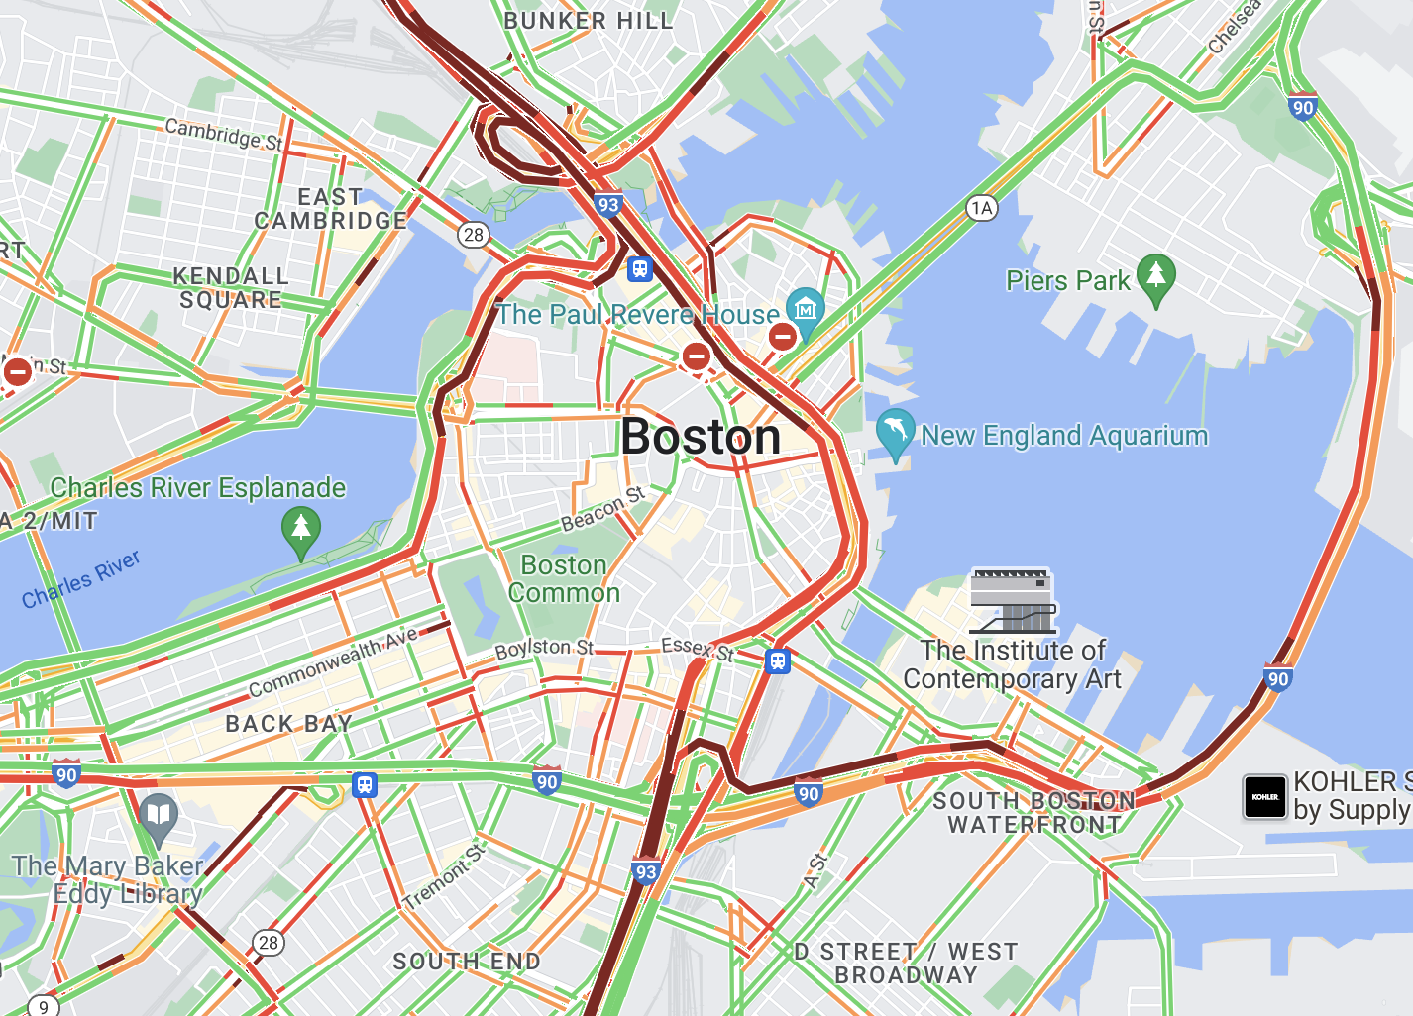
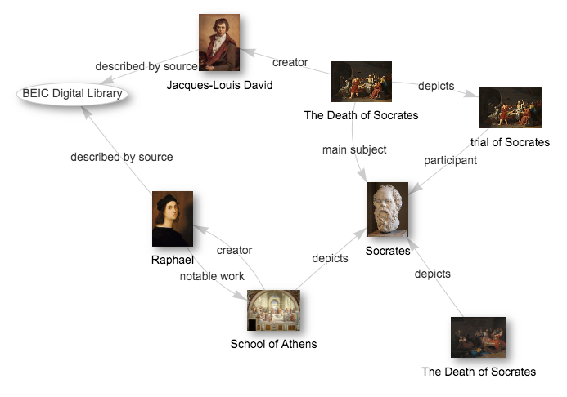
Graph Learning
Social Network Graphs
Molecular Graphs
Road Network Graphs
Knowledge Graphs

Slide 7
Types of Tasks
$$f( )$$
Node-level tasks
Node classification
Node clustering
Node regression
Edge-level tasks
Link prediction
Edge classification
Knowledge graph completion
Graph-level tasks
Graph classification
Graph regression
$$f( )$$
$$f( )$$

Slide 8
Challenges of Machine Learning on Graphs
Much of deep learning is on sequence or grid data
Transformers on sequences of tokens
Convolutional neural networks (CNNs) on pixel grids
Graphs have more general topological structures
Local neighborhoods vary in structure
How to identify or order nodes within the graph?

Slide 9
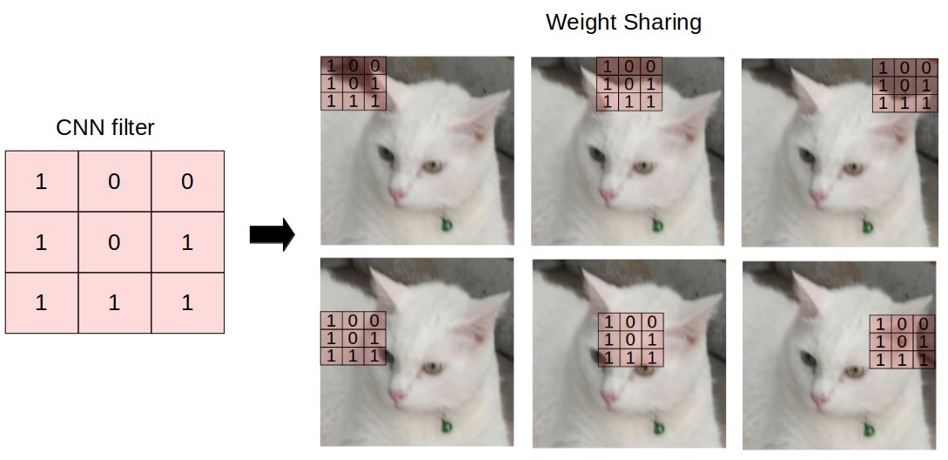
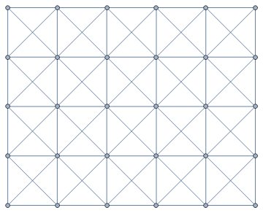
Convolutional Networks
Weight sharing
Filters capture neighborhood on a grid graph
ResNet, VGGNet, etc.
Image from https://towardsdatascience.com/understanding-graph-convolutional-networks-for-node-classification-a2bfdb7aba7b

Slide 10
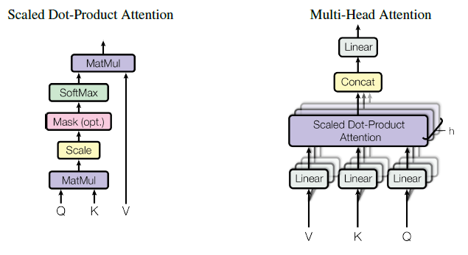
Transformers
Sequences of tokens
Next token prediction based on a past context window
Line graph
Image from https://towardsdatascience.com/understanding-graph-convolutional-networks-for-node-classification-a2bfdb7aba7b

Slide 11
EARLY METHODS

Slide 12
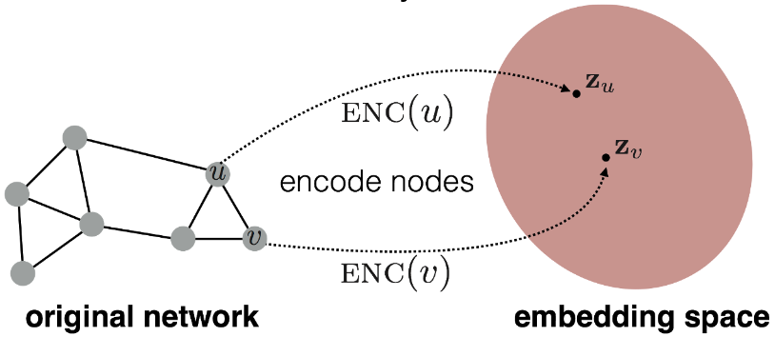
Early Methods: Node Embeddings and Graph Kernels
Map nodes into a (low-dimensional) embedding space
Similar nodes should have similar embeddings
Methods
DeepWalk ([Perozzi et al., 2014])
Node2vec ([Grover and Leskovec, 2016])
Techniques based on random walks, matrix factorization
Graph kernels: map graphs to embeddings

Slide 13
Node Embeddings for Downstream Tasks
v₁
Graph clustering
Link prediction
Graph classification
Node classification
Node regression
Anomaly detection
v₂
v₃
⋮
v_{n}

Slide 14
Similarity in Node Embeddings
Similarity of two nodes given by embeddings: 〈z^{u}, z^{v}〉
Embeddings should maximize 〈z^{u}, z^{v}〉 for those pairs (u, v) that are similar
How to decide whether u, v are similar?
Supervised approach: learn node embeddings based on tasks, labels
Unsupervised approach: learn node embeddings according to some structural aspects of the network

Slide 15
Random Walks for Node Embeddings
Idea: Similarity of two nodes determined by whether they occur together in a random walk
Random walks capture local information as well as some multi-hop information
Filters out pairs of nodes that don't occur together on random walks (efficiency)

Slide 16
Random Walks for Node Embeddings
Collect random walk statistics according to some random walk strategy
Run short fixed-length random walks starting from different nodes
Collect statistics on which nodes appear on random walks starting from each node
Optimize the embeddings according to random walk stats
Define loss (e.g., based on maximum likelihood)
Stochastic gradient descent (SGD)

Slide 17
Random Walk Strategies
DeepWalk ([Perozzi et al., 2013]): Use fixed-length, unbiased random walks starting from every node
node2vec ([Grover and Leskovec, 2016]): Use biased random walks that can trade off between local and global views of the graph
Interpolate between BFS and DFS
In-out parameter and return parameter

Slide 18
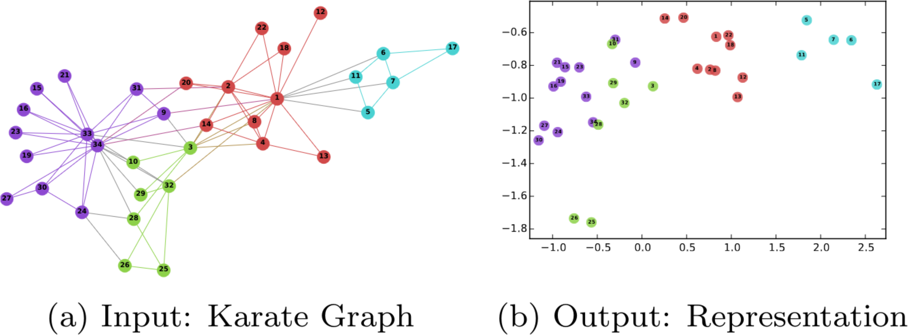
DeepWalk [Perozzi et al., 2014]
Fixed length, unbiased random walks from every node

Slide 19
Limitations of Node Embeddings
Transductive: Cannot get embeddings for nodes not seen during training, e.g., in new or dynamic graphs
Unable to capture common structural properties across long distances
Unclear how to incorporate rich node-, edge-, and graph-level features
SOLUTION: Graph neural networks (GNNs) for deep representation learning!

Slide 20
Going Beyond Node Embeddings
How to generate embeddings for unseen nodes? (Going beyond "transductive")
How to incorporate node and edge features?
Parameter sharing
IDEA: Use deep learning architectures that combine graph structure with node, edge, graph features

Slide 21
Intuition: Convolutional Networks
Weight sharing
Filters capture neighborhood on a grid graph
GNNs generalize this intuition to general graphs
Challenge: neighborhoods look different!
Image from https://towardsdatascience.com/understanding-graph-convolutional-networks-for-node-classification-a2bfdb7aba7b

Slide 22
GRAPH NEURAL NETWORKS (GNNs)

Slide 23
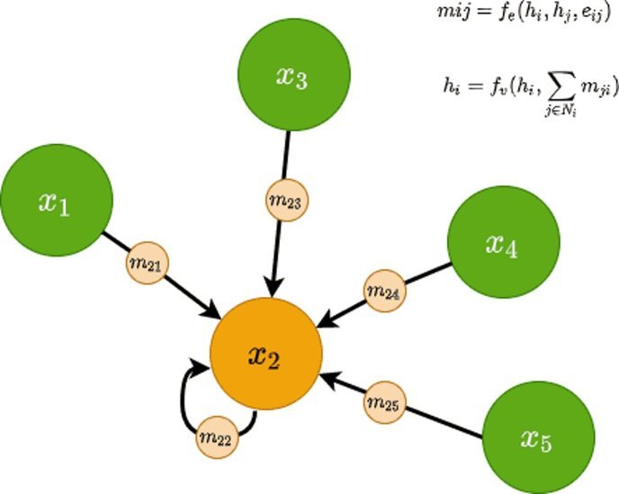
GNNs - Message Passing Networks (MPNNs)
Combine node-, edge-, and graph-level features
Perform iterative message passing step
Deal with varying local neighborhoods
Parameter sharing (#params not depending on graph size)
Gilmer, J., Schoenholz, S. S., Riley, P. F., Vinyals, O., & Dahl, G. E. Neural message passing for quantum chemistry. ICLM 2017.

Slide 24
MPNNs: Aggregate and Update
Initial node features h_{u}⁽⁰⁾
Edge features e_{u,v}
Iteratively perform L message passing steps to produce node embeddings h_{u}⁽¹⁾, h_{u}⁽²⁾, … h_{u}^{(L):}
Message from neighbor v to u
Permutation invariant function (e.g., SUM, MAX, AVG)
Final update combining aggregation with self features

Slide 25
Readout Layer
Node-level task:
After L message-passing layers, we get embeddings h_{u}^{(L)} at each u
How to convert to a final prediction?
Use a readout layer
Graph-level task:
Edge-level task:

Slide 26
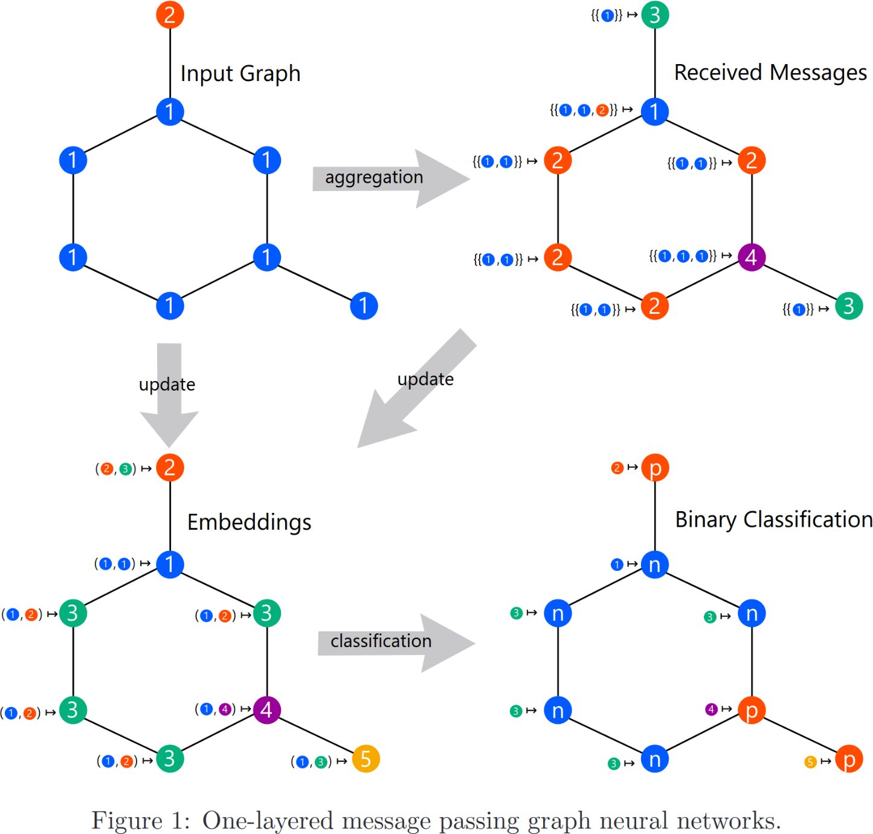
GNN in Action: Node Classification
Sato, R. (2020). A survey on the expressive power of graph neural networks. arXiv:2003.04078.

Slide 27
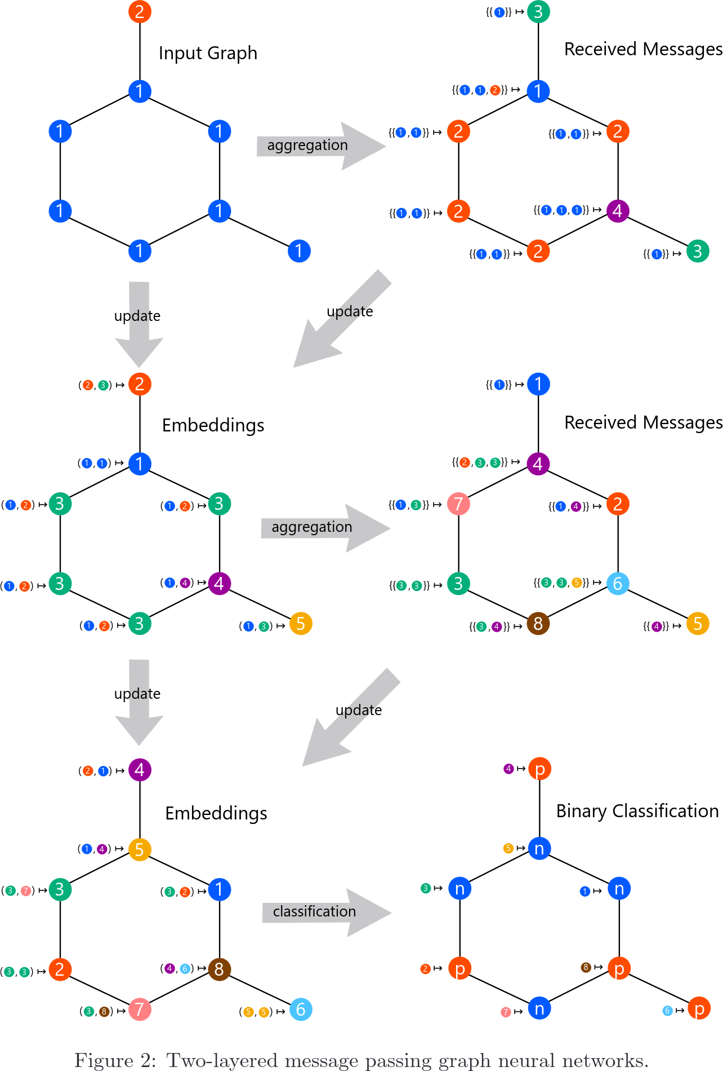
GNN in Action: More Layers
Sato, R. (2020). A survey on the expressive power of graph neural networks. arXiv:2003.04078.

Slide 28
Graph Convolutional Networks (GCN) [Kipf and Welling, 2017]
A = n x n adjacency matrix
D = n x n diagonal (degree) matrix
Column-stacked node representations
Update Rule:
Nonlinear activation (e.g., ReLU)
d_{t+1} x d_{t} weight matrix (learnable)

Slide 29
Graph Convolutional Networks (GCN) [Kipf and Welling, 2017]
Column-stacked node representations
Update Rule:
Nonlinear activation (e.g., ReLU)
d_{t+1} x d_{t} weight matrix (learnable)

Slide 30
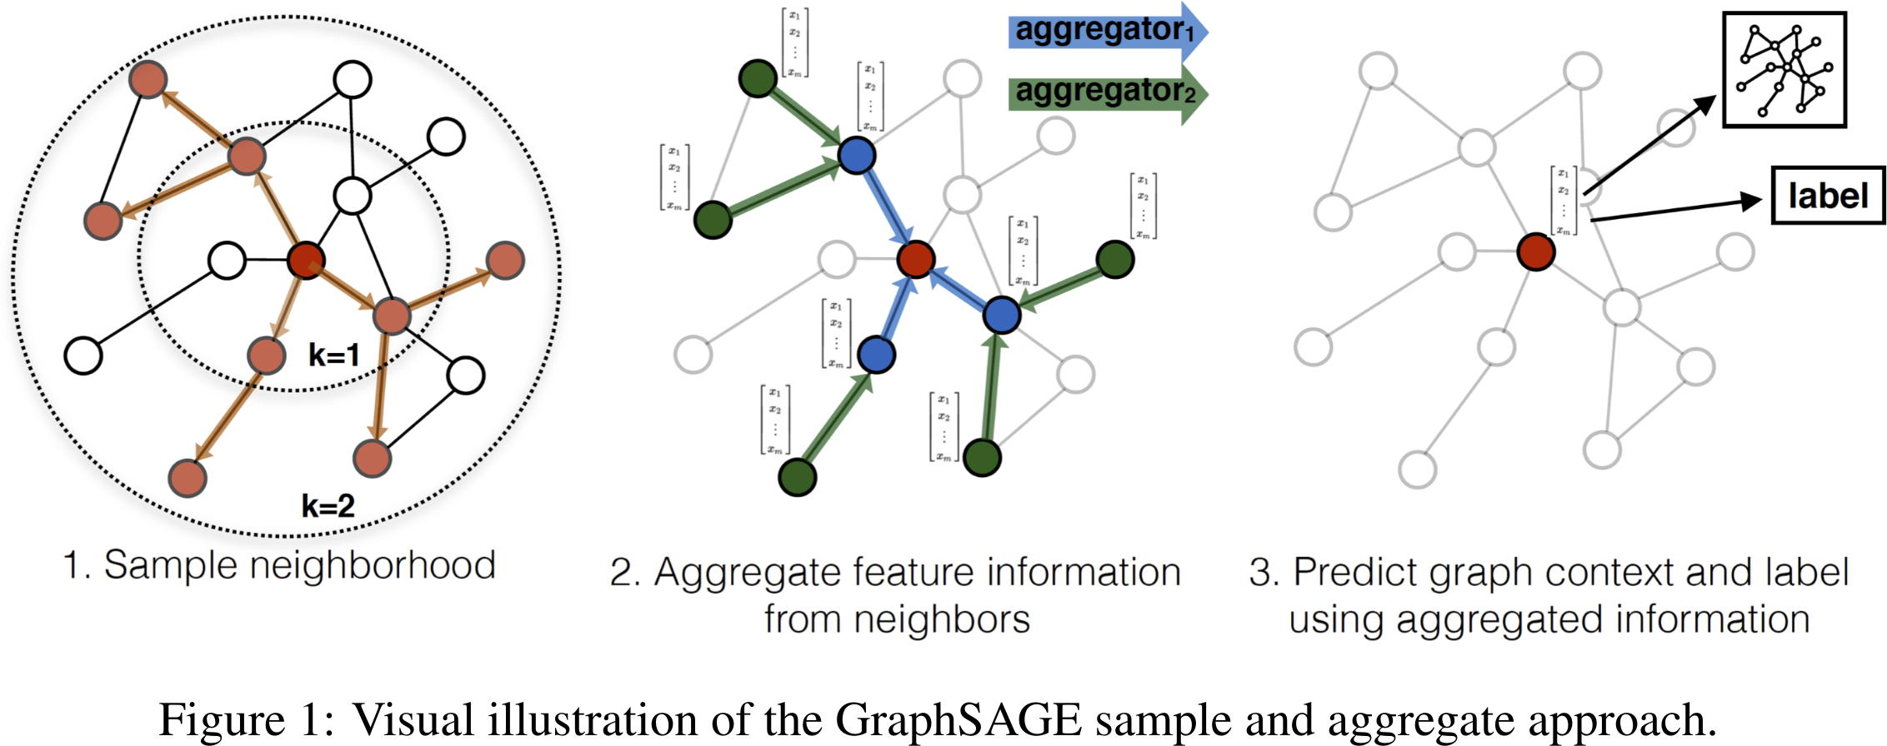
GraphSAGE [Hamilton et al., 2017]
Idea: Sample and aggregate
Use random samples of neighbors from multiple hops

Slide 31
GraphSAGE [Hamilton et al., 2017]
Neighborhood = fixed-size sample from 1-hop, 2-hop neighbors
Nonlinear activation (e.g., ReLU)

Slide 32
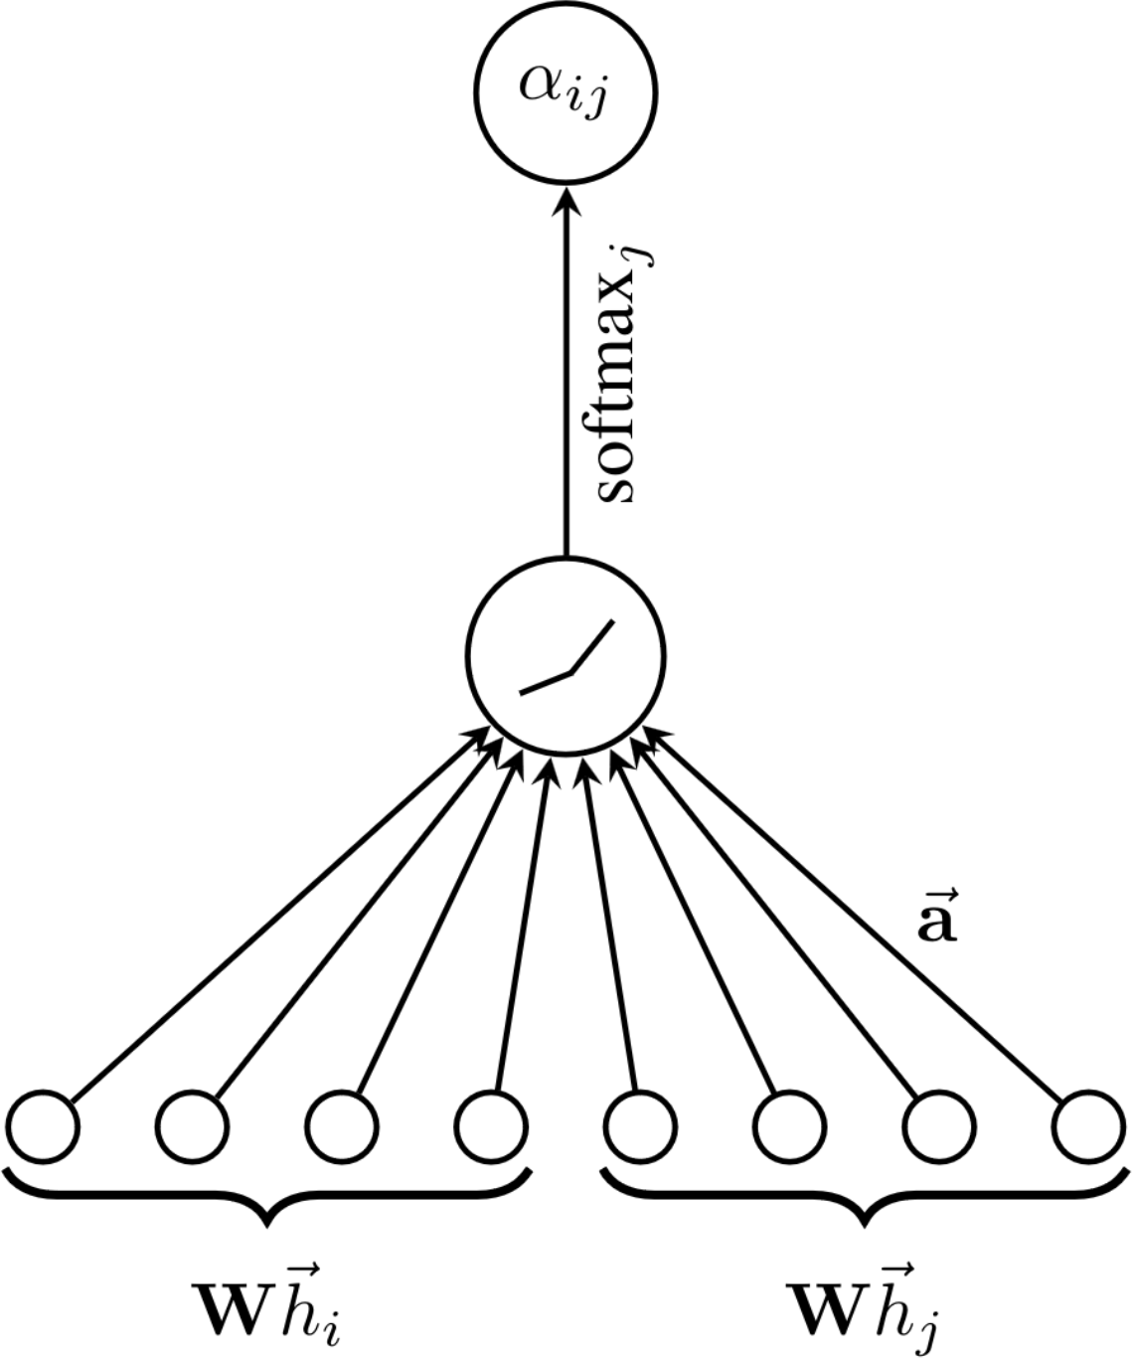
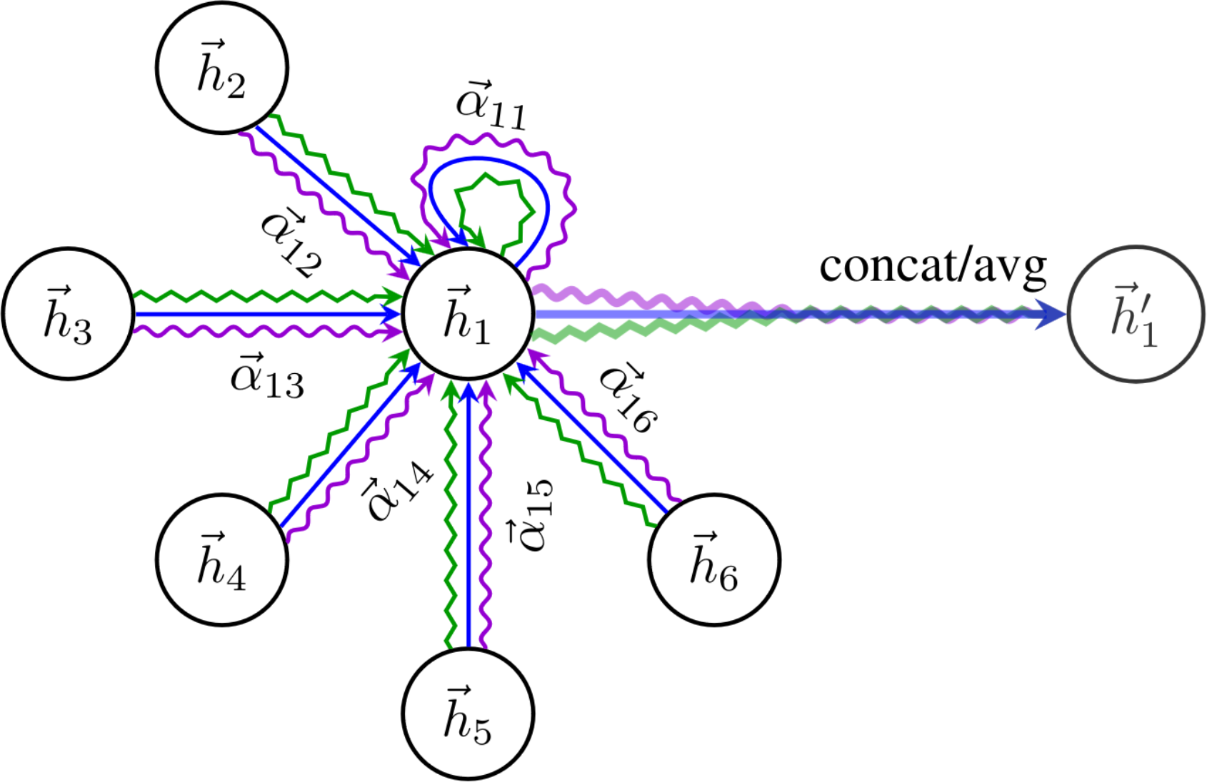
Graph Attention Networks (GAT) [Veličković et al., 2018]
Assign importances to neighbors in the aggregation step
Use an attention mechanism to compute scores
LeakyReLU activation function

Slide 33
Graph Attention Networks (GAT) [Veličković et al., 2018]
Attention Scores:

Slide 34
TOOLS FOR GRAPH LEARNING
Notes:
We are going to introduce some concepts and metrics that will appear all throughout the presentation
Those concepts are related with the eigenvalues and eigenvectors of the graph Laplacian, i.e. the spectrum of the graph

Slide 35
Spectral Graph Theory
$$Φ$$
$$Λ$$
$$Φ^{T}$$
$\left(\begin{matrix}| & ⋮ & | \\ v_{1} & ⋮ & v_{n} \\ | & ⋮ & |\end{matrix}\right)$ $\left(\begin{matrix}λ_{0} & 0 & 0 \\ 0 & ⋱ & 0 \\ 0 & 0 & λ_{n}\end{matrix}\right)$ $\left(\begin{matrix}− & v_{1} & − \\ … & … & … \\ − & v_{n} & −\end{matrix}\right)$
=
Notes:
We are going to introduce some concepts and metrics that will appear all throughout the presentation
Those concepts are related with the eigenvalues and eigenvectors of the graph Laplacian, i.e. the spectrum of the graph

Slide 36
Laplacian Eigenvectors
Eigenvectors are a set orthonormal functions that minimize the Rayliegh Quotient on the graph
[Chung, 1997]
Notes:
Eigenvectors and eigenvalues
Laplacian Matrix of the graph: L=D-A or normalized L
We can see them as a decomposition of the Graph Laplacian
Symmetric. Positive semidefinite

Slide 37
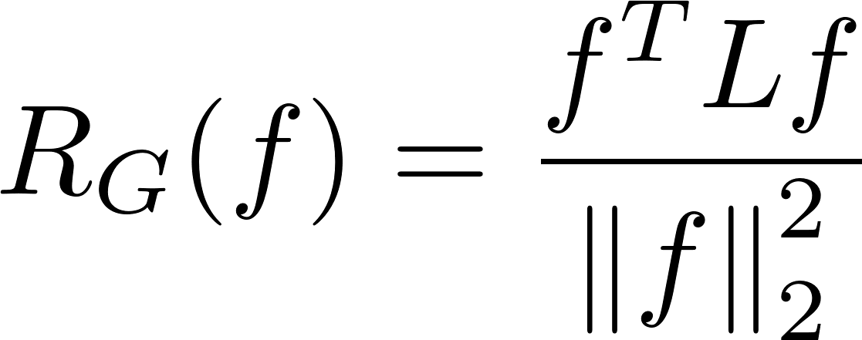
Laplacian Eigenvectors
Eigenvectors are a set orthonormal functions that minimize the Rayliegh Quotient on the graph
[Chung, 1997]
Variability of node signal wrt graph structure
Eigenvalues are the Rayleigh Quotient of the eigenvectors of the graph (orthonormal functions that minimizes variability wrt the structure of the graph)
Notes:
Eigenvectors as minimizing functions wrt the structure of the graph.
Minimize Rayleigh coefficient → Constrained variability
Each function is orthogonal to the previous
As they are normalized by the norm then eigens are a set of orthonormal functions.

Slide 38
Laplacian Eigenvectors
Spectral gap
Notes:
Example of eigenvectors
First ones are globally smooth and with and its energy is lower.
Set of coordinates
Directions of low variability
Why are they important? Next slide

Slide 39
Cheeger constant
[Cheeger 1970; Chung 1997]
Min Cut
Cut
Size of the minimum cut to disconnect the graph
# of inter-edges
Normalized by minimum volume of node subset
Cheeger Constant
Notes:
Cheeger – MinCut problem
What is the minimum number of edges to remove to disconnect the graph?
Partial → number of edges
Denominator → normalized by the size of the disconnected components.
Problem – NP-HARD

Slide 40
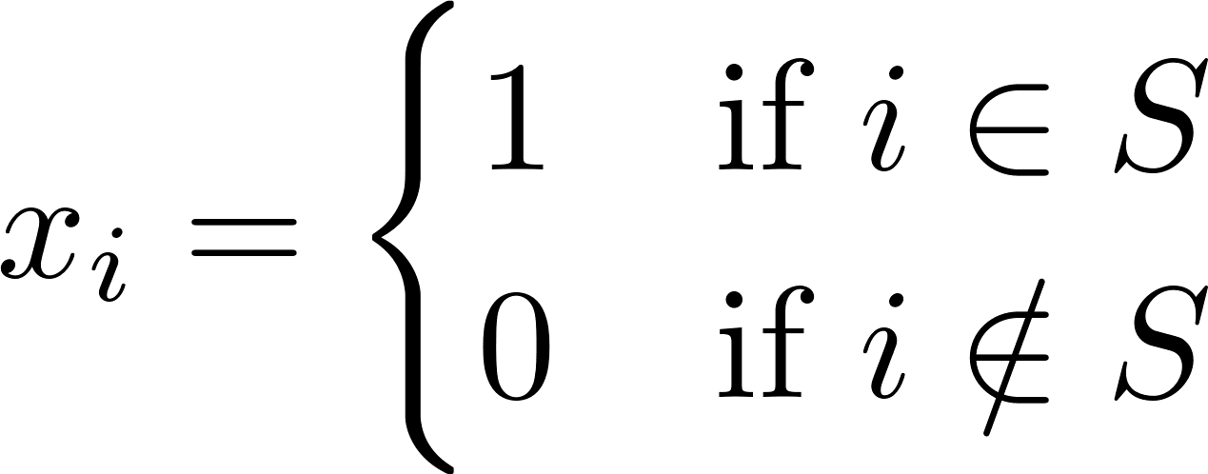
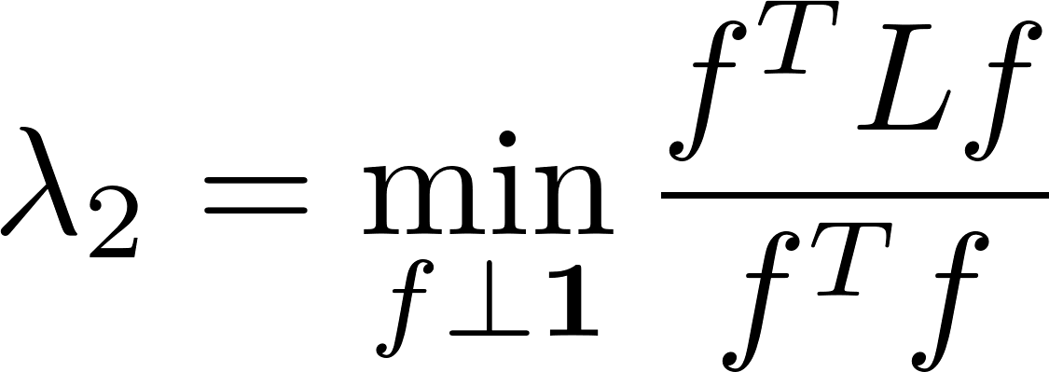
Cheeger constant
[Cheeger 1970; Chung 1997]
Min Cut
Cut
Size of the minimum cut to disconnect the graph
# of inter-edges
Normalized by minimum volume of node subset
Cheeger Constant
Cheeger Inequality
Size of Cut as Laplacian Quadratic form
Notes:
NP-HARD? → Bounded by Fiedler
Inequality with second eigenvalue
Why? → we can encode 2 the solution to cheeger with a vectors
Then the “loss” of that problem is exactly the numerator of the Rayleigh coefficient for the case that it must be orthogonal to 1, i.e., of the solution to the second eigenvector.

Slide 41
Laplacian Eigenvectors
$$λ_{2}$$
Minimum amount of energy needed to disconnect the graph
Bottleneck
Notes:
Increase the inter community edges

Slide 42
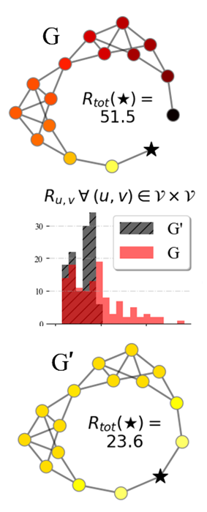
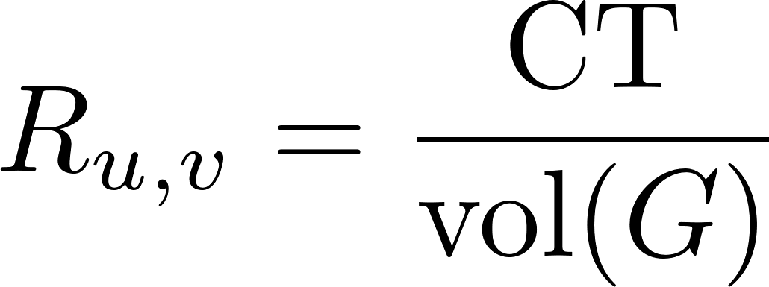
Effective Resistance and Commute Time
Commute time: Expected number of steps for a Random-Walker go from u to v and come back Captures global behavior and long-range dependencies
The more and shorter paths between a pair of nodes The smaller R_{uv} is
Even if SP does not change
Notes:
We introduce a metric that will appear in different parts of the presentation.
Pairwise distance
ER or CT is the expected number of steps that a random walker takes to go back and forth in a pair of nodes.
Adding an edge that does not change the SP distances, drastically changes the ER.

Slide 43
Effective Resistance and Commute Time
Commute time: Expected number of steps for a Random-Walker go from u to v and come back Captures global behavior and long-range dependencies
The more and shorter paths between a pair of nodes The smaller R_{uv} is
Even if SP does not change
Pseudo-Inverse
Notes:
How do we compute it?
Spectrally as the weighted difference of eigenvectors
Using the Pseudo-inverse → one-hot encoded vector difference

Slide 44
Effective Resistance
View graph as electrical circuit
Edges are resistors
Send current between two points and measure effective resistance
ERs capture topological structure in graph
Widely used in theoretical computer science
Graph sparsification
Linear system solvers
Graph clustering
v
u
Res(u, v)

Slide 45
Effective Resistance as Commute Times
Start random walk from u
C_{u,v} is expected time to reach v and come back to u
v
u
Notes:
Ilustration what do I mean but expected number of steps by a RW

Slide 46
Effective Resistance as Commute Times
Start random walk from u
C_{u,v} is expected time to reach v and come back to u
v
u

Slide 47
Effective Resistance as Commute Times
Start random walk from u
C_{u,v} is expected time to reach v and come back to u
v
u
u ⇝ v ⇝ u in 6 steps

Slide 48
Effective Resistance as Commute Times
Start random walk from u
C_{u,v} is expected time to reach v and come back to u
v
u

Slide 49
Effective Resistance as Commute Times
Start random walk from u
C_{u,v} is expected time to reach v and come back to u
v
u

Slide 50
Effective Resistance as Commute Times
Start random walk from u
C_{u,v} is expected time to reach v and come back to u
v
u
u ⇝ v ⇝ u in 5 steps

Slide 51
GRAPH TRANSFORMERS

Slide 52
Transformers
Sequences of tokens
Next token prediction based on a past context window
Line graph
Typically dense
Image from https://towardsdatascience.com/understanding-graph-convolutional-networks-for-node-classification-a2bfdb7aba7b

Slide 53
Graph Transformers
Extension of transformers to graph-structured data
Instead of next-token prediction in sequences, learn node representations
Often dense (full connections) - computational graph different from input graph
Challenges
How to account for loss of inductive bias from input graph structure?
How to identify nodes (position, structure) within the graph?
Scaling?

Slide 54
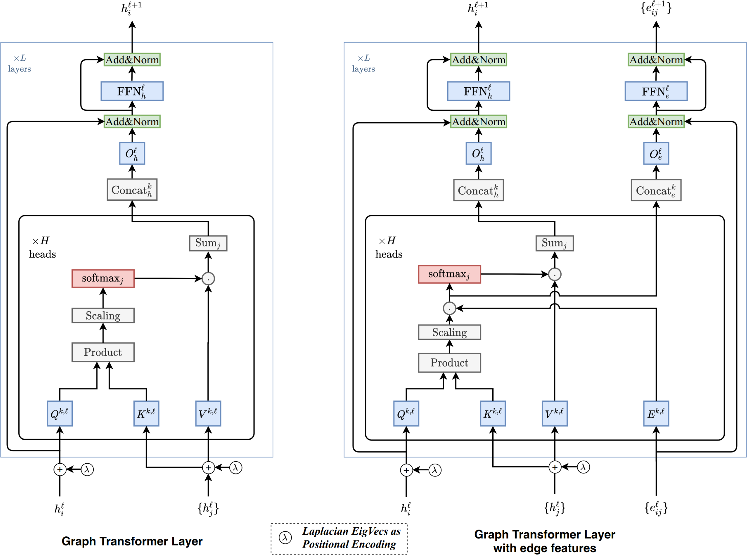
Graph Transformers
Sample architecture ([Dwivedi and Bresson, 2021])
Number of newer architectures
SAN
Graphormer
GraphGPS

Slide 55
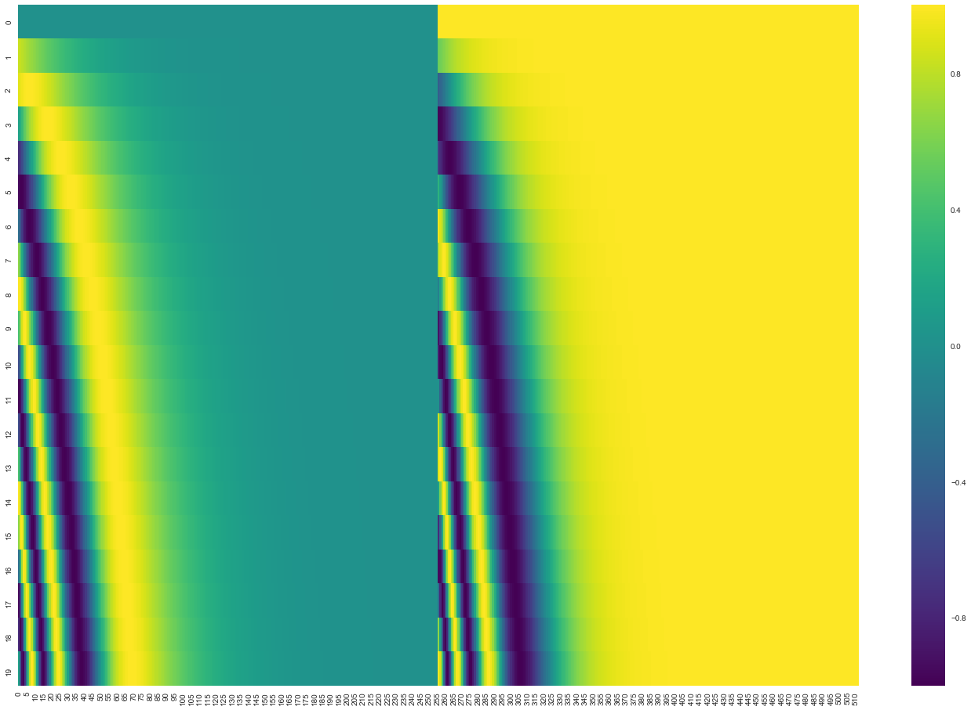
Positional Encodings
Sequence transformers use sinusoids (sin, cos functions)

Slide 56
Positional Encodings
Sin, cos functions arise as eigenfunctions of Laplacians in Euclidean space
On graphs: eigenvectors of graph Laplacian L = D - A

Slide 57
Laplacian Eigenvalues/Eigenvectors

Slide 58
Learned Positional Encodings (LPE) [Kreuzer et al., 2021]
Learned positional encodings (LPE) on top of Laplacian-based features

Slide 59
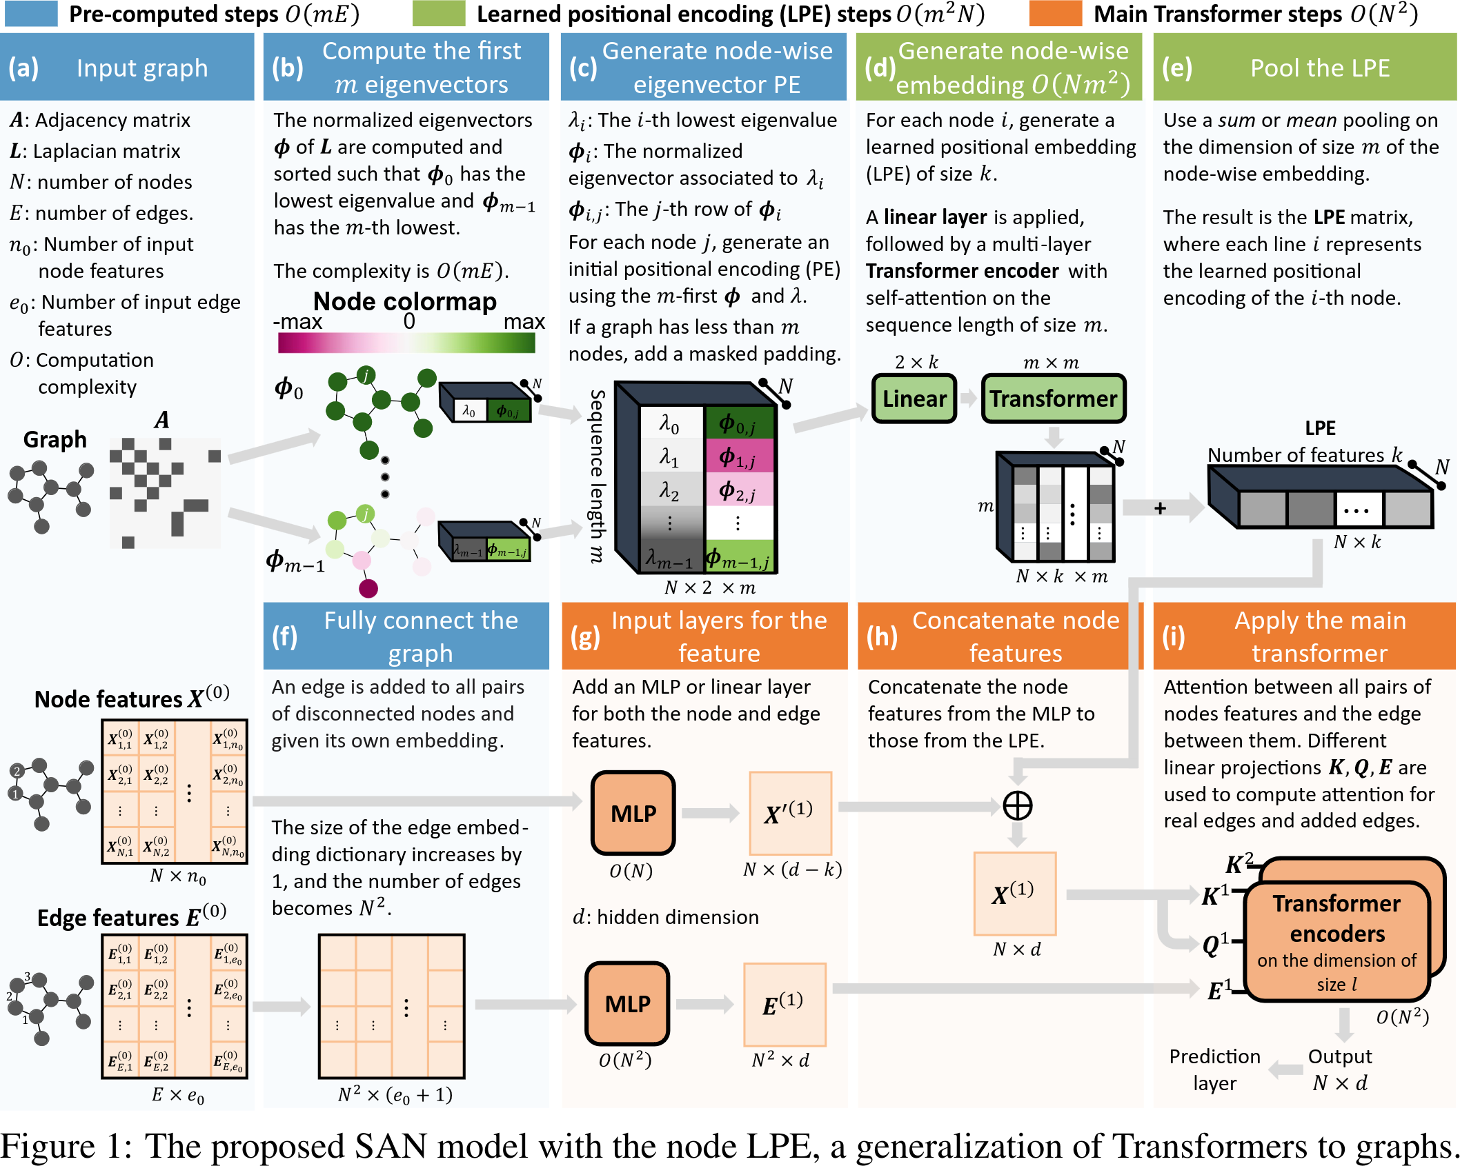
Combine LPEs with Attention
Spectral Attention Networks (SAN) - [Kreuzer et al., 2021]

Slide 60
Positional Encodings (with vs. without)

Slide 61
Graphormer [Ying et al., 2021]
Two key new ideas
Centrality encoding
Spatial encoding (distance-based attention bias)
Shortest path distance
Standard attention computation
Attention bias

Slide 62
Graphormer [Ying et al., 2021]

Slide 63
Graphormer: Molecular Graphs [Ying et al., 2021]

Slide 64
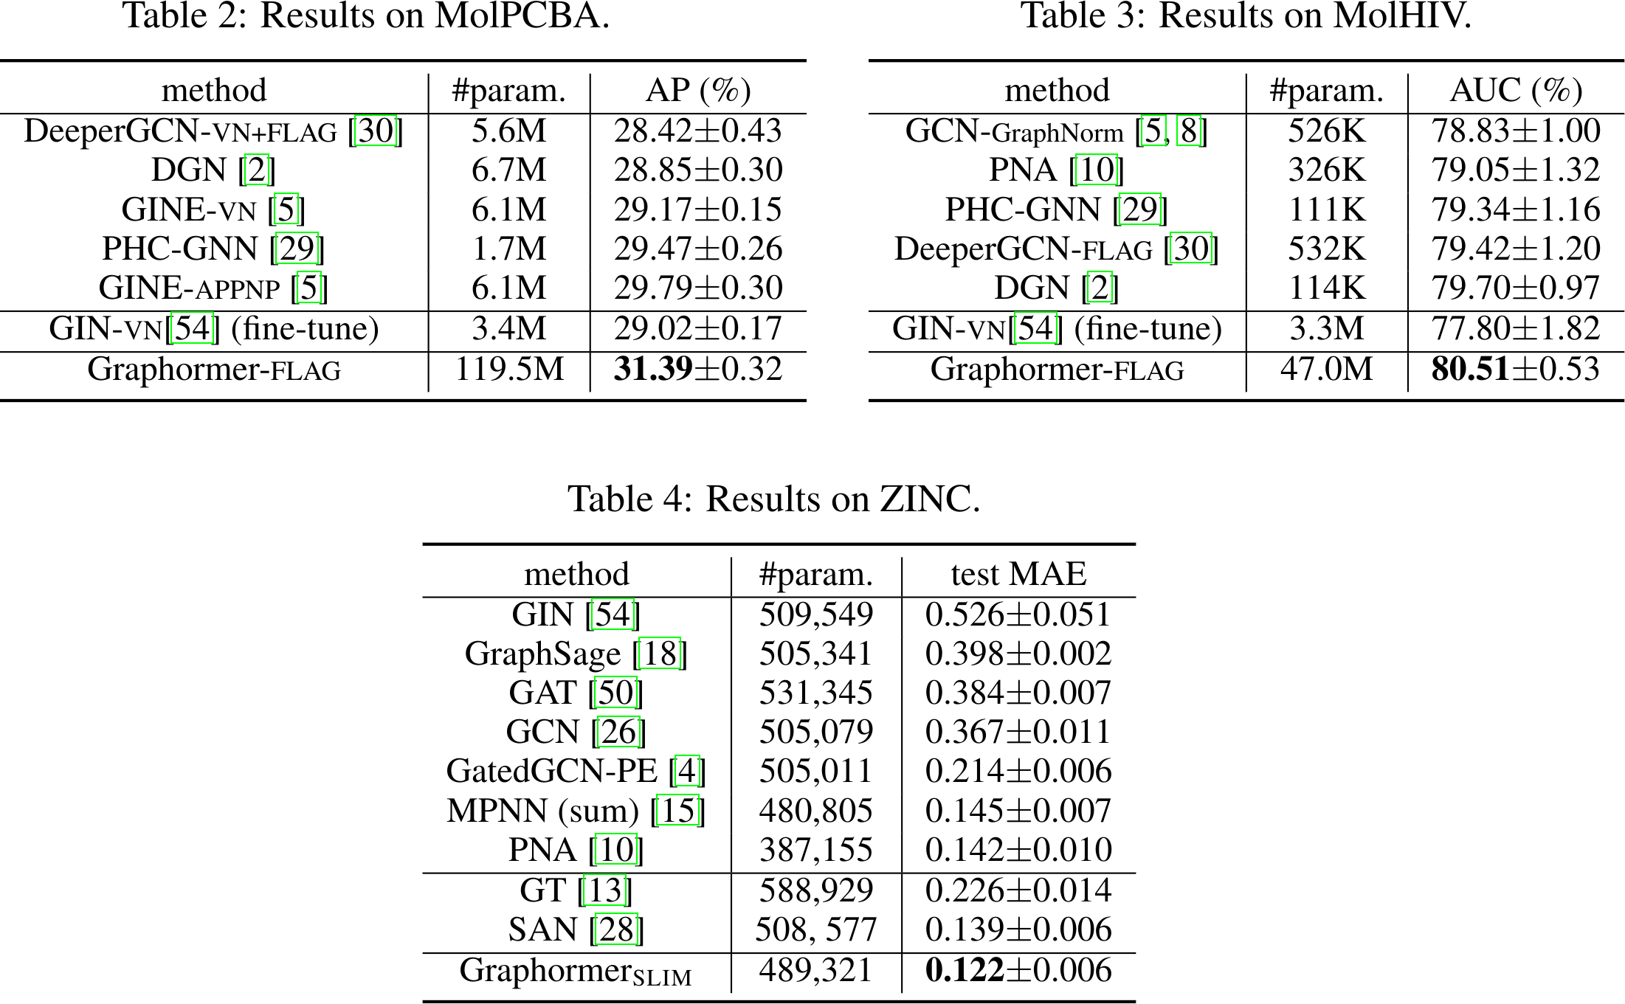
Graphormer: Molecular Graphs [Ying et al., 2021]

Slide 65
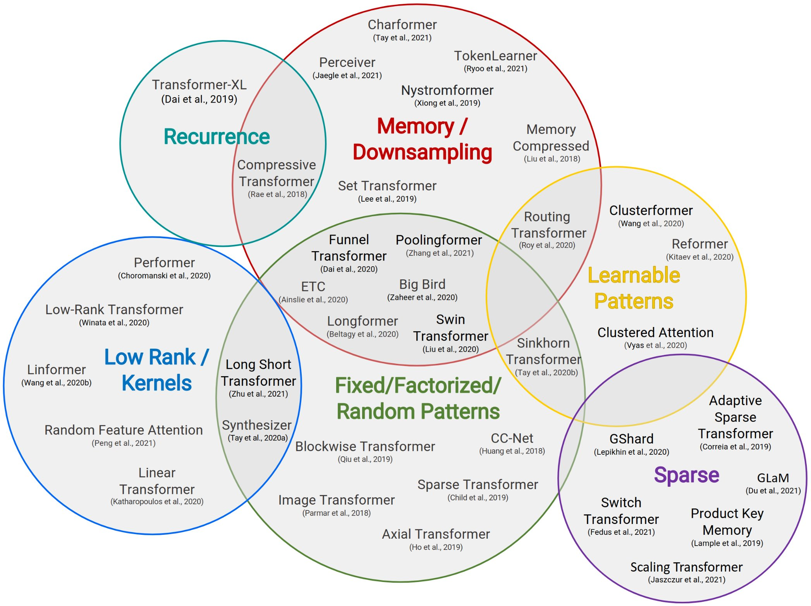
Scaling
Typical transformer has O(N²) dependence – prohibitive for long sequences or large graphs
Dense attention ⟶ sparse attention
Still maintain good global connectivity
Efficient computation: O(N+M) interaction pairs
Many sparse attention mechanisms proposed for sequence transformers
Y. Tay, M. Dehghani, D. Bahri, and D. Metzler. Efficient Transformers: A Survey. ACM Computing Survey, volume 55. 2022

Slide 66
Sparse Transformers for Graphs
Exphormer ([Shirzad et al., 2023]) – similar to Big Bird ([Zaheer et al., 2020])
Nodeformer ([Wu et al., 2023)) – inspired by Performer ([Choromanski et al., 2021]), uses kernelized Gumbel-Softmax operator
Sampling-based: Gophormer ([Zhao et al., 2021]), NAGphormer ([Chen et al., 2022])
Diffusion-based: Difformer ([Wu et al., 2023])
Spectral filtering: Specformer ([Bo et al., 2023])
And many more…

Slide 67
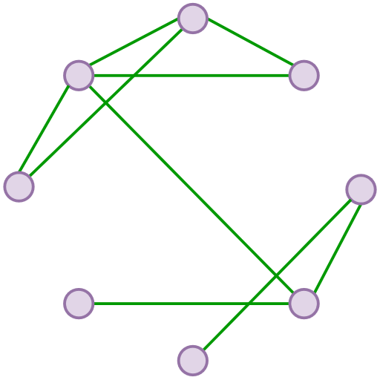
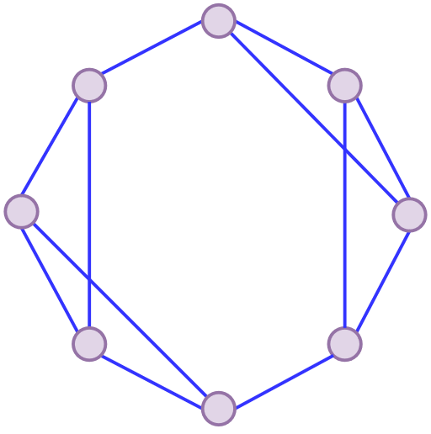
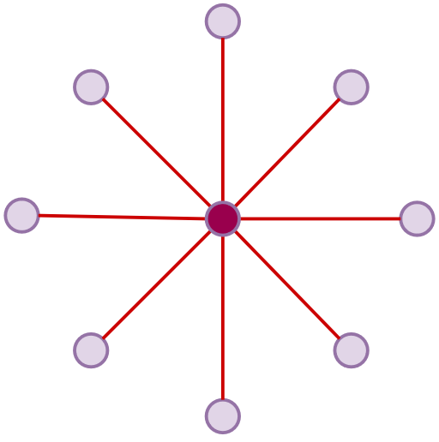
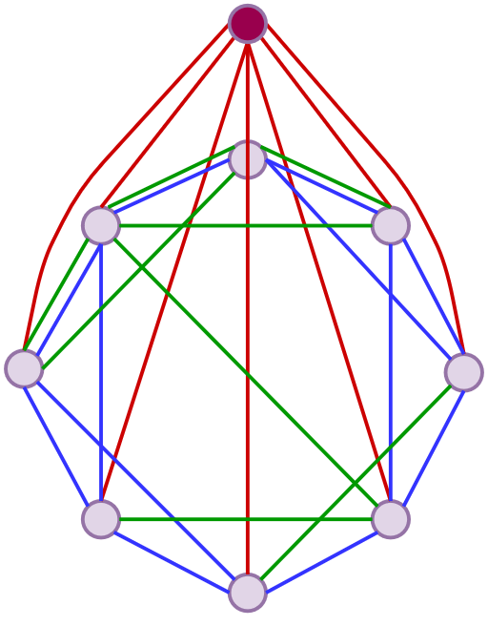
Exphormer [Shirzad, Velingker, Venkatachalam, Sutherland, Sinop – ICML 2023]
Original Graph
Preserve locality from the original graph
Expander Graph
Random walk mixing
Constant degree, O(N) edges
Global Sink
"Storage sink"
Short connections between all node pairs
Exphormer: Combine all three to form the interaction graph!

Slide 68
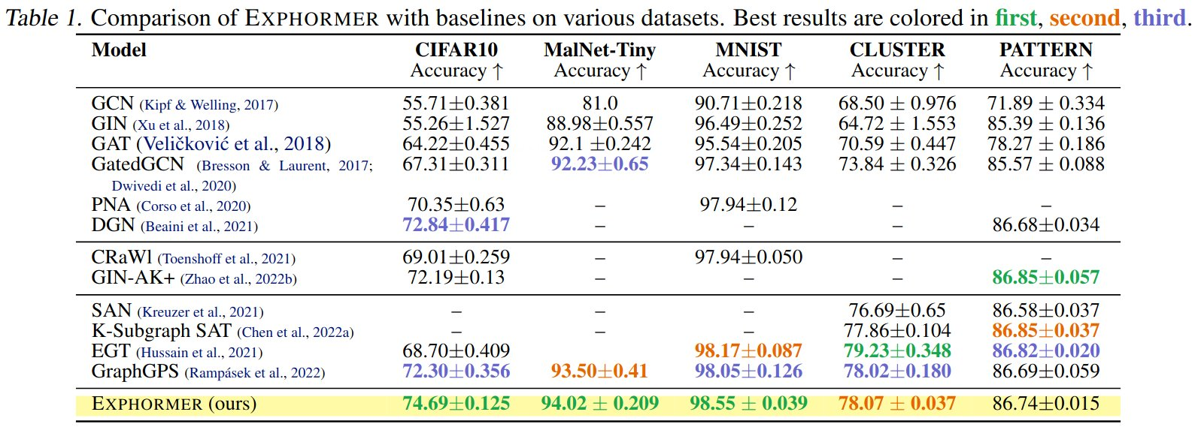
Exphormer: Experimental Results [Shirzad, Velingker, Venkatachalam, Sutherland, Sinop – ICML 2023]

Slide 69
Exphormer: Long-Range Benchmark [Shirzad, Velingker, Venkatachalam, Sutherland, Sinop – ICML 2023]

Slide 70
Message Passing vs. Graph Transformers
Message Passing
Graph Transformers
Updates across edges of input graph
✅ Captures inductive bias from input graph topology
✅ Efficient computation: O(N + M)
❌ Difficulty with long-range dependencies
❌ Oversmoothing, oversquashing
❌ Expressivity limitations
Use global attention
✅ Computation graph can be different from input graph
✅ Long-range modeling
❌ Identifying nodes within graph
❌ Loss of inductive bias from graph
❌ Inefficient computation: O(N²)
Positional and structural encodings
Graph-oriented sparse attention schemes
70

Slide 71
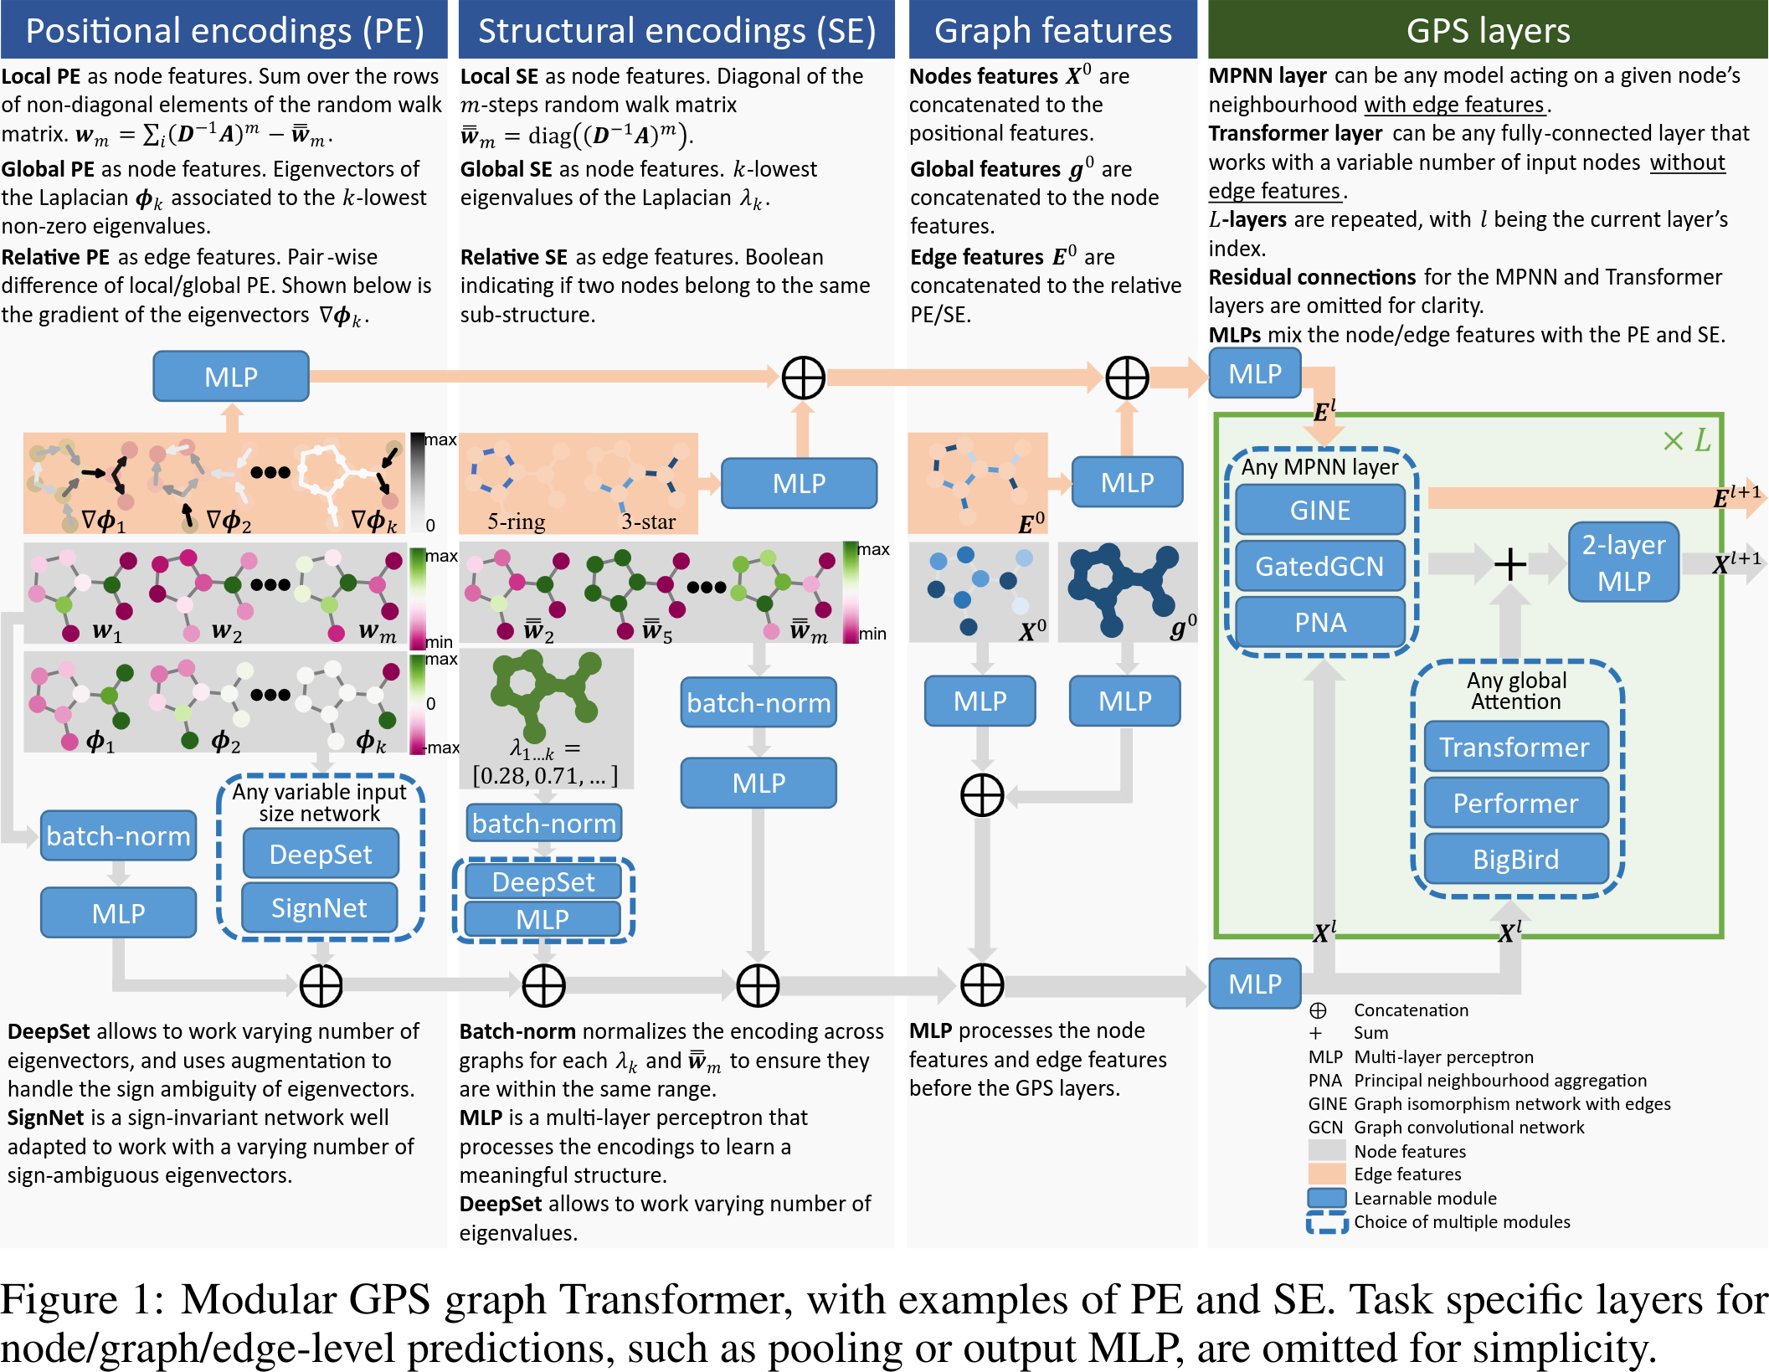
GraphGPS [Rampášek et al., 2022]
Combine transformers with message-passing
Transformers give added expressivity while message-passing retains input graph structure
Framework – mix and match MPNN layers, attention layers, and positional/structural encodings

Slide 72
EXPRESSIVITY

Slide 73
Expressivity of GNNs
GNN architectures can represent some functions but not others
What functions can a message-passing GNN represent?

Slide 74
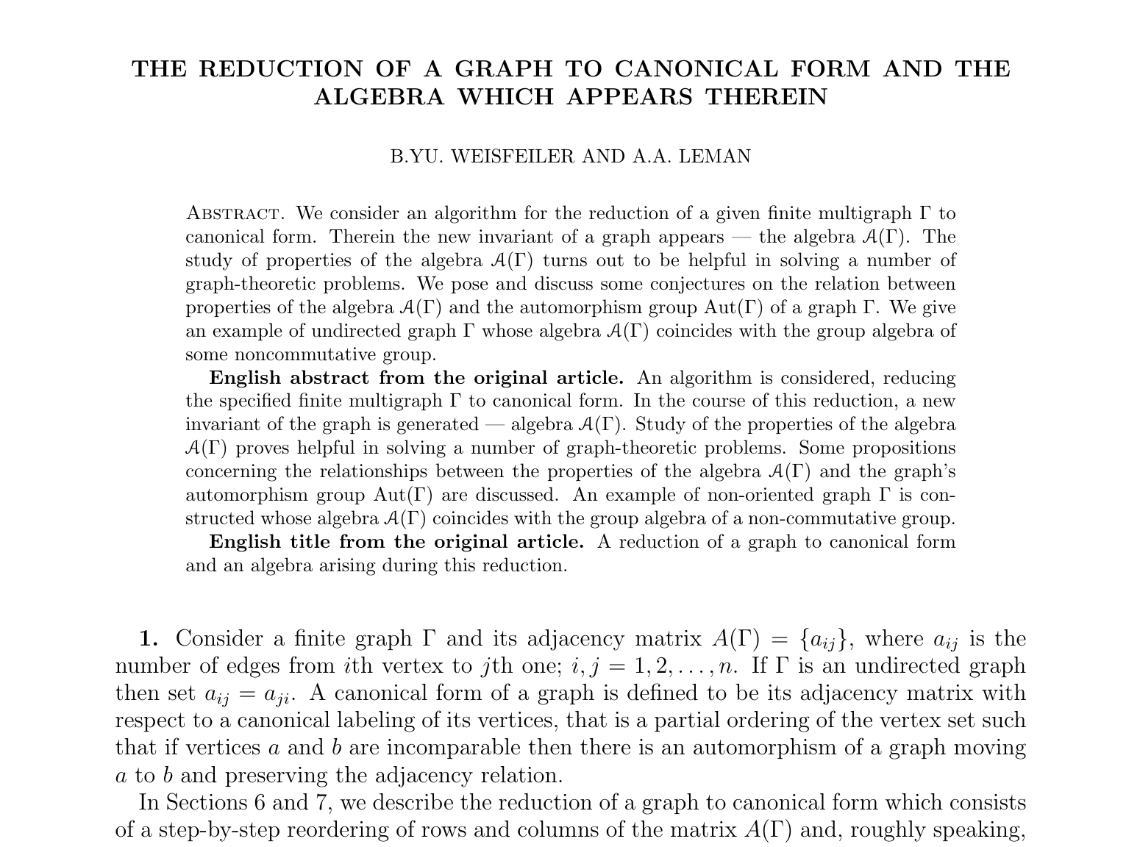
Expressivity: WL Isomorphism Test
WL test was proposed in 1968 as a heuristic for the existence of an isomorphism between two graphs
Relation to result of [Babai, 2015]
GNNs known to be bounded in expressivity by the Weisfeiler-Leman (WL) test ([Morris et al., 2019], [Xu et al., 2019])
1-WL test: Hash aggregated color multisets of neighbors at each step

Slide 75
1-WL Isomorphism Test in Action
1-WL test: Hash aggregated color multisets of neighbors at each step
Check if node color multisets of two given graphs match
h(•, {•,•,•})
h(•, {•,•,•})
h(•, {•,•})
h(•, {•,•})
h(•, {•,•})

Slide 76
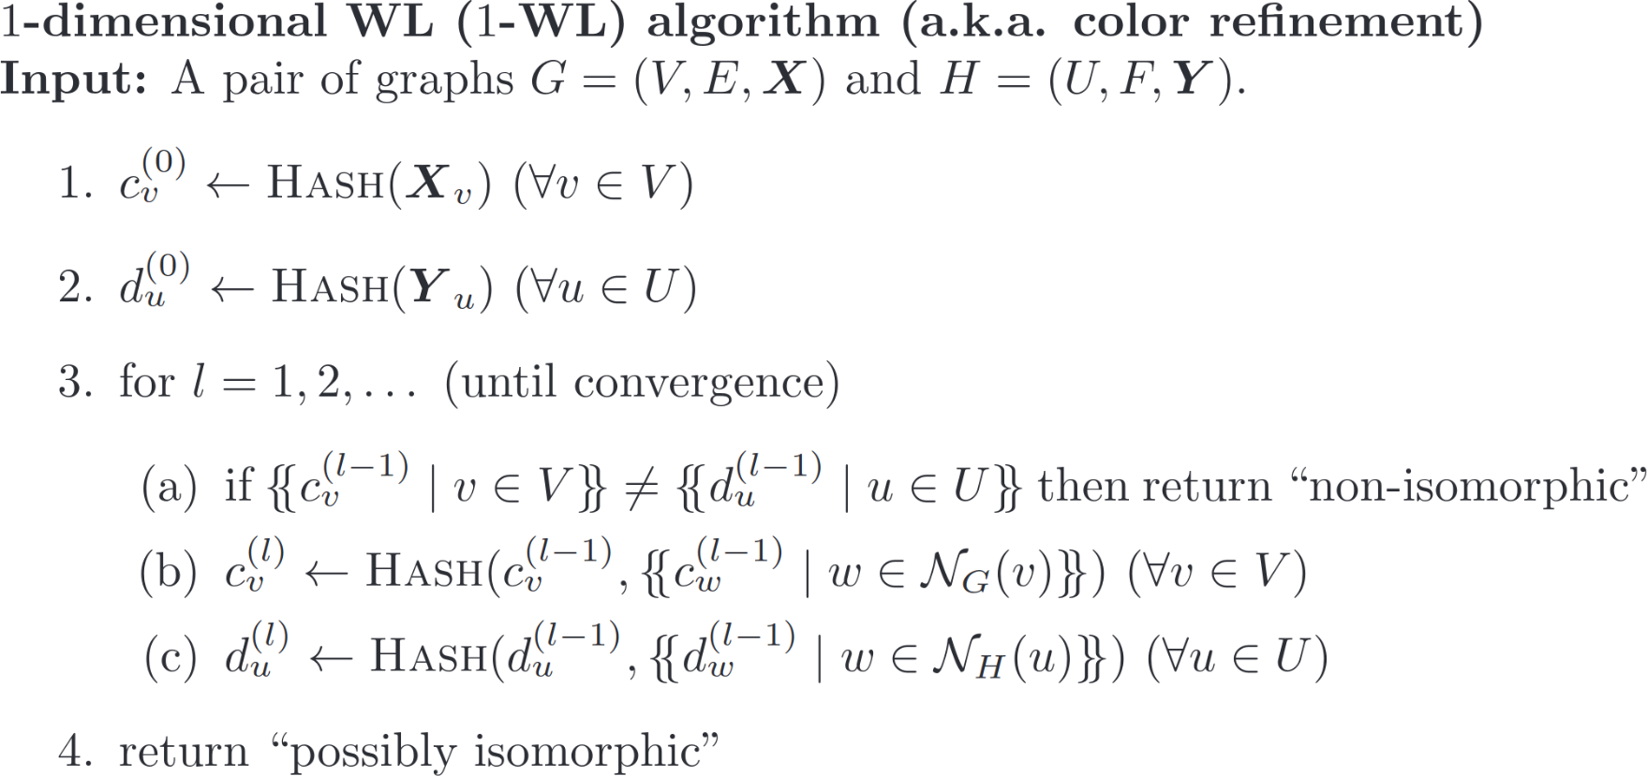
1-WL Algorithm

Slide 77
1-WL Isomorphism Test
Graph isomorphism is hard!
1-WL test fails to distinguish some pairs of non-isomorphic graphs
A vanilla message-passing GNN also cannot distinguish such graphs

Slide 78
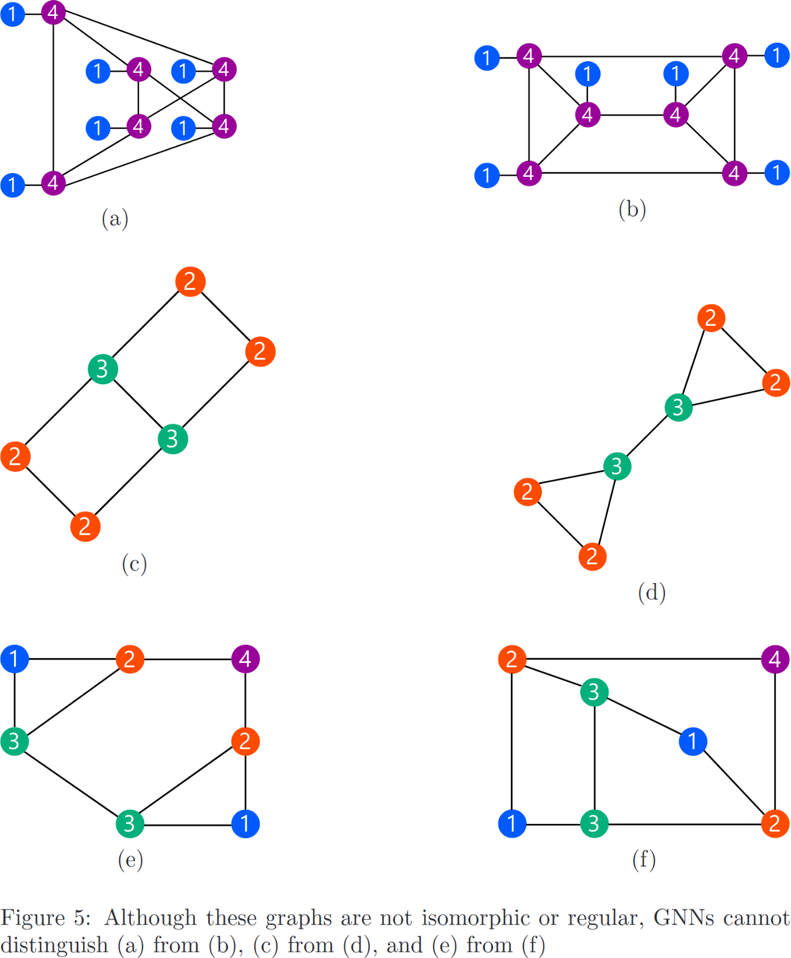
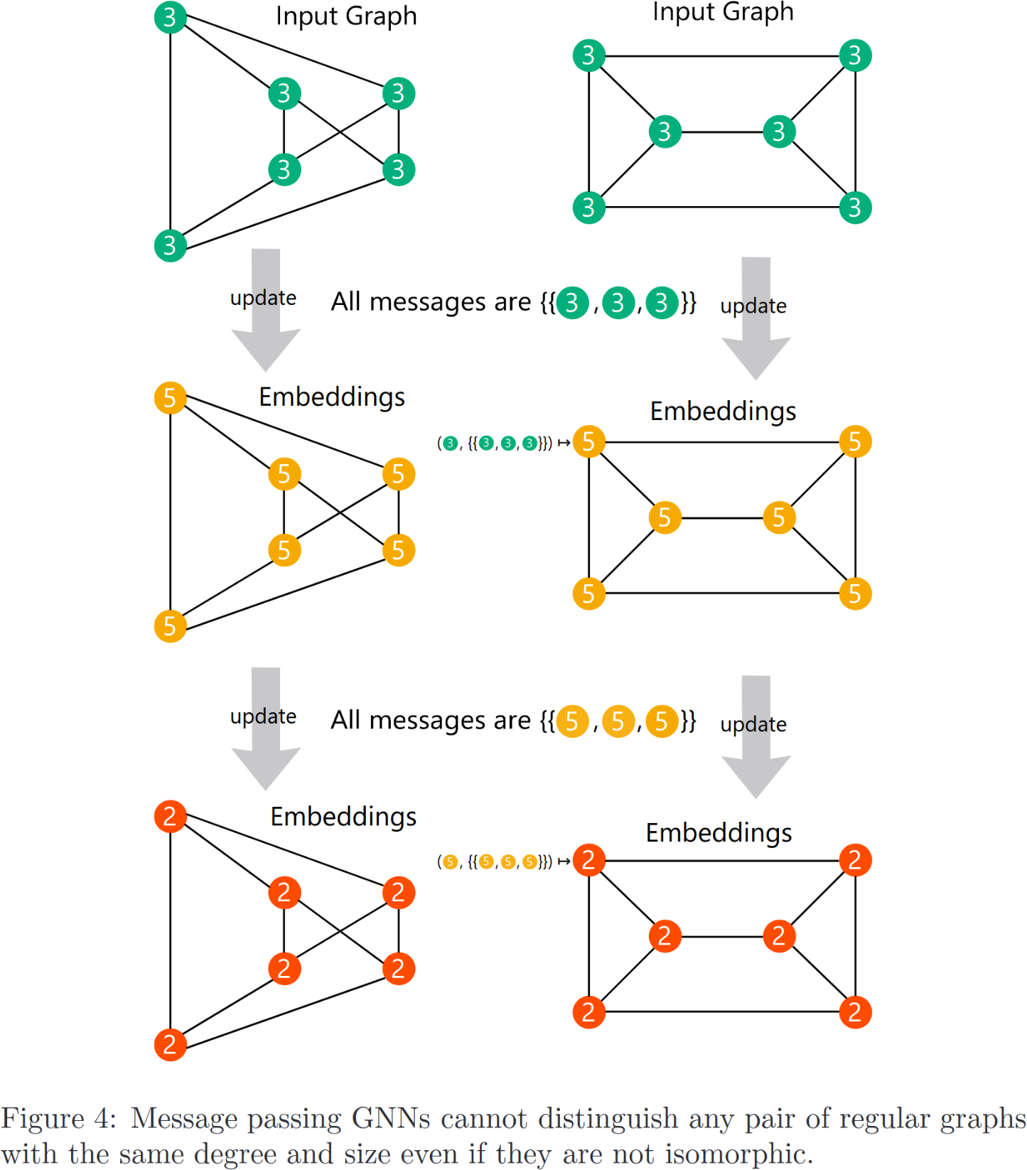
1-WL Limitations

Slide 79
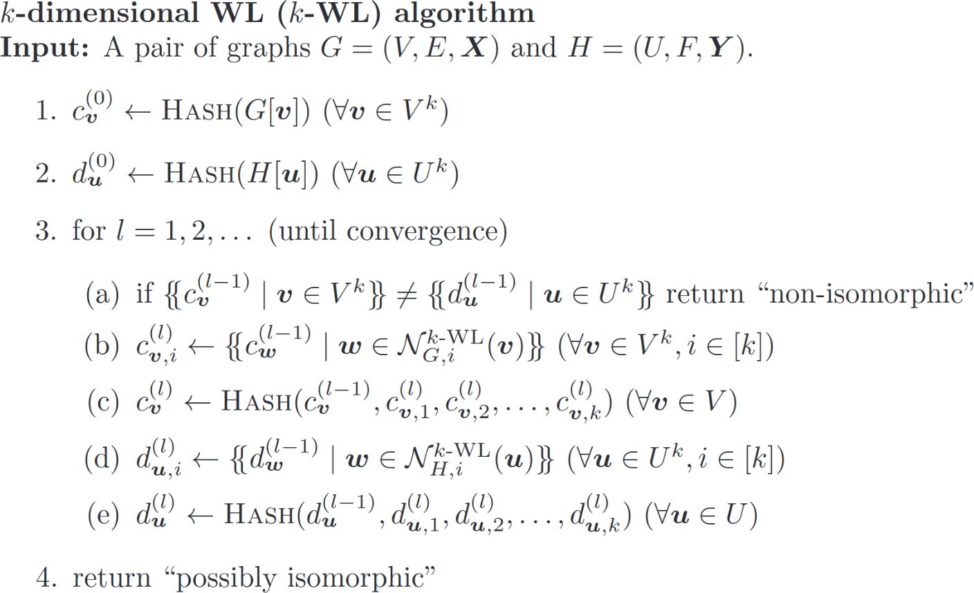
k-WL Algorithm
Assign colors to k-tuples of nodes

Slide 80
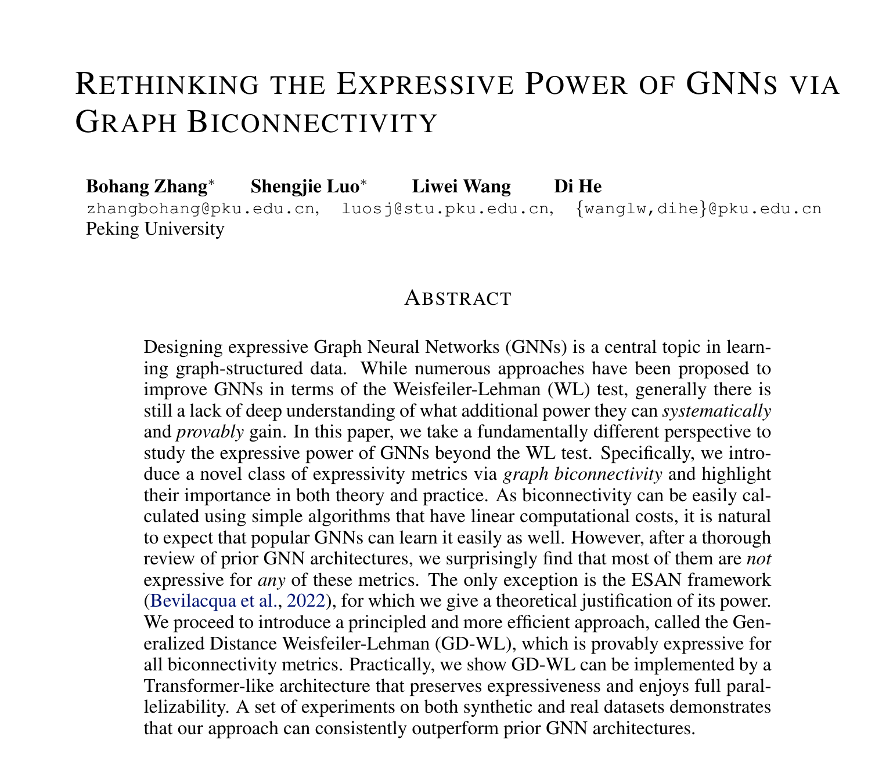
Going Beyond WL Test?
Going beyond WL by proposing expressivity metrics via graph biconnectivity ([Zhang et al., 2023])
Generalized Distance WL (GD-WL)
Uncovers limitations of many current GNN approaches

Slide 81
How to Enhance Expressivity?
Standard GNNs limited by 1-WL graph isomorphism test
Ways to improve GNN expressivity
Add features
Modulate message-passing
Modify underlying graph

Slide 82
How to Enhance Expressivity?
Standard GNNs limited by 1-WL graph isomorphism test
Ways to improve GNN expressivity
Add features
Modulate message-passing
Modify underlying graph

Slide 83
Adding Features
Add node, edge, or graph features that incorporate structural, positional, etc. information
Often computed offline as a preprocessing step
Incorporate edge features
New node features can be added to h_{u}⁽⁰⁾
Graph-level features can be incorporated in M_{t} and aggregation, update functions

Slide 84
Adding Features
1-WL limitation applies to very limited setting
Inability to distinguish node identities
Simple tweak: initializing nodes with random features goes beyond 1-WL ([Sato et al., 2021], [Abboud et al., 2021])

Slide 85
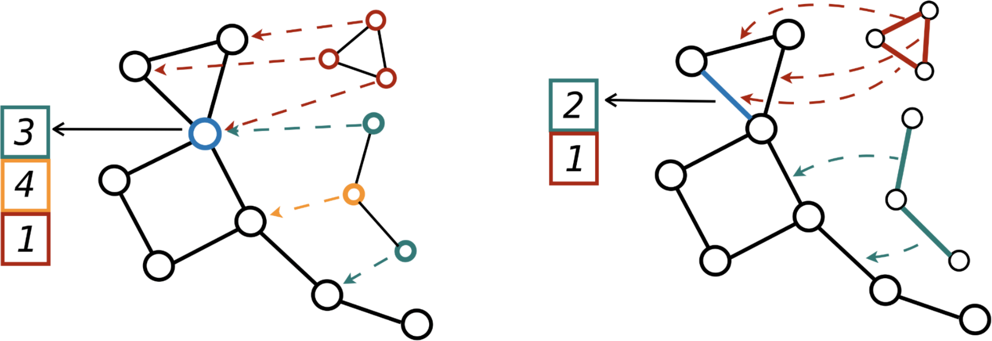
Graph Substructure Networks
Features that encode topological structures/substructures
Graph Substructure Networks (GSN) [Bouritsas et al., 2022]: Encode subgraph counts
Pick a set of graphs: {H₁, H₂, …, H_{K}}
Node features: Count appearance of v in different orbits for each H_{i}
Edge features: Count appearance of e in different edge automorphism orbits

Slide 86
Graph Substructure Networks
Graph Substructure Networks (GSN): Encode subgraph counts
Pick a set of graphs: {H₁, H₂, …, H_{K}} and encode node, edge orbits as features
Choice of substructures is domain-specific
Chains and cycles in molecules

Slide 87
Adding Features
GSN requires domain specific knowledge to know which substructures to use
General-purpose (not domain-specific) ways of adding features
Affinity Measures: capture structural information about graph ([Velingker et al., 2023])
Effective resistances (or commute time)
Hitting times
Resistive embeddings

Slide 88
Effective Resistance
ERs capture topological structure in graph
Widely used in theoretical computer science
Graph sparsification
Linear system solvers
Graph clustering
View graph as electrical circuit
Edges are resistors
Send current between two points and measure effective resistance
v
u
Res(u, v)

Slide 89
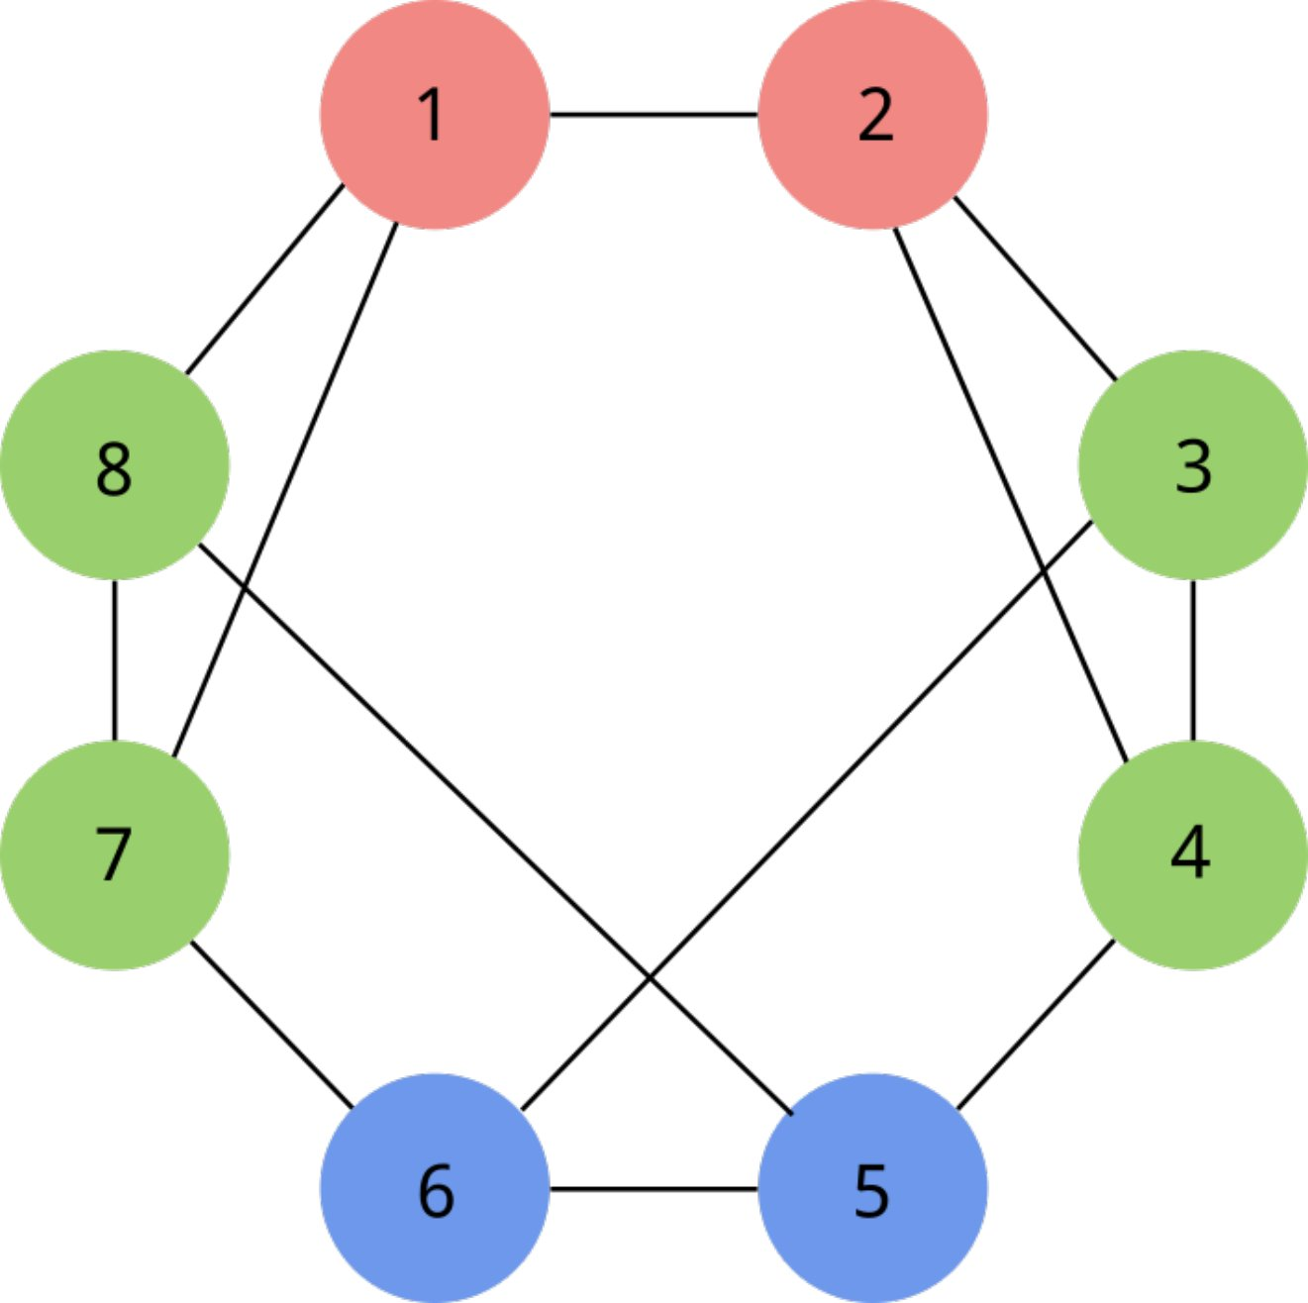
Effective Resistance: Going Beyond 1-WL
ERs capture topological structure in graph
Widely used in theoretical computer science
Graph sparsification
Linear system solvers
Graph clustering
View graph as electrical circuit
Edges are resistors
Send current between two points and measure effective resistance

Slide 90
Resistive Embeddings
ERs are scalar features along each edge
Define richer vector embeddings that capture more structure
Resistive embedding for each node satisfying:
Efficient computation using dimensionality reduction techniques (JL Lemma)

Slide 91
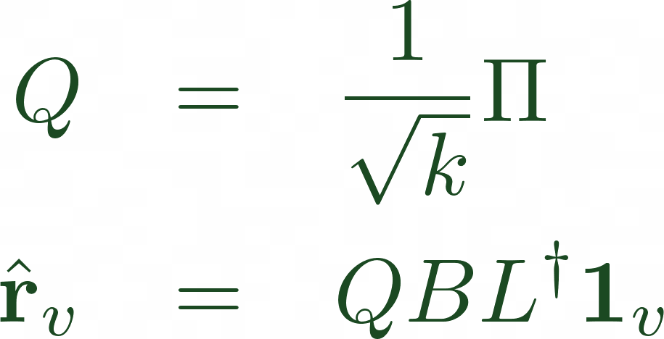
Efficient Computation
JL Lemma:
One can map n points x₁, x₂, …, x_{n} into dimension Ω((log n)/ε²) and preserve squared-distances up to multiplicative 1 ± ε factor.
ER = L₂-squared distance of resistive embeddings
Use constructive version of JL to map embeddings into smaller space (e.g., [Spielman, Srivastava '08])
k x m projection matrix
Reduced dimensionality resistive embedding
k = O(log n / ε²)
Use fast Laplacian solvers to solve O((n+m) log n / ε²) Laplacian systems ([Spielman and Teng - STOC'04])
Õ(n+m) total running time!

Slide 92
Efficient Computation
Can approximate effective resistances:
True resistive embeddings:
Dimensionality-reduced resistive embeddings:

Slide 93
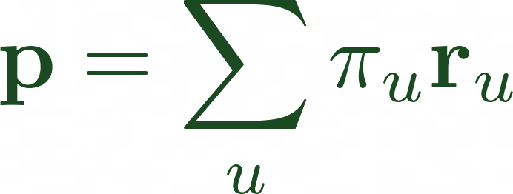
Efficient Computation
Can approximate hitting times:
True resistive embeddings:
Define weighted mean of resistive embeddings:
Dimensionality-reduced resistive embeddings:
Hitting time can be written as:

Slide 94
Incorportating Affinity Measures into GNNs
Use affinity measures as edge features in aggregation step!
ER, hitting time affinity measures are scalar features
Use Resistive Embeddings as node features

Slide 95
Large-Scale Molecular Graphs: PCQM4M-LSCv1
PCQM4M-LSCv1 in KDD Cup 2021 Contest
Best published single model result (validation MAE < 0.12)
Outperforms without molecular geometric features or use of dense attention networks!!!

Slide 96
How to Enhance Expressivity?
Standard GNNs limited by 1-WL graph isomorphism test
Ways to improve GNN expressivity
Add features
Modulate message-passing
Modify underlying graph

Slide 97
Modulate the Message Passing
Instead of adding features, modify the message passing mechanism itself
Allow anisotropic aggregation of messages from neighbors
We already saw one example: GAT

Slide 98
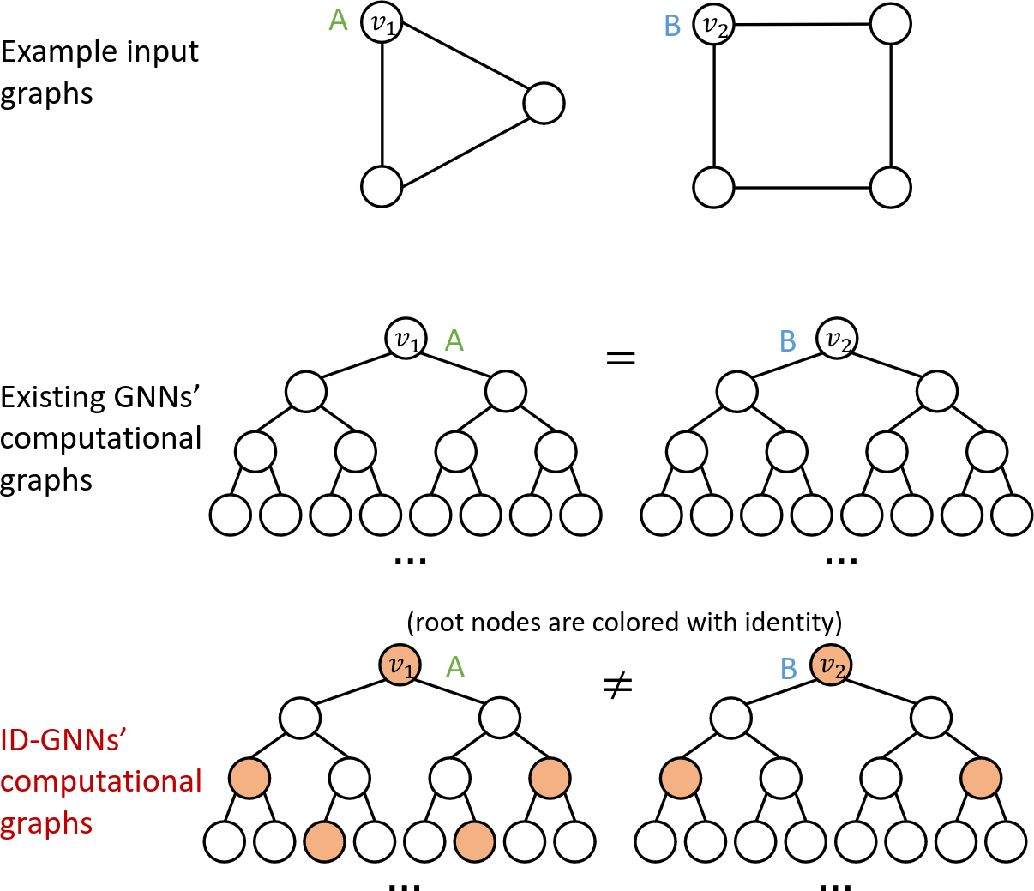
Identity-Aware Graph Networks [You et al., 2021]
Use heterogeneous message-passing to distinguish "root" node from other nodes
First compute ego network centered at a node of interest
Isolate instances of the center node in the computational graph
Apply message passing with different sets of parameters for center node vs. others
Allows cycle detection

Slide 99
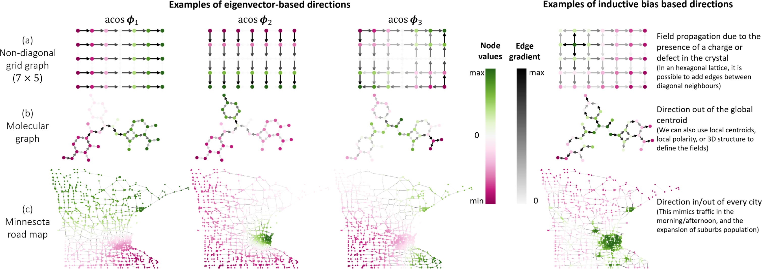
Directional Graph Networks (DGN) [Beaini et al., 2020]
Anisotropic message passing using Laplacian flows

Slide 100
How to Enhance Expressivity?
Standard GNNs limited by 1-WL graph isomorphism test
Ways to improve GNN expressivity
Add features
Modulate message-passing
Modify underlying graph

Slide 101
Modify Underlying Graph
Use a computation graph that is different from the input graph
Can add/remove edges or nodes to the input graph
Can be an altogether different graph
Can be useful for datasets/tasks where the given input graph is noisy
Challenge: Allow less restrictive computation while still maintaining the inductive bias of the input graph structure

Slide 102
Higher Order GNNs
Recall the WL test of order k, i.e., k-WL
Hierarchy in expressivity/distinguishing power
1-WL = 2-WL < 3-WL < 4-WL < ...
Build GNN architectures that mimic k-WL
Hierarchy in expressivity/distinguishing power

Slide 103
Higher Order GNNs [Morris et al., 2019]
Input graph G = (V, E)
[V(G)]^{k} = set of k-element subsets of V
Neighborhoods on [V(G)]^{k}:
Local neighborhoods:

Slide 104
Higher Order GNNs [Morris et al., 2019]
Input graph G = (V, E)
[V(G)]^{k} = set of k-element subsets of V
Aggregation and update rule:

Slide 105
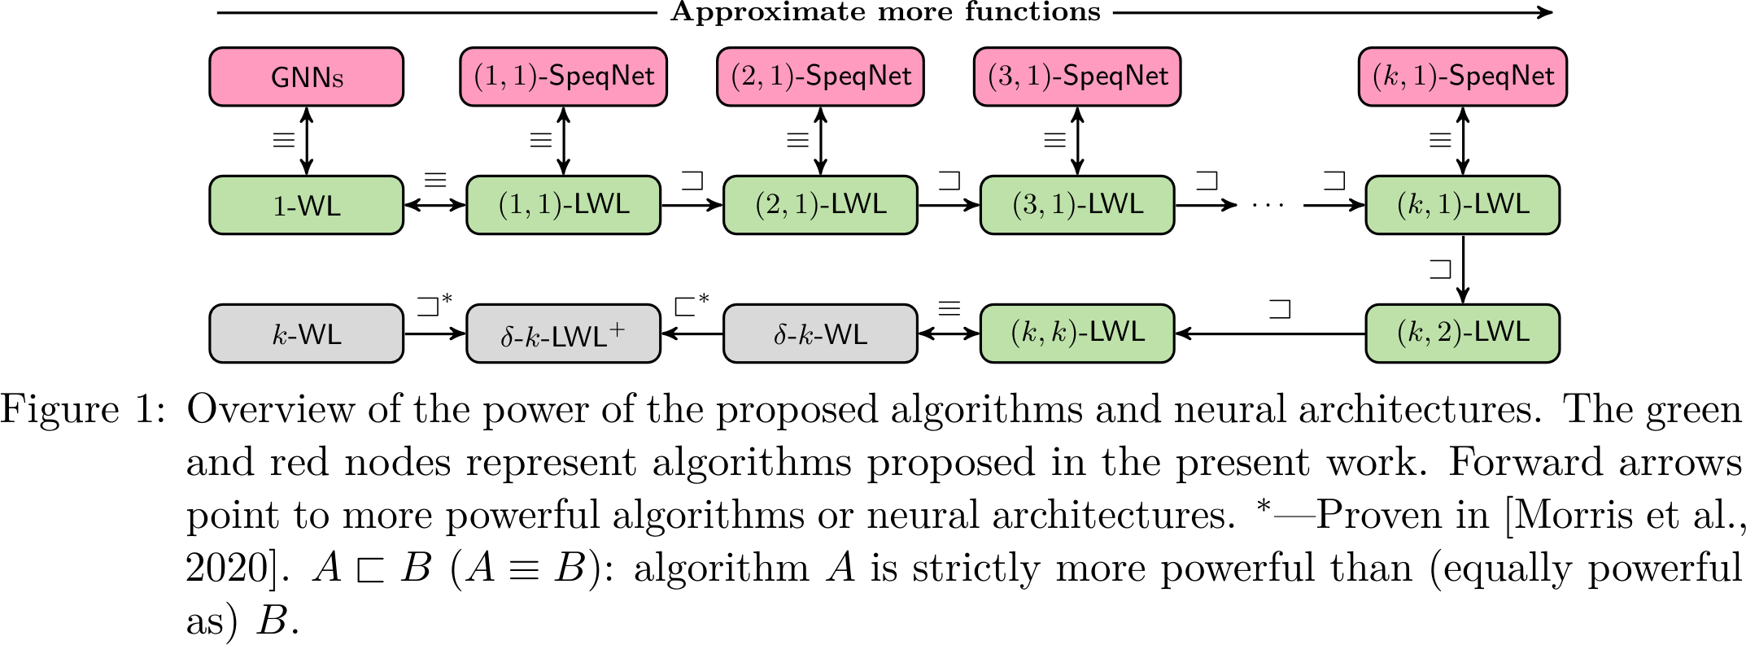
High Order Hierarchy
Variety of high-order WL variants
Various new GNN architectures that are as expressive as k-WL ([Azizian and Lelarge, 2020], [Geerts, 2020], [Maron et al., 2019])
Sparse variants (e.g., SpeqNets [Morris et al., 2022])
High-order GNNs still suffer from a O(n^{k}) dependence – k > 3 impractical for larger graphs

Slide 106
GENERALIZABILITY

Slide 107
Generalizability of GNNs
Expressivity vs. generalizability
More expressive networks lead to overfitting?
In practice, no! Expressivity and generalizability often go hand in hand
Subgraph-based enhancements: Graph Substructure Networks (GSN)

Slide 108
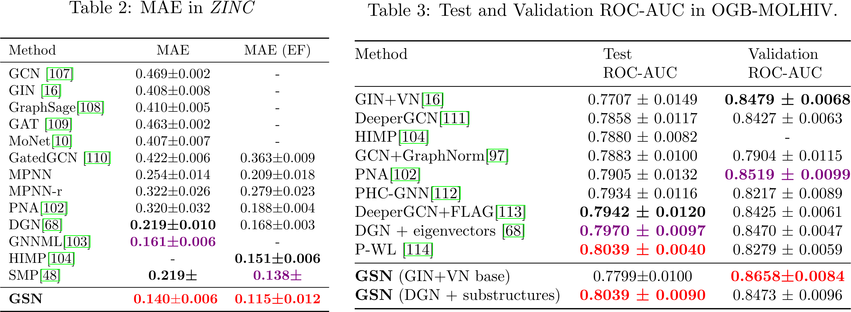
Graph Substructure Networks (GSN) [Bouritsas, Frasca, Zafeiriou, Bronstein '22]
Experimental results show improvements

Slide 109
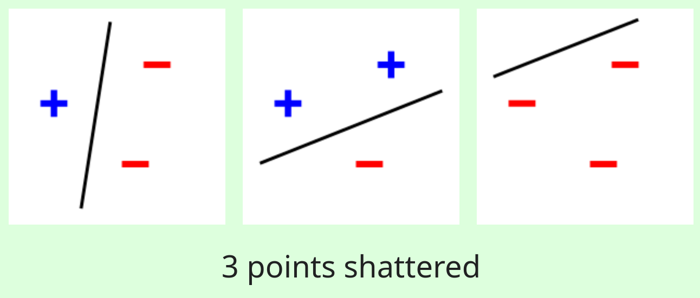
Vapnik-Chervonenkis (VC) Dimension
Binary classification model f
Model f (with params θ) shatters data points x1, x2, …, xn if for every assignment of labels, there exists θ for which f correctly classifies all xi
VC dim = max number of points that are shattered by f

Slide 110
VC Dimension
Statistical learning theory: VC dimension gives a bound on test error in terms of training error
Hypothesis class H (output {-1, 1}), with h in H. VC dim = d. Training set size = m. Then, with probability ≥ 1 - δ, test error is not too big compared to training error:

Slide 111
WL Meets VC [Morris, Geerts, Tönshoff, Grohe - ICML '23]
Consider binary graph classification
Class C of GNNs
G₁, G₂, …, G_{m} are shattered by C if for any τ in {0, 1}^{m}, there exists a gnn in C such that:

Slide 112
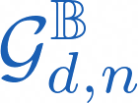
WL Meets VC [Morris, Geerts, Tönshoff, Grohe - ICML '23]
Class of graphs of order ≤ n with d-dim boolean features
m_{n,d,L} = max #graphs distinguishable by L iterations of 1-WL
For all n, d, L:
Proof is simple: Any set of m_{n,d,L} + 1 graphs must contain two that are not distinguishable by 1-WL. Thus, shattering is impossible.

Slide 113
WL Meets VC [Morris, Geerts, Tönshoff, Grohe - ICML '23]
Class of graphs of order ≤ n with d-dim boolean features
m_{n,d,L} = max #graphs distinguishable by L iterations of 1-WL
Constructive result: The upper bound can be matched by sufficiently wide L-layer GNNs:
Proof overview: Choose S = {G₁, G₂, …, G_{m}} to be a maximal set of 1-WL distinguishable graphs. Show that for any T, there is GNN_{mlp}(d', L) so that for all i,

Slide 114
WL Meets VC [Morris, Geerts, Tönshoff, Grohe - ICML '23]
Constructive result: The upper bound can be matched by sufficiently wide L-layer GNNs:
Proof overview: Choose S = {G₁, G₂, …, G_{m}} to be a maximal set of 1-WL distinguishable graphs. Show that for any T, there is GNN_{mlp}(d', L) so that for all i,
Construction: Can take GNN_{MLP}(d', L), with d' large enough. Powerful enough to return one-hot encoding of the graphs in S, i.e., vector in {0,1}^{m}.
Encode 1-WL color histograms!

Slide 115
WL Meets VC [Morris, Geerts, Tönshoff, Grohe - ICML '23]
VC dimension bounds for a variety of settings:

Slide 116
Expressivity vs. Generalizability
Empirical results (e.g., Graph Substructure Networks (GSN)) show added expressivity results in improved predictive performance
Upper and lower bounds on VC dimensions of message-passing GNNs ([Morris, Geerts, Tönshoff, Grohe - ICML '23])
Question: Why does increased expressivity correspond to better generalization while keeping the training set equal?
[Morris et al. '23] demonstrated correlation between VC dimension and the number of non-isomorphic graphs that 1-WL can differentiate
Increased expressivity ==> higher VC dimension

Slide 117
Expressivity vs. Generalizability [Franks, Morris, Velingker, Geerts – ICML '24]
Initial work in ICLR 2024 in Vienna: Bridging the Gap Between Practice and Theory in Deep Learning (BGPT) workshop
Poster on Thursday!

Slide 118
PREVIEW: Expressivity vs. Generalizability [Franks, Morris, Velingker, Geerts – ICML '24]
Consider linear classifiers
Generalization error is characterized by the margin
Address the question: When does expressivity lead to a larger vs smaller margin?
Extend theory of partial concepts ([Alon et al., FOCS’21]) to MPNNs to get margin-based VC bounds

Slide 119
PREVIEW: Gradient Flow Convergence to Max Margin [Franks, Morris, Velingker, Geerts – ICML '24]
MPNNs exhibit an "alignment" property
Gradient flow pushes network weights toward the maximum margin solution
Builds on results of [Ji and Telgarsky '19]

Slide 120
Challenges for GNNs Under-reaching, Over-smoothing and Over-squashing

Slide 121
Common origin of the problems
GNNs arise to leverage information on the graph topology to improve inference
HOW?
Diffusion of information over the structure A
→ Locality nature or Smoothness principle
Repeated computation over X to reach information over the k-hop neighborhood
Source: D. Zelle et al. GNNs in TensorFlow. Google Research Blog. 2024
Random Walks
Graph Diffusion
Lovasz 1993; Chung 1997; Kondor 2002
Notes:
GNNs, as commented before, arise to leverage the information in the structure on the graph, otherwise, we will just use the feature nodes.
Develop GNNs to Leverage topology: connections, position of nodes i.e, (meaningful) Manifold constructed by the graph. → Useful for inference
ASSUMPTION of first works: LOCALITY-SMOOTHNESS → semisupervised
Interaction between atoms, transportation routes, friendship networks…
How GNNs leverage the structure? → Diffusion of information over edges or graph manifold
repeated computation in practice
k-Layer reaches the up to k-hop neighborhood

Slide 122
Common origin of the problems
GNNs arise to leverage information on the graph topology to improve inference
HOW?
Diffusion of information over the structure A
→ Locality nature or smoothness principle
Repeated computation over X to reach information over the k-hop neighborhood
Difficulties
☹ Long range dependencies
☹ Heterophily
☹ Uneven location distribution of labeled nodes
Source: D. Zelle et al. GNNs in TensorFlow. Google Research Blog. 2024
Random Walks
Graph Diffusion
Lovasz 1993; Chung 1997; Kondor 2002
Notes:
Locality-smoothness assumption is not always good?
This methodology, although very effective in many applications, it has been shown to be challenging in some tasks in applications that are not strictly local
Long range (information of A is important, but depends on nodes far away form each other)
Graph CLF of a chain that depends on the interaction between edge nodes (no homophilic) (g-b-b-b-…-b-b-b-g)
Heterophilc
Noce clf with alternate node chain (g-b-g-b-g-b…)
I’m going to talk about 3 specific problems that arise in GNNs from the Graph diffusion behavior on graphs.
Intersection of GNNs and Random Walks, PPR or Heat Kernel
Characteristic of Diffusion of information of graphs, lead to this 3 specific problems

Slide 123
Long-Range and Heterophily
Long-range 3D atomic contact not captured by the structure [Dwivedi et al., 2022]
Long Range tasks depend on interactions between distant nodes
[Alon. et al., 2020]
Notes:
Long-Range: nodes depend on long range node interactions

Slide 124
Long-Range and Heterophily
Long-range 3D atomic contact not captured by the structure [Dwivedi et al., 2022]
Long Range tasks depend on interactions between distant nodes
[Alon. et al., 2020]
Homophily metrics measure how the graph structure aligns with the nodes’ signals
Most widely used in the literature: based on 1-hop neighbors.
[Zhu, J., et al., 2020]
[Pei, H. et al., 2019]
$$h_{edges}=\frac{|\{\left(u,v\right)∈E:y_{u}=y_{v}\}|}{|E|}$$
$$H_{ij}(E)=\frac{|\{\left(u,v\right)∈E:y_{u}i∧y_{v}=j\}|}{|\{\left(u,v\right)∈E:y_{u}=i\}|}$$
$$h_{nodes}=\frac{1}{\left|V\right|}\sum_{v∈V}{\frac{|\{u∈N\left(v\right):y_{u}=y_{v}\}|}{|N\left(v\right)|}}$$
$$h_{class}=\frac{1}{|C|−1}\sum_{c∈C }{{\left[h_{c}−\frac{\left|C_{c}\right|}{n}\right]}_{+}, h_{c}=\frac{\sum_{v∈c}{|\{u∈N\left(v\right):y_{u}=y_{v}\}|}}{\sum_{v∈c}{|N\left(v\right)|}}}$$
[Lim, D. et al., 2021]
Notes:
Long-Range: nodes depend on long range node interactions
Homophily metrics measure how the graph structure aligns with the nodes’ signals
Specifically, 1-hop metrics (most used): how many neighbors have the same label as I have.
H_ij: Compatibility matrix. Fraction of outgoing E to nodes in class j among all outgoing E from nodes in class I

Slide 125
Problems briefly
r = problem radius
k = n layers
d = graph diameter
Under-reaching
↑ $k$
Over-smoothing
Over-squashing
$$k<r$$
$$k>r≈d$$
Node’s receptive field increases exponentially with $k$
Notes:
Under reaching: no reach
Over-smoothing: as we increase k (many repeated computations) → nodes indistinguishable
Over-squashing: as we increase k message of many nodes are merged into one single embedding due to bottlenecks in the graph.
Detail of the problems: how they arise, how we measure it and how we solve it.

Slide 126
Under-reaching

Slide 127
Under-reaching
Inability of nodes to be aware of nodes that are farther away than the number of layers $k$ [Barceló 2022]
Inability of information to propagate further than $k$ layers of the GNN [Alon 2022]
Number of layers smaller than problem radius
$k<r$
r typically grows with n → k dependent on the graph size
Solution Stack $k>r$ layers so information is exchanged among distant nodes
Notes:
Explained from expressiveness (Barceló 22) and Diffusion (Alon 2022)
Nodes are not aware VS node signal does not reach
for every fixed number of layers K, local information cannot travel farther than distance Kalong edges
Does increasing K and reaching all the nodes solves all the problems? :( No
Increasing the steps to reach K-hop nodes will node representations become indistinguishable.
Information might be over-squashed along the way dut to bottlenecks in the topology of the graph

Slide 128
Over-smoothing OSM

Slide 129
Over-smoothing
WHAT
When stacking many layers in a GNN, node representations can become indistinguishable [Li et al 2018; Oono and Suzuki 2020; Cai et al 2020; Chen et al 2020; Zhou et al 2020; Zhou et al 2020 ; Rusch et al 2023]
Convergence of the node embeddings as the number (k) of message passing layers increases
Notes:
Exponential convergence of the node-dissimilarity measure to zero as k increases
Increasing the steps to reach K-hop nodes will node representations become indistinguishable
This is a result of information between two nodes being combined and passed along back and forth over many iterations.
Tendency of node features to approach the same value

Slide 130
Over-smoothing
WHAT
When stacking many layers in a GNN, node representations can become indistinguishable [Li et al 2018; Oono and Suzuki 2020; Cai et al 2020; Chen et al 2020; Zhou et al 2020; Zhou et al 2020 ; Rusch et al 2023]
Conceptual origin of the problems: too much mixing
How many times do we mix (k layers)
How information is mixed A) Connectivity of 𝐺 B) GNN architecture
Convergence of the node embeddings as the number (k) of message passing layers increases
Notes:
Too much mixing of features and signals → loss of relevant information
Many mixing iterations
Graph topology makes mixing easier
GNN message passing mechanism and weights will have a role
Layer-wise exponential convergence of the node-similarity measure μ to zero

Slide 131
Over-smoothing
WHAT
When stacking many layers in a GNN, node representations can become indistinguishable [Li et al 2018; Oono and Suzuki 2020; Cai et al 2020; Chen et al 2020; Zhou et al 2020; Zhou et al 2020 ; Rusch et al 2023]
Conceptual origin of the problems: too much mixing
“Independent” of the problem radius
How many times do we mix (k layers)
How information is mixed A) Connectivity of 𝐺 B) GNN architecture
Convergence of the node embeddings as the number (k) of message passing layers increases
Notes:
It happens when we stack many layers and THORETICALLY no matter what is the radius of our problem.
However, if our problem has a small radius, few layers will be enough and then OSM won’t happen.
We will see how this have been studied

Slide 132
Over-smoothing
WHAT
When stacking many layers in a GNN, node representations can become indistinguishable [Li et al 2018; Oono and Suzuki 2020; Cai et al 2020; Chen et al 2020; Zhou et al 2020; Zhou et al 2020 ; Rusch et al 2023]
ACCURACY
k-layers
[Chen et al 2020]
k-layers
Convergence of the node embeddings as the number (k) of message passing layers increases
Notes:
Spoiler: here it it shown how the Accuracy drops as layers increase
Spoiler 2: there are ways to solve it

Slide 133
How do we measure Over-smoothing?
Measure
Other metrics such as
Consensus in using Dirichlet Energy of a signal on the Graph [Chung, 1997; Cai et al 2020; Rusch et al 2023]
Principled
Constrained variability of signal H wrt G
1
.7
.5
0
.2
.5
Notes:
How do we measure this similarity?
There has been previous work where they measure by the average distance between embeddings
However, Dirichlet energy has been proposed to measure as the variability of a node signal CONSTRAINED the structure of a graph.
Principled: connection with diffusion and spectrum. It will allow us to draw conclusion on why and how oversmoothing happens

Slide 134
How do we measure Over-smoothing?
Recap on Eigenvectors
Eigenvectors are a set orthonormal functions that minimize the Rayliegh Quotient (normalized DE) on G
[Chung, 1997]
Eigenvalues are the Rayliegh Quotient (normalized DE) of the eigenvectors of the graph (orthonormal functions that minimizes DE)
Notes:
Before we look into why and when over-smoothing happens…
Intuition and connection of eigenvectors and Dirichlet energy
Previous conclusion: DE measures the “smoothness”, and eigenvectors of the normL are minimizers of the DE.

Slide 135
How do we measure Over-smoothing?
Recap on Eigenvectors
Eigenvectors are a set ortonormal functions that minimize the Rayliegh Quotient (normalized DE) on G
[Chung, 1997]
Spectral gap
Minimum amount of energy needed to disconnect the graph
Notes:
Before we look into why and when over-smoothing happens

Slide 136
How do we measure Over-smoothing?
Dirichlet Energy of a signal on the Graph [Chung, 1997; Cai et al 2020; Rusch et al 2023]
Constrained variability of signal H wrt G
Dirichlet Energy
Dirichlet Energy
[Rusch et al 2023]
Ongoing work with Rishabh Anand
Notes:
What happens with DE as k increases?
Previous conclusion: DE measures the “smoothness”, and eigenvectors of the normL are minimizers of the DE.
Once we have a better intuition of DE, how DE behaves in a GNN training
In Fig. 1 DE for three popular GNN models
i.e., GCN, GAT and the
We can see that all three GNN architectures over-smooth, with both layer-wise measures converging exponentially fast to zero for increasing gnumber of layers
In my figure – the more dense the graph is, the faster DE goes down

Slide 137
Reasons for Over-smoothing
Why - connectivity
Random Walk perspective: stationary (stable) distribution
Connection with
Over-smoothing as the stationary distribution $π$ of a random walk in a Graph [Chung, 1997; Spielman; 2018; Giraldo et al 2023]
Distribution over nodes in G
Distribution over nodes in G after k steps
Converges to stationary distribution (no feature information)
Notes:
Random walk transition matrix that is repeatedly applied to a node feature, thus converging to a stationary distribution and washing away all the feature information.
Over-smoothing as a random walk transition matrix that is repeatedly applied to a node feature, thus converging to a stationary distribution and washing away all the feature information.
Laplacian smoothing many times, the features of the nodes in the (connected) graph would converge to similar values.

Slide 138
Reasons for Over-smoothing
Why - connectivity
Random Walk perspective: stationary (stable) distribution
Connection with
Over-smoothing as the stationary distribution $π$ of a random walk in a Graph [Chung, 1997; Spielman; 2018; Giraldo et al 2023]
Distribution over nodes in G
Distribution over nodes in G after k steps
Converges to stationary distribution (no feature information)
denotes the rate of convergence → The higher the spectral gap, the faster the convergence to $π$
Apply RW smoothing too many times → stationary point
The more connectivity, the higher the rate of convergence
Notes:
At which rate?
after s steps, the L2 distance between fP^s and \pi is at most the upper bound → Inversely proportional to the spectral gap
The higher the spectral gap, the smaller the upper bound so the fastest the convergence
The more layers k, the fastest the convergence
Message Passing converge exponentially to a stationary distribution when stacking several layers. AND the convergence of this exponential function depends on the spectral gap.
Conclusion: . The rate of convergence depends on the structure and can be bounded by the spectral gap.

Slide 139
Reasons for Over-smoothing
Why - connectivity
Random Walk perspective: averaging network
Connection with
Over-smoothing as averaging network [Ghosh et al 2008]
Discrete diffusion (heat) equation converges to the averaging network at infinite steps
Notes:
Averaging network in heat equation
dynamical system ̇governed by the Laplacian (D-A).
This system carries out (asymptotic) averaging, which converges to 11T /n as t → ∞,so x(t) = e−tGx(0) converges to 11T x(0)/n.

Slide 140
Reasons for Over-smoothing
Why - connectivity
Random Walk perspective: averaging network
Connection with
Over-smoothing as averaging network [Ghosh et al 2008]
Discrete diffusion (heat) equation converges to the averaging network at infinite steps
Rate of convergence
determine the rate at which averaging takes place
are the mode of the system
Time constant for $φ_{k}$ to decay by a factor$e$
Total effective resistance is proportional to the sum of time constants → the lower, the faster convergence
Notes:
At which rate?
The eigenvalues λ2, . . . , λn of G determine the rate at which the averaging takes place.
The eigenvectors v2, . . . , vn are the modes of the system,
Each mode corresponds to a specific frequency of oscillation or directions in which the signal evolves according to the eigenvalues.
Time constants (time for mode k to decay by a factor e) are given by T_k = 1/λ_k.
Lambda_2 is the smalles eigenvalue → the higher the spectral gap, the lower the time constant.
Therefore, R_tot is proportional to the sum of the time constants of the averaging system.

Slide 141
Does this analysis answer the question?
GCN is augmented heat diffusion process
W
$σ$
Feature Transformation
Non-linear feature transformation
Non-linear aggregation
Notes:
GCN is Laplacian smoothing WHY?
GCN is an augmented heat diffusion process with an additional weight matrix W and a nonlinearity σ

Slide 142
Reasons for Over-smoothing
Why - GNN
GNN architecture perspective
Over-smoothing in a GCN with feature transformation and non-linear activation functions (GCN)
[Cai et al 2020]
How does each component affect the DE between one layer and the next one?
[Oono et al 2019; Cai et al 2020]
ReLu LeakyReLu
Structure
Weight matrix
Activation
Notes:
Several works (Oono, Li…) Here I focus on some of the first works analyzing it from the DE perspective.
Study the effect of neural feature transformation and non-linearity in a GCN
Use matrix P → transition probability matric of a GCN.
How DE evolves from one layer and the next one?
Analysis of each element: individual effect from one layer to the next one of each element
1st, no matter The DE of the previous layer is an upper bound of the DE of the next layer (structure, weight or non-linearity)
2nd, weight matrix norm upper bounds the DE

Slide 143
Reasons for Over-smoothing
Why - GNN
GNN architecture perspective
Over-smoothing in a GCN with feature transformation and non-linear activation functions (GCN)
[Cai et al 2020]
How does each component affect the DE between one layer and the next one?
[Oono et al 2019; Cai et al 2020]
ReLu LeakyReLu
DE of one layer is upper-bounded by the previous layer DE
The upper bound depends on the graph connectivity and the structure of the weights
[Zhou et al 2021]
Square of maximum singular value of $W^{k}$
Notes:
Analysis all together (they remove non-linearity):
Interactions between the eigenvalues of W weight matrices and those of the graph Laplacian
Lambda
The more connected the graph is → The smaller the upper bound is → the higher the difference between one layer and the other → more over-smoothing (faster convergence)
The less connected → The lower eigenvalues are → the closer the upper bound is to the DE of the previous layer the tighter the upper bound will be → less over-smoothing (slower convergence)
In the extreme case where all the edges are dropped in any a graph, L becomes a zero matrix. As a result, we have eigenvalue λ=0 and maximize the upper bound.
HOWEVER, Erdos–Rényi graph with dense connections, the eigenvalues of matrix L converge to 1 with high probability.
Weight matrix
s(k) max is the squares of the maximum singular value of weight matrix W
channel-mixing W encodes attractive interactions between connected nodes via its positive eigsingular values
More interaction → more mixing → strength of mixing
Conclusion
Cai et al prove that Dirichlet energy decreases exponentially with respect to the number of layers.
The node embeddings created by a GCN will converge to a fixed point which depending on the topology of the graph and the weight matrix
DE measures the “smoothness” and eigenvectors normL are minimizers of the DE.
Details
Note that the eigenvalues of ∆˜ vary with the real-world graphs, and locate within range [0, 2)
The sparse the graph is → The lower eigenvalues are, the more tight the upper bound will be, the less changes in dirichlet energies between one layer and another will happen, the less over-smoothing? (in terms of slower convergence to Dirichlet=0) → slow down the decrease of Dirichlet energy in subsequent GNN layers, since higher values of Dirichlet energy per layer correspond to lower over-smoothing (cai et al)

Slide 144
OSM in GCN wrt aggregation function
OSM in Practice
DE slightly converges per epoch but explodes per layer
DE converges per epoch and layer
16
LAYER
Epoch VS Layer DE
MEAN aggregation function
ADD aggregation function
GCN Depth VS Last-layer DE VS Accuracy
DE does not always correlate with accuracy
Ongoing work with R. Anand
Notes:
SHORT: Over-smoothing effect is fragile and varies a lot – effect of aggregation function
Empirical example of how these plays role in life. GCN in CORA
First 2 figures, evolution of DE per epoch in X-axis and per layer in different color.
With ADD – DE not converges for ADD. It explodes between layers.
Last figure, accuracy VS GCN depth accounting for the DE of the last layers
Both cases bad accuracy but one OSM and other no – OSM measured as right now is not the cause of OSM

Slide 145
How is OSM manifested in practice?
Why - GNN
GNN architecture perspective
But… Main intuition of Laplacian smoothing (low-pass filters) only proven for
non-linear ReLU or LReLU
Small weight matrices (measured by their singular values)
No residual connections, no normalization, no for all aggregation functions…
Dominant frequency explanation [Di Giovanni 2023, TMLR]
Low-Frequency-Dominant (LFD) MPNNs
High-Frequency-Dominant (HFD) MPNNs
When?
Small eigenvectors are related to smoothing
Homophily
For some X
High eigenvectors are related to sharpness
Heterophily
In principle, OSM is mitigated by choosing message passing functions that do not act as low-pass filters
Notes:
SHORT: OSM analysis is fragile because in practique GNNs use different dynamics and ML elements
Category of gnn behavior – LFD or HFD
Solve not using low pass filter
But– you would be wondering that GNN have a lot of different parts in the architecture form different MP procedures to different losses to different ML tricks.
However, The smoothing is only proven for those cases (SLIDE).
Therefore, some of those procedures that we add in GNNs (normalization, skip connections, aggregation functions)
Over-smoothing is not proven to happen
They will even fix OSM → and they do! (Let’s see the solutions)
Explanation: In general, we can define that a GNN (whatever components have) is:
LFD if RQ goes to 0: If this RQ goes to 0 ,then the lowest frequency component is dominating the dynamics diffusion – low eigens
Li et al. (2018) showed that the graph convolution of GCN is a special form of Laplacian smoothing
HFD if RQ goes to \lambda_max: If RQ goes to the maximum, then the dynamics is dominated by the highest frequencies – high eigens
When are they LFD or HFD → for most of the X → relation between eigenvalues of W and eigenvalue of the graph.
For more details go to Di Giovanni 2023 paper in TMLR: in-depth explanation, and way of fixing it

Slide 146
OSM in Practice
VS
GCN(add). Evolution of DE and RQ per epoch (X-axis) and layer (color)
OSM in k=10 is detected by RQ and not DE (‘add’ function creates an exponentially increase in the node features)
k=2
k=4
k=10
Notes:
We choose one function that DOES NOT OSM WRT DE BUT DOES WRT RW

Slide 147
Solutions
Normalization of node-embeddings
Graph Sparsification
Regularization of weight matrix
Skip-connections
Change GNN Dynamics
GAT, GraphSage
Physics inspired GNN
Adaptative GNNs
Empirical review of some of the methods and tricks in Chen, et al 2022. “Bag of tricks”
Notes:
Parts
Graph structure → Sparsification
Weight matrix and message passing mechanism → SkipCon and new losses (graff – adaptative – neural sheaf)
ML trikcs → Normalization and SkipCon

Slide 148
Solutions to Over-smoothing
Normalization of embeddings
Node embedding normalization techniques.
Set distances to be constant throughout every layer in the GNN: PairNorm [Zhao et al 2020] or NodeNorm [Zhou et al 2021b]
Also extensible to group-normalization: DGN
Learn to maintain the node pair distance in the node batch or group
[Zhao et al 2020]
[Zhou et al 2020]
Notes:
Directly normalize the embeddings to avoid DE
DGN:
normalize within groups of the same labeled nodes, leading to Differentiable Group Normalization
they learn to maintain the node pair distance in the node batch or group

Slide 149
Solutions to Over-smoothing
Graph Sparsification
To sparsify a graph reduces the spectral gap, therefore the rate of convergence of node features
[Lovász 1993]
Rayleigh Monotonicity principle When removing edges of the graph, all $R_{uv}$’s are equal or higher
Sparser graphs → Higher $R_{uv}$’s → decreased lower bound
Max degree lower bound of spectral gap
Sparser graphs → decreased upper bound
Notes:
When eliminating an edge of the graph, all $R_{uv}$’s are equal or higher → Reduce the lower bound of spectral gap → the lower the less OSM
When reducing the maximum degree → Reduce upper bound of spectral gap

Slide 150
Solutions to Over-smoothing
Graph Sparsification
To sparsify a graph reduces the spectral gap, therefore the rate of convergence of node features
Strategies
Random sparsification [Rong et al 2020]
Drop different edges per feature and learn it via posterior inference [Hasanzadeh et al 2020]
Neural sparsification [Zheng et al 2020]
[Lovász 1993]
Rayleigh Monotonicity principle When removing edges of the graph, all $R_{uv}$’s are equal or higher
Sparser graphs → Higher $R_{uv}$’s → decreased lower bound
Max degree lower bound of spectral gap
Sparser graphs → decreased upper bound
Notes:
When eliminating an edge of the graph, all $R_{uv}$’s are equal or higher → Reduce the lower bound of spectral gap → the lower the less OSM
When reducing the maximum degree → Reduce upper bound of spectral gap

Slide 151
Solutions to Over-smoothing
Skip connections
Skip connections to alleviate information loss [Li et al 2019]
Notes:
Similar approaches aggregate not just the initial node features but all node features of every layer of a deep GNN at the final layer.

Slide 152
Solutions to Over-smoothing
Skip connections and trainable weights regularization
Skip connections to alleviate information loss [Li et al 2019]
Parametrized skip connection and identity mapping to reduce the singular values of W. GCNII [Chen et al 2020] and EGNN [Zhou et al 2021]. Initial Residual connections also present in APPNP [Gasteiger et al 2018]
GCNII →
Initial residual
Identity mapping
Reduce the norm and eigenvalues of W
Notes:
Similar approaches aggregate not just the initial node features but all node features of every layer of a deep GNN at the final layer.
GCNII: It is an extension of the vanilla GCN model with two simple techniques at each layer:
Residual connection to input features (slow down convergence on the features).
ORTHOGONAL NORMALIZATION. identity mapping added to trainable weights W (slow down convergence because of the structure of W
force the norm of W to be small. Consequently, the singular values of I+W will be close to 1. Therefore, the maximum singular value will also be close to 1, which implies that sK is large, and the information loss is relieved.
EGNN does it in the loss as a regularizer rather than in the message passing.
In general: (from “Bag of tricks” paper)
1) residual connection connecting to the last layer
2) initial connection connecting to the initial layer
3) dense connection connecting to all the preceding layers
4) jumping connection combining all the preceding layers only at the final graph convolutional layer.

Slide 153
Solutions to Over-smoothing
Skip connections and trainable weights regularization
Skip connections to alleviate information loss [Li et al 2019]
Parametrized skip connection and identity mapping to reduce the singular values of W. GCNII [Chen et al 2020] and EGNN [Zhou et al 2021]. Initial Residual connections also present in APPNP [Gasteiger et al 2018]
GCNII →
Combine all hidden node embeddings at the last layer JKNet [Xu et al 2018] and DAGNNs [Liu et al 2020]
Initial residual
Identity mapping
Reduce the norm and eigenvalues of W
Skip connections can enhance the High-Frequency-Dominant (HFD) MPNNs [Di Giovanni 2023, TMLR]
Notes:
Similar approaches aggregate not just the initial node features but all node features of every layer of a deep GNN at the final layer.
GCNII: It is an extension of the vanilla GCN model with two simple techniques at each layer:
Residual connection to input features (slow down convergence on the features).
ORTHOGONAL NORMALIZATION. identity mapping added to trainable weights W (slow down convergence because of the structure of W
force the norm of W to be small. Consequently, the singular values of I+W will be close to 1. Therefore, the maximum singular value will also be close to 1, which implies that sK is large, and the information loss is relieved.
EGNN does it in the loss as a regularizer rather than in the message passing.
In general: (from “Bag of tricks” paper)
1) residual connection connecting to the last layer
2) initial connection connecting to the initial layer
3) dense connection connecting to all the preceding layers
4) jumping connection combining all the preceding layers only at the final graph convolutional layer.

Slide 154
Advanced GNN Architectures
Change GNN Dynamics
GraphSAGE [Hamilton et al., '17], GAT [Veličković et al '17]
Modify the dynamic of the GNN message passing sampling or learning the messages to aggregate
Physics informed GNNs (PDEs and ODEs) – Time-continuous dynamical GNNs
CGNN [Xhonneux et al 2020], PDE-GCN [Eliasof et al 2021], GRAND [Chamberlain et al 2021b], Neural Sheaf [Bodnar et al 2022], HKGCN [Zhao et al 21], GraphCON [Rusch et al 22], GRAFF [Di Giovanni et al 22], BLEND [Chamberlain et al 22], G-MHKG [Shao et al 23], FLODE [Maskey et al 2024]
Adaptative GNNs [Errica et al 2023]
Learn the depth of the network during training
Differentiable message filtering
Notes:
GAT
Adaptative ERRICA
Advanced spectral filters
Physics informed ODE
GRAND [Chamberlain et al 2021b] linked the graph heat equation and related PDEs to the GNNs’ propagation.
HKGCN [Zhao et al 21] and G-MHKG [Shao et al 23] deploy the graph heat kernel to enhance GNN performance via homophily graphs.

Slide 155
Recap on Over-smoothing
Theoretically proved to be caused by
Stacking many layers
High Graph conductance
Structure of the trainable weight matrix
If the architecture acts as a low-pass filter (LFD MPNNs) then there will be OSM
Empirically, all the ML tricks (aggregation functions, normalization, self-loops, bias, skip-connections) have a different effect on different graphs
Mitigated by
Sparsification
Node embedding normalization and trainable weights regularization
Skip-connections
Changed GNN dynamics

Slide 156
Over-squashing OSQ

Slide 157
Over-squashing

Slide 158
Over-squashing
Number of nodes in the receptive field increases exponentially with the depth
Neighbors in the k-hop increment exponentially with k
How much does node u influences node v when considering all paths of length k? if $SP(u, v)=r$ in a binary tree, then:
Compressed into fixed-size vector $X_{i}=$
No longer sensitive in relative terms
Therefore, if there is bottlenecks in the graph, all information is compressed and have to pass through that bottleneck → exponential compression
Long-range fails X
[Alon and Yahav 2021; Topping et al 2022]
Normalized connection strength between u and v
Notes:
The stacking of MPNN layers exponentially increases the receptive field of nodes.
As we increase k – more nodes send me info that have to be compressed on the same fixed size vector.
Example tree
Even worse when bottlenecks → unique paths, lots of nodes
This large volume of message propagation from fixed-sized node representations ultimately results in information loss.
Growing amount of information into the same vector space
Formula – Normalized adjacency
Normalized signal strength between 2 nodes in the graph.
The OSQ phenomenon is better understood by the existence of bottlenecks in graph topology, primarily characterized by edges that serve as connections between distinct clusters.
OSQ heavily affects the information flow and model performance in long-range interactions.
Over-squashing is an issue iff the given task is a function of long-range relations
The over-squashing phenomenon is independent of the chosen MPNN architecture

Slide 159
Over-squashing
NeighborsMatch problem
[Alon and Yahav 2021]
Synthetic benchmark for controlling over-squashing
Tree problem with controllable depth
Training accuracy drops with depth
Some types of GNNs more susceptible to over-squashing
+FA propose a Full Connected graph in the last MP layer
Notes:
The goal is to predict, gor a given node, the label of the other node that has the same # neighbors
Controllable Depth
The deeper the les accuracy

Slide 160
How to Measure Over-squashing?
How to measure the bottlenecks in the graph?
Betweenness centrality?
Cheeger constant and bottleneck [Topping et al ‘22; Arnaiz-Rodriguez et al ‘22; Banjeree et al ‘22]
Effective resistance / Commute Times [Arnaiz-Rodriguez et al '22 ; Banjeree et al ‘22; Di Giovanni et al., '23; Black et al., ‘23]
Jacobian (Sensitivity analysis) [Xu et al '18; Di Giovanni et al '23; Black et al '23]
Curvature (Balanced Forman, Ollivier) [Topping et al '22]
Hessian measure [Di Giovanni and Rusch et al. '24]
Notes:
Can we identify if there is a bottleneck in the graph?
can we identify the edges responsible for bottlenecks?

Slide 161
Measures of OSQ
Cheeger constant, Spectral Gap and Effective Resistance
Cheeger constant measures the MinCut to disconnect the graph
[Lovász 1993; Chung 1997; Qiu and Hancock 2007] [Topping et al ‘22; Arnaiz-Rodriguez et al ‘22; Banjeree et al ‘22]
Notes:
Cheeger
Cheeger measures the minimun set of nodes to disconnect the graph → explain formula
Measures the bottleneck
This problem in NP-hard → spectral gap approximates it (see How to in FOSR app A.2)
Spectral gap and Cheeger
This bound tell us that Cheeger is approximated
Explanation –> think about the eigen as a minimizer of energy
Write numerator (partial S) in terms of one-hot encoded vector about the community of each node.
Lovász bound
The intuition is that graphs with large 𝜆2 ∝ ℎ𝐺 have short CT distances and thus they have better information flow.
The higher hg, the lower the Rmax.
The higher the bottlenect, the lower Rtot (expected distrance between 2 nodes)

Slide 162
Measures of OSQ
Cheeger constant, Spectral Gap and Effective Resistance
Cheeger constant measures the MinCut to disconnect the graph
Cheeger Inequality
[Lovász 1993; Chung 1997; Qiu and Hancock 2007] [Topping et al ‘22; Arnaiz-Rodriguez et al ‘22; Banjeree et al ‘22]
Notes:
Cheeger
Cheeger measures the minimun set of nodes to disconnect the graph → explain formula
Measures the bottleneck
This problem in NP-hard → spectral gap approximates it (see How to in FOSR app A.2)
Spectral gap and Cheeger
This bound tell us that Cheeger is approximated
Explanation –> think about the eigen as a minimizer of energy
Write numerator (partial S) in terms of one-hot encoded vector about the community of each node.
Lovász bound
The intuition is that graphs with large 𝜆2 ∝ ℎ𝐺 have short CT distances and thus they have better information flow.
The higher hg, the lower the Rmax.
The higher the bottlenect, the lower Rtot (expected distrance between 2 nodes)

Slide 163
Measures of OSQ
Cheeger constant, Spectral Gap and Effective Resistance
Cheeger constant measures the MinCut to disconnect the graph
Cheeger Inequality
Cheeger constant and Effective Resistance
[Lovász 1993; Chung 1997; Qiu and Hancock 2007] [Topping et al ‘22; Arnaiz-Rodriguez et al ‘22; Banjeree et al ‘22]
Notes:
Cheeger
Cheeger measures the minimun set of nodes to disconnect the graph → explain formula
Measures the bottleneck
This problem in NP-hard → spectral gap approximates it (see How to in FOSR app A.2)
Spectral gap and Cheeger
This bound tell us that Cheeger is approximated
Explanation –> think about the eigen as a minimizer of energy
Write numerator (partial S) in terms of one-hot encoded vector about the community of each node.
Lovász bound
The intuition is that graphs with large 𝜆2 ∝ ℎ𝐺 have short CT distances and thus they have better information flow.
The higher hg, the lower the Rmax.
The higher the bottlenect, the lower Rtot (expected distrance between 2 nodes)

Slide 164
Measures of OSQ
Cheeger constant, Spectral Gap and Effective Resistance
Cheeger constant measures the MinCut to disconnect the graph
Cheeger Inequality
Cheeger constant and Effective Resistance
Spectral Gap and Effective Resistance
Lovász Bound
More ER-related bounds
[Lovász 1993; Chung 1997; Qiu and Hancock 2007] [Topping et al ‘22; Arnaiz-Rodriguez et al ‘22; Banjeree et al ‘22]
Notes:
Cheeger
Cheeger measures the minimun set of nodes to disconnect the graph → explain formula
Measures the bottleneck
This problem in NP-hard → spectral gap approximates it (see How to in FOSR app A.2)
Spectral gap and Cheeger
This bound tell us that Cheeger is approximated
Explanation –> think about the eigen as a minimizer of energy
Write numerator (partial S) in terms of one-hot encoded vector about the community of each node.
Lovász bound
The intuition is that graphs with large 𝜆2 ∝ ℎ𝐺 have short CT distances and thus they have better information flow.
The higher hg, the lower the Rmax.
The higher the bottlenect, the lower Rtot (expected distrance between 2 nodes)

Slide 165
Measure Over-squashing
Sensitivity between node embeddings
How much do the original features of the u node affects the features of node v after m layers? Influence Score [Xu et al 2018; Hamilton 2020]
Notes:
Jacobian: Influence of features of layer 0 of node u ON the features of node v at layer r.
pG,K (u|v) denotes the probability of visiting node v on a length-Krandom walk starting from node u
An important consequence of this, however, is that as K → ∞ the influence of every nodea pproaches the stationary distribution of random walks over the graph, meaning that local neighborhood information is lost
J metric: Symmetric Jacobian obstruction:
Jacobian gives a quantity, but compare with what? → Xu normalize over all nodes BUT more meaningful → self and degree normalization AND symmetric
What is each term?
difference between the self influence from layer k to layer m AND u-v k-to-m influence.
Symmetric
Value intuition. The larger the worse communication.
J larger if nodes v and u are failing to communicate in the MPNN (self more influential than pairwise)
J smaller → sensitive to each other information
O metric, generalization for up to k-layers
Same: smaller if both are influential and higher if they are not. The higher the worse.

Slide 166
Measure Over-squashing
Sensitivity between node embeddings
How much do the original features of the u node affects the features of node v after m layers? Influence Score [Xu et al 2018; Hamilton 2020]
Connection to under-reaching
[Gutteridge et al 2023]
Notes:
Jacobian: Influence of features of layer 0 of node u ON the features of node v at layer r.
pG,K (u|v) denotes the probability of visiting node v on a length-Krandom walk starting from node u
An important consequence of this, however, is that as K → ∞ the influence of every nodea pproaches the stationary distribution of random walks over the graph, meaning that local neighborhood information is lost
J metric: Symmetric Jacobian obstruction:
Jacobian gives a quantity, but compare with what? → Xu normalize over all nodes BUT more meaningful → self and degree normalization AND symmetric
What is each term?
difference between the self influence from layer k to layer m AND u-v k-to-m influence.
Symmetric
Value intuition. The larger the worse communication.
J larger if nodes v and u are failing to communicate in the MPNN (self more influential than pairwise)
J smaller → sensitive to each other information
O metric, generalization for up to k-layers
Same: smaller if both are influential and higher if they are not. The higher the worse.

Slide 167
Measure Over-squashing
Sensitivity between node embeddings
How much do the original features of the u node affects the features of node v after m layers? Influence Score [Xu et al 2018; Hamilton 2020]
How to measure the overall sensitivity between both nodes? [Di Giovanni et al 2023; Black et al 2023]
$Δ$ node v self-sensitivity VS u->v sensitivity
from layer k features to layer m features
Notes:
Jacobian: Influence of features of layer 0 of node u ON the features of node v at layer r.
pG,K (u|v) denotes the probability of visiting node v on a length-Krandom walk starting from node u
An important consequence of this, however, is that as K → ∞ the influence of every nodea pproaches the stationary distribution of random walks over the graph, meaning that local neighborhood information is lost
J metric: Symmetric Jacobian obstruction:
Jacobian gives a quantity, but compare with what? → Xu normalize over all nodes BUT more meaningful → self and degree normalization AND symmetric
What is each term?
difference between the self influence from layer k to layer m AND u-v k-to-m influence.
Symmetric
Value intuition. The larger the worse communication.
J larger if nodes v and u are failing to communicate in the MPNN (self more influential than pairwise)
J smaller → sensitive to each other information
O metric, generalization for up to k-layers
Same: smaller if both are influential and higher if they are not. The higher the worse.

Slide 168
Measure Over-squashing
Sensitivity between node embeddings
How much do the original features of the u node affects the features of node v after m layers? Influence Score [Xu et al 2018; Hamilton 2020]
How to measure the overall sensitivity between both nodes? [Di Giovanni et al 2023; Black et al 2023]
$Δ$ node v self-sensitivity VS u->v sensitivity
from layer k features to layer m features
Same but reversed for v->u
Notes:
Jacobian: Influence of features of layer 0 of node u ON the features of node v at layer r.
pG,K (u|v) denotes the probability of visiting node v on a length-Krandom walk starting from node u
An important consequence of this, however, is that as K → ∞ the influence of every nodea pproaches the stationary distribution of random walks over the graph, meaning that local neighborhood information is lost
J metric: Symmetric Jacobian obstruction:
Jacobian gives a quantity, but compare with what? → Xu normalize over all nodes BUT more meaningful → self and degree normalization AND symmetric
What is each term?
difference between the self influence from layer k to layer m AND u-v k-to-m influence.
Symmetric
Value intuition. The larger the worse communication.
J larger if nodes v and u are failing to communicate in the MPNN (self more influential than pairwise)
J smaller → sensitive to each other information
O metric, generalization for up to k-layers
Same: smaller if both are influential and higher if they are not. The higher the worse.

Slide 169
Measure Over-squashing
Sensitivity between node embeddings
How much do the original features of the u node affects the features of node v after m layers? Influence Score [Xu et al 2018; Hamilton 2020]
How to measure the overall sensitivity between both nodes? [Di Giovanni et al 2023; Black et al 2023]
$Δ$ node v self-sensitivity VS u->v sensitivity
from layer k features to layer m features
Same but reversed for v->u
Symmetric Jacobian Obstruction: Symmetric $Δ$ self-sensitivity VS pairwise sensitivity from layer-k’s features to layer-m’s features
Notes:
Jacobian: Influence of features of layer 0 of node u ON the features of node v at layer r.
pG,K (u|v) denotes the probability of visiting node v on a length-Krandom walk starting from node u
An important consequence of this, however, is that as K → ∞ the influence of every nodea pproaches the stationary distribution of random walks over the graph, meaning that local neighborhood information is lost
J metric: Symmetric Jacobian obstruction:
Jacobian gives a quantity, but compare with what? → Xu normalize over all nodes BUT more meaningful → self and degree normalization AND symmetric
What is each term?
difference between the self influence from layer k to layer m AND u-v k-to-m influence.
Symmetric
Value intuition. The larger the worse communication.
J larger if nodes v and u are failing to communicate in the MPNN (self more influential than pairwise)
J smaller → sensitive to each other information
O metric, generalization for up to k-layers
Same: smaller if both are influential and higher if they are not. The higher the worse.

Slide 170
Measure Over-squashing
Sensitivity between node embeddings
How much do the original features of the u node affects the features of node v after m layers? Influence Score [Xu et al 2018; Hamilton 2020]
How to measure the overall sensitivity between both nodes? [Di Giovanni et al 2023; Black et al 2023]
Extension to m layers
$Δ$ node v self-sensitivity VS u->v sensitivity
from layer k features to layer m features
Same but reversed for v->u
Symmetric Jacobian Obstruction: Symmetric $Δ$ self-sensitivity VS pairwise sensitivity from layer-k’s features to layer-m’s features
Symmetric Jacobian Obstruction after m layers
Notes:
Jacobian: Influence of features of layer 0 of node u ON the features of node v at layer r.
pG,K (u|v) denotes the probability of visiting node v on a length-Krandom walk starting from node u
An important consequence of this, however, is that as K → ∞ the influence of every nodea pproaches the stationary distribution of random walks over the graph, meaning that local neighborhood information is lost
J metric: Symmetric Jacobian obstruction:
Jacobian gives a quantity, but compare with what? → Xu normalize over all nodes BUT more meaningful → self and degree normalization AND symmetric
What is each term?
difference between the self influence from layer k to layer m AND u-v k-to-m influence.
Symmetric
Value intuition. The larger the worse communication.
J larger if nodes v and u are failing to communicate in the MPNN (self more influential than pairwise)
J smaller → sensitive to each other information
O metric, generalization for up to k-layers
Same: smaller if both are influential and higher if they are not. The higher the worse.

Slide 171
Measure Over-squashing
Sensitivity between node embeddings – Bounds
How much do the original features of the u node affects the features of node v after m layers? [Di Giovanni et al 2023; Black et al 2023] → Bounded by topology
Normalized # paths of length r between u and v
Notes:
Jacobian bounded by:
parameters depending in the nonlinear functions
Topology → number of paths of length r between u and v
Jacob Obstruction bounded by:
Value intuition. The larger the worse communication.
J larger if node sv, u are failing to communicate in the MPNN (self more influential than pairwise)
J smaller → sensitive to each other information
Bounds:
Bounds also incorporate concepts about the depth, the width of W and also about the degrees of the graph.
However, we focus on the effective resistance.
O metric, generalization for up to k-layers
Same: smaller if both are influential and higher if they are not. The higher the worse.

Slide 172
Measure Over-squashing
Sensitivity between node embeddings – Bounds
How much do the original features of the u node affects the features of node v after m layers? [Di Giovanni et al 2023; Black et al 2023] → Bounded by topology
Jacobian obstruction and sum of pairwise jacobians → Bounded by ER
Normalized # paths of length r between u and v
The larger Effective Resistance is, the higher the Symmetric Jacobian Obstruction [Di Giovanni et al 2023]
The larger Total Effective Resistance is, the lower the sum of pairwise jacobians
[Black et al 2023]
Connection to what functions can be learned by a MPNN in [Di Giovanni et al 2024]
Notes:
Jacobian bounded by:
parameters depending in the nonlinear functions
Topology → number of paths of length r between u and v
Jacob Obstruction bounded by:
Value intuition. The larger the worse communication.
J larger if node sv, u are failing to communicate in the MPNN (self more influential than pairwise)
J smaller → sensitive to each other information
Bounds:
Bounds also incorporate concepts about the depth, the width of W and also about the degrees of the graph.
However, we focus on the effective resistance.
O metric, generalization for up to k-layers
Same: smaller if both are influential and higher if they are not. The higher the worse.

Slide 173
Solutions
HIDDEN SLIDE
Rewiring
Virtual Nodes
Josh, Hierarchical Message-Passing Graph Neural Networks, Scarselli et al. (2008) add“supersource nodes”;
Architecture
GAT, GraphSage
High Order (Mixhop, MHGB…)
Infinity of methods using k-hops matrices and MLPs for learning: Liu et al. (2022); explore multi-hop aggregations (Ma et al., 2020; Wang et al., 2020; Nikolentzoset al., 2020). Ever since over-squashing was identified as an issue in MPNNs (Alon & Yahav, 2021), (EN LASER)
Adaptative
Physics informed
Transformers and PE
We should mention that aside from rewiring the inputgraph, some works pursue different approaches to solve oversquashing, such as creating positionalembeddings for the nodes or edges inspired by the transformer architecture (Vaswani et al., 2017).The most direct generalization of this approach to graphs is using Laplacian embeddings (Kreuzeret al., 2021; Dwivedi and Bresson, 2020). Brüel-Gabrielsson et al. (2022) combine this with addingneighbors to encode the edges which are the result of multiple hops. [from FOSR]
Rethinking graph transformers with spectral attentionD Kreuzer, D Beaini, W Hamilton, V Létourneau… - Advances in Neural …, 2021
Most spatial rewiring models attempt to alleviate over-squashingby adding direct connections between a node and every other node within a certain distance (BrüelGabrielsson et al., 2022; Abboud et al., 2022) — with (dense) Graph Transformers being the extremecase (Ying et al., 2021; Mialon et al., 2021; Kreuzer et al., 2021; Rampasek et al., 2022)

Slide 174
Solutions
GRAPH REWIRING
More: - Multi-hop architectures - Transformers
Virtual Nodes
Advanced GNN Architectures
- Adaptative
- Transformers
- Advanced Spectral Filters
- Physics-Informed Methods
Figures from Topping et al 2022, Arnaiz-Rodriguez et al 2022, Errica et al 2023, Geisler et al 2024
Notes:
Add edges based on the structure before/during MP
Add nodes
Adaptative
Transformers
Spectral
Physics-Informed

Slide 175
Graph Rewiring
Change the edges of the graph such that message passing mechanism is affected
Connecting long-distance nodes
Reduce bottlenecks
Increase sensitivity between distant and relevant nodes
Notes:
A. Connecting long-distance nodes reduce bottlenecks and increase sensitivity between distant and relevant nodes

Slide 176
Graph Rewiring
Change the edges of the graph such that message passing mechanism is affected
Spatial vs Spectral
Connecting long-distance nodes
Reduce bottlenecks
Increase sensitivity between distant and relevant nodes
Spatial Add edges within a certain k-hop (locality)
Spectral Add edges based on a global spectral measure (connectivity)
Both Reduce the ER of G
[Di Giovanni et al 2023]
Notes:
Spatial Spectral
Difference (see slide)
Spatial has to add a lot of edges to connect distant nodes but preserves the locality information. FAIL GLOBAL → DENSE
Spectral is way more effective to improve connectivity with very few edges but. GOOD GLOBAL → SPARSE. DIMINISH ROLE OF LOCALITY.

Slide 177
Graph Rewiring
Change the edges of the graph such that message passing mechanism is affected
Spatial vs Spectral
Static vs Dynamic
Connecting long-distance nodes
Reduce bottlenecks
Increase sensitivity between distant and relevant nodes
Spatial Add edges within a certain k-hop (locality)
Spectral Add edges based on a global spectral measure (connectivity)
Both Reduce the ER of G
[Di Giovanni et al 2023]
Nodes do not always interact with the same delay
[Gutteridge et al 2023]
Notes:
Static vs dynamic:
Distant nodes always interact with a fixed delay given by their distance.
Make this delay dynamically change
t might be based on the GNN layer for inscante

Slide 178
Graph Rewiring
Change the edges of the graph such that message passing mechanism is affected
Spatial vs Spectral
Static vs Dynamic
Pre-processing vs In-processing (differentiable and data-driven)
Connecting long-distance nodes
Reduce bottlenecks
Increase sensitivity between distant and relevant nodes
Spatial Add edges within a certain k-hop (locality)
Spectral Add edges based on a global spectral measure (connectivity)
Both Reduce the ER of G
[Di Giovanni et al 2023]
Nodes do not always interact with the same delay
[Gutteridge et al 2023]
[Arnaiz-Rodriguez et al 2022]
Rewiring is learned during the GNN training

Slide 179
Graph Rewiring
Spatial vs Spectral
Spatial
Add edges within a certain k-hop (locality). Also, multi-hop architectures ($A^{k}$) and transformers (full connected)
❌Need for very dense graphs to solve OSQ
✅Preserve locality
Spectral
Add edges based on a global spectral measure (connectivity)
✅Preserve sparsity
❌Does not maintain the locality information
Figure from [Barbero et al 2024]

Slide 180
Graph Rewiring
Spatial vs Spectral
Spatial
Rewiring:
Based on Curvature: SDRF [Topping et al 22]
Based on random edges: G-RLEF [Banerjee et al 22]
High-order networks:
SPN [Abboud et al. 22], Mix-Hop [Abu-El-Haija et al 19], H2GNN [Zhue et al 20], DHGR [Bi et al 22], DRew [Gutteridge et al 23], GREET [Liu et al 23b]
Transformers and Positoinal Encodings (PE):
PE [Brüel-Gabrielsson et al 23], Graphormer [Ying et al, '21], SAN [Kreuzer et al, '21], GraphGPS [Rampášek et al, '22], Exphormer [Shirzad, Velingker, Venkatachalam et al, '23]
Spectral
Rewiring:
Based on PageRank smoothing: DIGL [Gasteiger et al 19]
Learnable Effective Resistance: DiffWire (Data-driven rewiring) [Arnaiz-Rodriguez et al 22]
Increase approximately $λ_{2}$: FOSR [Karhadkar et al. 22]
Cayley expander graphs: EGP [Deac et al. 22]
Precomputed Effective Resistance: GTR [Black et al 23]
Spatio-Spectral
LASER [Barbero et al 2023]
Spatio-Spectal GNNs[Geisler et al 2024] – GNN
Notes:
High-order and Transformers does not tewire the input graph, but they chante the way you allow information to propagate in the input network.
High order – A^k → topping show that does not work

Slide 181
Graph Rewiring
Spectral VS Spatial

Slide 182
Spatial Rewiring - Curvature
SDRF [Topping et al 2022]
Notes:
Explain the intuition of curvature in graphs
Sphere
Euclidean
Hyperbolic

Slide 183
Spatial Rewiring - Curvature
SDRF [Topping et al 2022]

Slide 184
Spatial Rewiring - Curvature
SDRF [Topping et al 2022]
How to identify bottleneck? Edges with lowest Ricci Curvature (Balanced Forman as lower bound)
How to fix bottlenecks? Add edges around edges with low curvature
Identify edge $e_{min}$ with lowest Ricci Curvature
Add edge between 2 ($k,l$) neighbors of the endpoints $e_{min}$ sampled with probability proportional to the improvement of the curvature of $e_{min}$ after adding ($k,l$)
Remove edge $e_{max}$ with highest Ricci Curvature
Notes:
γmax(i, j) is the maximal number of 4−cycles traversing a common i-j node.

Slide 185
Spectral Rewiring – Differentiable
DiffWire - Background
[Doyle and Snell, 1984]
[Qiu and Hancock, 2006]
Effective Resistance
Commute Times Embedding
$$Z=\sqrt{vol(G)}Λ^{−1/2}F^{T} \text{given} L=FΛF^{T}$$
$$Z=\arg{\min_{s.t. Z^{T}Z=𝕀}{\frac{Tr[Z^{T}L_{G}Z]}{Tr[Z^{T}D_{G}Z]}}}$$
$$CT(u,v)={\left\|z_{u}−z_{v}\right\|}_{2}^{2}$$
Commute Times
Adrián Arnaiz-Rodríguez, Ahmed Begga, Francisco Escolano, and Nuria Oliver. DiffWire: Inductive Graph Rewiring via the Lovász Bound. In The First Learning on Graphs Conference, 2022.

Slide 186
Spectral Rewiring – Differentiable
DiffWire – CT Layer
$$Z=\arg{\min_{s.t. Z^{T}Z=𝕀}{\frac{Tr[Z^{T}L_{G}Z]}{Tr[Z^{T}D_{G}Z]}}}$$
Learn to rewire in a GNN layer
Differentiable pipeline
Data-Driven
GNN Layer learns the Commute Time Embedding between nodes (therefore, it learns the Effective Resistance distance)
Modifies the message passing (adjacency) using the learned CT → prioritized edges between nodes at large CT
$$CT(u,v)={\left\|z_{u}−z_{v}\right\|}_{2}^{2}$$
Adrián Arnaiz-Rodríguez, Ahmed Begga, Francisco Escolano, and Nuria Oliver. DiffWire: Inductive Graph Rewiring via the Lovász Bound. In The First Learning on Graphs Conference, 2022.

Slide 187
Spectral Rewiring – Differentiable
DiffWire
$$Z=\arg{\min_{s.t. Z^{T}Z=𝕀}{\frac{Tr[Z^{T}L_{G}Z]}{Tr[Z^{T}D_{G}Z]}}}$$
$$L_{CT}= \frac{Tr[Z^{T}LZ]}{Tr[Z^{T}DZ]}+{\left\|\left.\frac{Z^{T}Z}{{\left\|Z^{T}Z\right\|}_{F}}−I_{N}\right.\right\|}_{F}$$
$$Z=\sqrt{vol(G)}Λ^{−1/2}F^{T}$$
Use Effective Resistances matrix (commute times) to modify the input adjacency matrix for new layers
MLP tanh
$${T^{CT}∈ℝ}^{n×n}\text{=}\frac{cdist(Z)}{vol(G)}\text{⊙}\text{A}$$
$$X$$
$${Z∈ℝ}^{n×O(n)}$$
$$T^{CT}$$
$$\text{A}$$
$$L_{CT}= \frac{Tr[Z^{T}LZ]}{Tr[Z^{T}DZ]}+{\left\|\left.\frac{Z^{T}Z}{{\left\|Z^{T}Z\right\|}_{F}}−I_{N}\right.\right\|}_{F}$$
CT-layer can be added as the first layer or as the # desired layer
Adrián Arnaiz-Rodríguez, Ahmed Begga, Francisco Escolano, and Nuria Oliver. DiffWire: Inductive Graph Rewiring via the Lovász Bound. In The First Learning on Graphs Conference, 2022.

Slide 188
Spectral Rewiring – Differentiable
DiffWire
$$L_{CT}= \frac{Tr[Z^{T}LZ]}{Tr[Z^{T}DZ]}+{\left\|\left.\frac{Z^{T}Z}{{\left\|Z^{T}Z\right\|}_{F}}−I_{N}\right.\right\|}_{F}$$
CT as diffusion matrix
MLP tanh
$$X$$
$${Z∈ℝ}^{n×O(n)}$$
CT as edge features
CTE as differentiable Positional Encoding
Adrián Arnaiz-Rodríguez, Ahmed Begga, Francisco Escolano, and Nuria Oliver. DiffWire: Inductive Graph Rewiring via the Lovász Bound. In The First Learning on Graphs Conference, 2022.

Slide 189
Spectral Rewiring – Differentiable
DiffWire
CT learned by CT-Layer as diffusion matrix
CTE learned by CT-Layer as differentiable Positional Encoding
PE for homophily
Diffusion for heterophily
Adrián Arnaiz-Rodríguez, Ahmed Begga, Francisco Escolano, and Nuria Oliver. DiffWire: Inductive Graph Rewiring via the Lovász Bound. In The First Learning on Graphs Conference, 2022.

Slide 190
Curvature and Effective Resistance
Connection of curvature and Effective Resistance [Devriendt and Lambiotte, 2022]
Direct connection for node and edge curvature [Devriendt and Lambiotte, 2022]
Direct connection with node bottleneckedness [Arnaiz-Rodriguez et al 2024]
Node Curvature
Edge Curvature
Node bottleneckedness
Arnaiz-Rodriguez, A., Curto, G., & Oliver, N. (2024). Structural Group Unfairness: Measurement and Mitigation by means of the Effective Resistance. In TrustLOG Workshop at WWW 2024.

Slide 191
Spectral Rewiring
FOSR [Karhadkar et al 2022]
Estimate the change of $λ_{2}$ after edge $(u,v)$ addition
Goal: minimize the dominant term
Approximate $λ_{2}$ via power iteration
Choose edge that minimizes the dominant term
Notes:
Power iteration
Initialize lambda_2 as random and iteratively apply that dormula to estimate the second eigenvector before rewiring.

Slide 192
Spectral Rewiring
EGP

Slide 193
Spectral Rewiring
GTR [Black et al 2023]
How much adding a specific decreases $R_{tot}$?
Biharmonic Distance [Lipman et al., 2010]
Proportional to the partial derivative of the total resistance with respect to the weight of the edge [Gosh et al., 2008]
Notes:
discovered that the squared biharmonic distance between u and v is proportional to the partial derivative of the total resistance with respect to the weight of the edge {u, v},
Greedy

Slide 194
GTR and FOSR
GTR
SDRF
Number of added links
Notes:
Basically, when adding weak ties instead of classical strong links, the information flows over the network is improved

Slide 195
Rewiring Comparison
DiffWire / GTR
DiffWire / GTR
DiffWire / GTR
DiffWire / GTR
Notes:
Comparison of local (SDRF) y Spectral
Comparison of ER-based, curvature-based and SG-based

Slide 196
Spatial Rewiring - Dynamic
Drew [Gutteridge et al 2023]
Closer nodes should interact earlier in the architecture
Rewire to modulate not only if nodes interact, but also when.
Notes:
Closer nodes should interact earlier in the architecture

Slide 197
Spatial Rewiring - Dynamic
Drew [Gutteridge et al 2023]
Closer nodes should interact earlier in the architecture
Rewire to modulate not only if nodes interact, but also when.
Multi-hop rewiring that evolves during the layers.
Nodes interact from a certain depth (Hop 𝒍+𝟏 is only aggregated in layer 𝒍)
Nodes interact with Delay (nodes interact with previous states)
Delay for each hop to interact with the previous states of the nodes
Separate aggregation for each k-hop neighborhood
Hop $l+1$is only aggregated in layer $l$
Notes:
Nodes at distance l+1 are aggregated at time l. Directly, not through the path

Slide 198
Spatio-Spectral Rewiring
LASER [Barbero et al 2024]
Spatial
Add edges within a certain k-hop
❌Dense nature
✅Preserve locality
Spectral
Add edges based on a spectral measure
✅Preserve Sparsity
❌Override locality information
LASER
✅Preserve Sparsity
✅ Preserve locality

Slide 199
Spatio-Spectral Rewiring
LASER [Barbero et al 2024]
Use a sequence of rewired graphs (ℓ snapshots)
Successive "local" modifications
Connectivity threshold
Connectivity measure µ : V × V → R
Locality restriction
Locality measure ν : V × V → R
✅Preserves Sparsity
✅ Preserves locality
Notes:
Jacobian of Laser upper bounded by jacobian of normal MP by a constant that is lower than one.

Slide 200
Spatio-Spectral Rewiring
LASER [Barbero et al 2024]
Use a sequence of rewired graphs (ℓ snapshots)
Successive "local" modifications
✅Preserve Sparsity
✅ Preserve locality
Connectivity threshold
Connectivity measure µ : V × V → R
Locality restriction
Locality measure ν : V × V → R
Let SP(v, u) = r, and assume there is a single path of length r connecting u and v. Assume that LASER adds an edge between v and some node w belonging to the path of length r, with SP(v, w) = ℓ < r. Then, for all m ≤ r, we have:
Notes:
Jacobian of Laser upper bounded by jacobian of normal MP by a constant that is lower than one.
* Not only the sensitivity is higher, but is higher in less steps

Slide 201
Spatio-Spectral Rewiring
Spatio-Spectral

Slide 202
Other Rewiring Flavors
Beyond pure Spatial or/and Spectral
Sampling: GraphSAGE [Hamilton et al., '17], GAT [Veličković et al '17]
Graph transformers with PE: Graphormer [Ying et al., '21], SAN [Kreuzer et al., '21], GraphGPS [Rampášek et al., '22], Exphormer [Shirzad, Velingker, Venkatachalam et al., '23]
High-Order and Hierarchichal GNNS: Mix-Hop [Abu-El-Haija et al '19], H2GNN [Zhue et al '20], DHGR [Bi et al '22], …

Slide 203
Open problems for Graph Rewiring
Blind to the downstream task
Focus on addressing OSQ while potentially introducing OSM
Fail to answer how much rewiring is necessary to do
Most of them pre-processing approaches → task-agnostic and non-learnable

Slide 204
Virtual Nodes
Add new nodes that serve as a global attention shortcuts [Scarselli et al 08; Pham et al 17]
How many nodes do we add?
One global node
Several virtual nodes
Application to transformers → memory sinks [Cai et al 23; Shirzad, Velingker, Venkatachalam et al., 23]
How do we connect existing nodes to virtual ones?
All-to-one
Many-to-many
VN embedding
Mean node aggregation
Update for node embedding
Notes:
Virtual nodes
One aggregation function for the virtual node → Update VN embedding
One aggregation form normal nodes where the virtual node can be considered as any other node or as a separate one.
Decisions to make
BUT WE WANT TO FOCUS ON WHY THEY WORK
graph functions with strong mixing among i, j, is smaller than that of MPNN.

Slide 205
Virtual Nodes
Add new nodes that serve as a global attention shortcuts [Scarselli et al 08; Pham et al 17]
How many nodes do we add?
One global node
Several virtual nodes
Application to transformers → memory sinks [Cai et al 23; Shirzad, Velingker, Venkatachalam et al., 23]
How do we connect existing nodes to virtual ones?
All-to-one
Many-to-many
Why virtual nodes are beneficial?
[Southern et al 2024]
Average change in commute time
Sensitivity
For MPNN + VN with mean node aggregation for the embedding of the virtual node VN
For many real-world graphs, the change is negative (exception e.g. in complete graphs)
On these, the # layers required by MPNN + VN to learn graph functions with strong mixing is smaller than that of MPNN
Independent on of v whenever u and v are separated by more than 2 hops
Any message is first received by node at layer ℓ + 1 through the VN
Notes:
BUT WE WANT TO FOCUS ON WHY THEY WORK
Why they work?
Intuition: Shorten path between nodes
The analysis is like Giovanni, but in Relational GNNs, where different relations in the graph are encoded by different message passing functions.
VN’s impact can be determined in terms of the spectrum of the input graph
Average change in CT is that quantity that is explained in terms of the spectrum of the Laplacian
For real-world graphs where adding a VN significantly reduces the commute time → the average change it’s negative
On those graphs where that quantity is negative. The virtual node allows to learn graph functions with strong mixing is less layers than a normal MPNN.
VN’s impact in terms of sensitivity
For mpnn+vn with mean aggregation in VN
Jacobian in independent on the origin node whenever the origin and the final node are separated by more than 2 hops
Given a node at a distance larger than 2, any message is first received by node at layer ℓ + 1 through the VN.
Conclusion: for real-world graphs where adding a VN significantly reduces the commute time the minimal number of layers required by MPNN + VN to learn graph functions with strong mixing among i, j, is smaller than that of MPNN.

Slide 206
Advanced Architectures
What messages to share and how many times?
Adaptative Architectures
Adaptative Message Passing [Errica et al 24] learn the optimal depth and filter messages dynamically
Differentiable message filtering mechanism decides what to propagate at each layer
Decides what to propagate at each layer
Notes:
only propagate relevant information the times needed
Learn depth, parameters and message filtering as a function of the graph
Choose the “right” information to propagate at each point in time.
OSM
- AMP uses a **soft message filtering** mechanism to selectively propagate messages. This adaptive filtering ensures that only relevant messages are passed, maintaining the diversity of node embeddings across layers.
Formula. Here, F is the filtering function that controls the information passed from node u to v at layer l
Fi​(u,ℓ−1) is a filter that controls the information flow, ensuring only relevant messages are propagated
OSQ
- AMP prunes irrelevant messages through its filtering mechanism, thus reducing the amount of information that needs to be compressed at each node
UR
- AMP dynamically adjusts the depth of the network during training, allowing it to reach further into the graph and capture long-range interactions.
Formula L represents the depth of the network, and F_i denotes the message filters.
The depth is learned adaptively, avoiding the need for manual tuning.
---
AMP extends a variational inference framework to allow GNNs to:
- **Adapt their depth:** By learning an optimal depth rather than fixing it, AMP determines how many message-passing layers are required for a specific task.
- **Filter messages:** A soft filtering mechanism is used to decide which messages to propagate or discard at each layer, improving the efficiency and effectiveness of message passing.
**Key Components:**
- **Variational Distributions:**
\[
q(\theta, L, F_i | g_i, Y_i) = q(\theta | L; \nu) q(L; \lambda) q(F_i | g_i, L, \theta)
\]
These distributions model the parameters (\(\theta\)), depth (\(L\)), and message filters (\(F_i\)) of the network.
---
### Theoretical and Empirical Validation
**Theoretical Guarantees:**
- AMP can propagate messages effectively, ensuring mitigation of oversmoothing, oversquashing, and underreaching.
**Empirical Results:**
- AMP outperforms state-of-the-art methods on five node and graph prediction datasets, demonstrating its effectiveness in capturing long-range interactions.
**Example Datasets:**
- Diameter, SSSP, and Eccentricity datasets show significant improvements with AMP.
- AMP applied to GCN, GIN, and ADGN architectures consistently reduces errors and improves performance metrics.
---
### Qualitative Analysis
**Graphical Model:**
\[
\begin{array}{cccc}
g & \rightarrow & \{ h^\ell_v | v \in V \} & \rightarrow \{ y^\ell_v | v \in V \} \\
& \searrow & \downarrow & \\
& & \{ H^\ell | \ell = 1, 2, \ldots \} & \rightarrow y^\ell
\end{array}
\]
**Adaptive Filtering:**
- AMP dynamically decides which messages to propagate, allowing it to mitigate oversmoothing and oversquashing while ensuring relevant long-range dependencies are captured.
### Conclusion
AMP represents a significant advancement in graph neural networks, offering a flexible and adaptive framework that addresses key limitations in modeling long-range interactions. Through variational inference and adaptive filtering, AMP achieves superior performance across various benchmarks, providing a robust solution for complex systems requiring detailed interaction modeling.

Slide 207
Advanced Architectures
What messages to share and how many times?
Adaptative Architectures
Adaptative Message Passing [Errica et al 24] learn the optimal depth and filter messages dynamically
Differentiable message filtering mechanism decides what to propagate at each layer
Decides what to propagate at each layer
Dynamic adjustment of network depth
Learn depth using variational Inference
how many message-passing layers are required for a specific task?
Notes:
only propagate relevant information the times needed
Learn depth, parameters and message filtering as a function of the graph
Choose the “right” information to propagate at each point in time.
OSM
- AMP uses a **soft message filtering** mechanism to selectively propagate messages. This adaptive filtering ensures that only relevant messages are passed, maintaining the diversity of node embeddings across layers.
Formula. Here, F is the filtering function that controls the information passed from node u to v at layer l
Fi​(u,ℓ−1) is a filter that controls the information flow, ensuring only relevant messages are propagated
OSQ
- AMP prunes irrelevant messages through its filtering mechanism, thus reducing the amount of information that needs to be compressed at each node
UR
- AMP dynamically adjusts the depth of the network during training, allowing it to reach further into the graph and capture long-range interactions.
Formula L represents the depth of the network, and F_i denotes the message filters.
The depth is learned adaptively, avoiding the need for manual tuning.
---
AMP extends a variational inference framework to allow GNNs to:
- **Adapt their depth:** By learning an optimal depth rather than fixing it, AMP determines how many message-passing layers are required for a specific task.
- **Filter messages:** A soft filtering mechanism is used to decide which messages to propagate or discard at each layer, improving the efficiency and effectiveness of message passing.
**Key Components:**
- **Variational Distributions:**
\[
q(\theta, L, F_i | g_i, Y_i) = q(\theta | L; \nu) q(L; \lambda) q(F_i | g_i, L, \theta)
\]
These distributions model the parameters (\(\theta\)), depth (\(L\)), and message filters (\(F_i\)) of the network.
---
### Theoretical and Empirical Validation
**Theoretical Guarantees:**
- AMP can propagate messages effectively, ensuring mitigation of oversmoothing, oversquashing, and underreaching.
**Empirical Results:**
- AMP outperforms state-of-the-art methods on five node and graph prediction datasets, demonstrating its effectiveness in capturing long-range interactions.
**Example Datasets:**
- Diameter, SSSP, and Eccentricity datasets show significant improvements with AMP.
- AMP applied to GCN, GIN, and ADGN architectures consistently reduces errors and improves performance metrics.
---
### Qualitative Analysis
**Graphical Model:**
\[
\begin{array}{cccc}
g & \rightarrow & \{ h^\ell_v | v \in V \} & \rightarrow \{ y^\ell_v | v \in V \} \\
& \searrow & \downarrow & \\
& & \{ H^\ell | \ell = 1, 2, \ldots \} & \rightarrow y^\ell
\end{array}
\]
**Adaptive Filtering:**
- AMP dynamically decides which messages to propagate, allowing it to mitigate oversmoothing and oversquashing while ensuring relevant long-range dependencies are captured.
### Conclusion
AMP represents a significant advancement in graph neural networks, offering a flexible and adaptive framework that addresses key limitations in modeling long-range interactions. Through variational inference and adaptive filtering, AMP achieves superior performance across various benchmarks, providing a robust solution for complex systems requiring detailed interaction modeling.

Slide 208
OSQ Take-away
Over-squashing is caused by bottlenecks in the graph
Measured by spectral quantities and by the Jacobian obstruction
Obstruction is bounded by the topology and it’s independent of the GNN
Solutions
Rewiring (spatial vs spectral, static vs dynamic, pre-processing vs learnable)
Virtual nodes
Different architectures for diffusion in graphs
Multi-hops, Adaptative, Physics-informed, Spectral, Transformers…
Note: Some approaches are combined (e.g. global nodes+ rewiring, multi-hop + rewiring…)

Slide 209
Trade-off between OSM and OSQ

Slide 210
Trade-off between OSM and OSQ
A comparison of the bounds
The lower $λ_{2}$ → the higher the bottleneck → the more OSQ
The higher $λ_{2}$ → the faster convergence→ the more OSM

Slide 211
Trade-off between OSM and OSQ
A comparison of the bounds
The lower $λ_{2}$ → the higher the bottleneck → the more OSQ
The higher $λ_{2}$ → the faster convergence→ the more OSM
The higher $R_{tot}$→ the lower the bound of sum pairwise sensitivities → the more OSQ
The higher $R_{uv}$→ the larger the pairwise obstruction → the more OSQ
The lower $R_{tot}$ → the faster convergence→ the more OSM

Slide 212
Trade-off between OSM and OSQ
Good to mitigate over-smoothing
Risk of over-squashing
Risk of over-smoothing
Good to mitigate over-squashing

Slide 213
Trade-off between OSM and OSQ
Good to mitigate over-smoothing
Convergence of signal to stationary distribution takes longer
Less difference between DE of consecutive GNN Layers
Larger sum of time constants in the averaging network
Risk of over-squashing
Smaller bottleneck
Larger upper bound for obstruction
Smaller upper bound for sum of pairwise sensitivities
Risk of over-smoothing
Smaller upper bound of the difference between signal and $π$
More decay between difference of consecutive-layers DE
Lower sum of time constants in averaging network
Good to mitigate over-squashing
Big bottleneck
Smaller upper bound for obstruction
Larger upper bound for sum of pairwise sensitivities

Slide 214
Trade-off between OSM and OSQ
Layers needed for feature collapse vs Cheeger constant
The bottleneck of the graph is upper bounded by the inverse of the number of steps needed to reach at most $ε$-feature collapse [Giraldo et al 2023]
$ε$-feature collapse Difference of signal $f$ and $π$ at most $ε$
s is the number of steps to reach $ε$-feature collapse
Notes:
The bottleneck of the graph is upper bounded by the inverse of the number of steps needed to reach at most $ε$-feature collapse
HOW?
Feature collapse
Difference of signal and stationary distribution of at most epsilon
Steps needed for feature collapse
We choose a desired epsilon feature collapse
let 𝑠 be the number of required steps such that the ℓ2 distance between the signal and the stationary 𝝅 is at most 𝜖
The Cheeger is inversely bounded by the inverse of those steps

Slide 215
Trade-off between OSM and OSQ
Layers needed for feature collapse vs Cheeger constant
The bottleneck of the graph is upper bounded by the inverse of the number of steps needed to reach at most $ε$-feature collapse [Giraldo et al 2023]
$ε$-feature collapse Difference of signal $f$ and $π$ at most $ε$
s is the number of steps to reach $ε$-feature collapse
Mixing steps
Avoid OSM making the signal to never converge → Cheeger constant is 0
Bottleneck
Avoid OSQ making the bottleneck large → small steps for $ε$-feature collapse
Notes:
The bottleneck of the graph is upper bounded by the inverse of the number of steps needed to reach at most $ε$-feature collapse
HOW?
Feature collapse
Difference of signal and stationary distribution of at most epsilon
Steps needed for feature collapse
We choose a desired epsilon feature collapse
let 𝑠 be the number of required steps such that the ℓ2 distance between the signal and the stationary 𝝅 is at most 𝜖
The Cheeger is inversely bounded by the inverse of those steps

Slide 216
Trade-off between OSM and OSQ
Solutions and Analysis
Relational GNNs
FOSR [Karhadkar et al 22] and LASER [Barbero et al 24].
Curvature Methods
SJLR [Giraldo et al 23] adds and remove edges and analysis of trade-off in the spectral domain.
BORF [Nguyen et al 23] adds and remove edges with low and high curvatures (solving OSQ and OSM) resembling an expander. They connect of curvature with the DE and with Jacobian.
AFR-3 [Fesser and Weber, 24] propose a heuristic to choosing how many edges to add in curvature methods. They connect OSM and OSQ with augmented Forman curvature.
CurvDrop [Liu et al 23] sample edges based on curvature to mitigate OSM and OSQ.
Spectral
ProxyDelete [Jamadandi et al 24] analyze that deleting edges can address OSM and OSQ simultaneously.
UniFilter [Huang et al 24] propose a general graph filter based on a universal polynomial basis tailored for different heterophily degrees
More
Adaptative Message Passing [Errica et al 24] propose a probabilistic framework to learn how many messages to exchange between nodes (GNN depth) and which messages to filter out to prevent feature convergence and increase feature sensitivity.
[Southern et al 24] compares virtual nodes with smoothing techniques and over-squashing measures.

Slide 217
Open Questions

Slide 218
Open Questions on OSM
It is not always correlated with the accuracy… Is it really a problem of GNNs? Not the only one
Role of real world GNNs and training process? Mitigated even with gated GCNs or relational GCNs
Is OSM always a problem? Not too little, not too much (focus before $k→∞$)
Graph CLF → beneficial smoothing is desired if it is aligned with the task
Node CLF → For homophily some OSM is desired! [Keriven 2022]
OSM happens faster in some subspaces than in others
Useful if labels are correlated with those subspaces
Notes:
Does not happen in the real world –not correlate with acc
Very fragile to any architecture change
Some over-smoothing helps
linear GNNs with mean aggregation and random graphs with partially observed latent variables -- latent space random graph models
This local smoothing hurts in heterophilic graphs!
Premature local smoothing in local heterophilic neighborhoods → BAD
If you have too many irrelevant neighbours, and you smooth the information between them too quickly

Slide 219
Open Questions on OSQ
Bottleneck vs Sensibility – How do they measure OSQ? Are we identifying information bottlenecks?
$λ_{2}$ increases and $R_{tot}$ decreases, cool! But… Is OSQ Solved?
Notes:
Nodes are colored by normalized avg Ruv

Slide 220
Open Questions on OSQ
Bottleneck vs Sensibility – How do they measure OSQ? Are we identifying information bottlenecks?
$λ_{2}$ increases and $R_{tot}$ decreases, cool! But… Is OSQ Solved?
Seems to work very well but…
Becomes extreme
Becomes extreme
Does not change
Notes:
Nodes are colored by normalized avg Ruv

Slide 221
Open Questions on OSQ
Are we properly measuring which graphs suffer from task-relevant over-squashing?
Bottleneck vs Sensibility measures are independent of the label of the nodes – Measures blind to task (labels)
Prior work connection of OSQ with the function that MPNN seek to learn [Di Giovanni et al 2024]
Homophilic bottlenecking: analyze combined effect of heterophily and over-squashing [Rubin et al 2023]
OSQ datasets are currently measured with heterophily metrics – Heterophily is not the same as long range!
m
1-hop
Homophilic but long-range
Heterophilic but short-range
Most OSQ mitigation strategies are task-agnostic and non-learnable

Slide 222
Open Questions on OSQ
Beyond Heterophily - How does the structure align with the labels?
K-hop homophily metrics. High-order homophily.
Spectral metrics
Graph Fourier operator. Project Y signal in the spectral domain.
Homophilic signals have higher energy in low frequency components
[Zhu et al 2020; Luan et al 2024]
Heterophilic signals have higher energy in high frequency components
More discussion about homophily in [Zhu et al 20; Qian et al 21; Luan et al 22; Ma et al 22; Huang et al 24; Luan et al 24; Zheng et al 24]
Notes:
SIGNAL PROYECTED ON EIGENVECTOR
The more heterophilic, the more important are the higher eigenvectors/values.
If it is homophilic, there is less energy in the high components than if it is heterophilic.
They correlate more with low eigenvectors than with high ones.
Low-passfilter mainly captures the smooth components of the signals (neighborhood similarity), while high-pass filter mainly extracts the non-smooth ones (neighborhood dissimilarity).
Spectral distances based on eigenvectors capture this behavior (ER, Biharmonic…).
Low eigenvectors are locally similar and the opposite for the high eigenvectors.
LUAN PAPER

Slide 223
Underlying problem: Probability distribution of G
Graph Topology
A
Biased Topology
Homophily
Heterophily
Node Features X
Node Labels
Y
Is the structure helpful?
Survey on Deep Graph Generation [Zhu et al 2022]
Survey on Graph Structure Learning [Zhu et al 2021; Luan et al 2024]
Survey on Causality on GNNs [Jiang et al 2023]

Slide 224
Conclusions OSM and OSQ
OSM → Feature convergence to not expressive
Dirichlet Energy-based measures
Due to network depth and graph density
Solutions based on feature normalization, graph sparsification, W normalization and time-continuous GNNs
OSQ → Exponential compression of nodes’ features into fixed-length feature vectors
Measured by
Feature compression → Existence of bottlenecks in the graph
Feature Sensitivity → Interaction between nodes’ features
Solutions based on graph rewiring, virtual nodes or adaptative architectures
Trade-off → Both problems are connected

Slide 225
Recap on open questions
OSM
Extend OSM analysis to real world GNNs… Is it really a problem on GNNs?
Accuracy drops even with high DE’s
Is over-smoothing always bad?
Task-oriented over-smoothing
OSQ
Identify differences between bottleneck analysis and sensitivity
Do both happen at the same time?
Task-oriented Over-squashing
might not be always bad
Alignment of structure, features and labels
Currently: homophily. But homophily not is long range
What is the probability distribution of a graph/s?
Assumption of analysis Long Range
Notes:
As we assume long-range, we assume that feature collapse and bottlenecks are bad. What if they are not?

Slide 226
More recent work
ICML24
https://github.com/azminewasi/Awesome-Graph-Research-ICML2024
ICLR24
https://github.com/azminewasi/Awesome-Graph-Research-ICLR2024
LoG Conference
Sept 4th Abstract Deadline
Sept 11th Submission Deadline
azminewasi
Azmine Toushik Wasi

Slide 227
References
Abboud, R., Dimitrov, R., & Ceylan, I. I. (2022, December). Shortest path networks for graph property prediction. In Learning on Graphs Conference (pp. 5-1). PMLR.
Abu-El-Haija, Sami, et al. "Mixhop: Higher-order graph convolutional architectures via sparsified neighborhood mixing." international conference on machine learning. PMLR, 2019.
Alev, V. L., Anari, N., Lau, L. C., & Gharan, S. O. (2018). Graph clustering using effective resistance http://drops.dagstuhl.de/opus/volltexte/2018/8369.
Alon, U., & Yahav, E. (2020). On the bottleneck of graph neural networks and its practical implications. In ICLR 2021.
Arnaiz-Rodríguez, A., Begga, A., Escolano, F., & Oliver, N. (2022). Diffwire: Inductive graph rewiring via the Lovász bound. In the First Learning on graphs (LoG) Conference 2022.
Arnaiz-Rodriguez, A., Curto, G., & Oliver, N. (2024). Structural Group Unfairness: Measurement and Mitigation by means of the Effective Resistance. In TrustLOG Workshop at WWW 2024.
Banerjee, P. K., Karhadkar, K., Wang, Y. G., Alon, U., & Montúfar, G. (2022, September). Oversquashing in gnns through the lens of information contraction and graph expansion. In 2022 58th Annual Allerton Conference on Communication, Control, and Computing (Allerton) (pp. 1-8). IEEE.
Chamberlain, B., Rowbottom, J., Eynard, D., Di Giovanni, F., Dong, X., & Bronstein, M. (2021). Beltrami flow and neural diffusion on graphs. Advances in Neural Information Processing Systems, 34, 1594-1609.
Bi, W., Du, L., Fu, Q., Wang, Y., Han, S., & Zhang, D. (2022). Make heterophily graphs better fit gnn: A graph rewiring approach. arXiv preprint arXiv:2209.08264.
Black, M., Wan, Z., Nayyeri, A., & Wang, Y. (2023, July). Understanding oversquashing in gnns through the lens of effective resistance. In International Conference on Machine Learning (pp. 2528-2547). PMLR.
Bodnar, C., Di Giovanni, F., Chamberlain, B., Lio, P., & Bronstein, M. (2022). Neural sheaf diffusion: A topological perspective on heterophily and oversmoothing in gnns. Advances in Neural Information Processing Systems, 35, 18527-18541.
Brüel-Gabrielsson, R., Yurochkin, M., & Solomon, J. (2022). Rewiring with positional encodings for graph neural networks. TMLR 2023
Buchnik, E., & Cohen, E. (2018, June). Bootstrapped graph diffusions: Exposing the power of nonlinearity. In Abstracts of the 2018 ACM International Conference on Measurement and Modeling of Computer Systems (pp. 8-10).
Cai, C., & Wang, Y. (2020). A note on over-smoothing for graph neural networks. In ICML 2020.
Cai, C., Hy, T. S., Yu, R., & Wang, Y. (2023, July). On the connection between mpnn and graph transformer. In International Conference on Machine Learning (pp. 3408-3430). PMLR.
Chamberlain, B., Rowbottom, J., Gorinova, M. I., Bronstein, M., Webb, S., & Rossi, E. (2021, July). Grand: Graph neural diffusion. In International conference on machine learning (pp. 1407-1418). PMLR.
Chamberlain, B., Rowbottom, J., Eynard, D., Di Giovanni, F., Dong, X., & Bronstein, M. (2021b). Beltrami flow and neural diffusion on graphs. Advances in Neural Information Processing Systems, 34, 1594-1609.
Chen, M., Wei, Z., Huang, Z., Ding, B., & Li, Y. (2020, November). Simple and deep graph convolutional networks. In International conference on machine learning (pp. 1725-1735). PMLR.
Chen, T., Zhou, K., Duan, K., Zheng, W., Wang, P., Hu, X., & Wang, Z. (2022). Bag of tricks for training deeper graph neural networks: A comprehensive benchmark study. IEEE TPAMI.
Chung, F. R. (1997). Spectral graph theory (Vol. 92). American Mathematical Soc..
Devriendt, K., & Lambiotte, R. (2022). Discrete curvature on graphs from the effective resistance. Journal of Physics: Complexity, 3(2), 025008.
Di Giovanni, F., Giusti, L., Barbero, F., Luise, G., Lio, P., & Bronstein, M. M. (2023, July). On over-squashing in message passing neural networks: The impact of width, depth, and topology. ICML
Di Giovanni, F., Rowbottom, J., Chamberlain, B. P., Markovich, T., & Bronstein, M. M. (2023). Understanding convolution on graphs via energies. In TLMR.
Di Giovanni, F., Rusch, T. K., Bronstein, M. M., Deac, A., Lackenby, M., Mishra, S., & Veličković, P. (2024). How does over-squashing affect the power of GNNs?. TMLR.
Dwivedi, V. P., Rampášek, L., Galkin, M., Parviz, A., Wolf, G., Luu, A. T., & Beaini, D. (2022). Long range graph benchmark. Advances in Neural Information Processing Systems, 35, 22326-22340.
Eliasof, Moshe, Eldad Haber, and Eran Treister. "Pde-gcn: Novel architectures for graph neural networks motivated by partial differential equations." Advances in neural information processing systems 34 (2021): 3836-3849.
Errica, F., Christiansen, H., Zaverkin, V., Maruyama, T., Niepert, M., & Alesiani, F. (2024). Adaptive Message Passing: A General Framework to Mitigate Oversmoothing, Oversquashing, and Underreaching. In JMLR 2024
Fesser, L., & Weber, M. (2024, April). Mitigating over-smoothing and over-squashing using augmentations of Forman-Ricci curvature. In Learning on Graphs Conference (pp. 19-1). PMLR.
Gasteiger, J., Weißenberger, S., & Günnemann, S. (2019). Diffusion improves graph learning. Advances in neural information processing systems, 32.
Giraldo, J. H., Skianis, K., Bouwmans, T., & Malliaros, F. D. (2023, October). On the trade-off between over-smoothing and over-squashing in deep graph neural networks. In ICKM.
Gutteridge, B., Dong, X., Bronstein, M. M., & Di Giovanni, F. (2023, July). Drew: Dynamically rewired message passing with delay. In International Conference on Machine Learning (pp. 12252-12267). PMLR.

Slide 228
References
Hamilton, W. L. (2020). Graph representation learning. Morgan & Claypool Publishers.
Hasanzadeh, A., Hajiramezanali, E., Boluki, S., Zhou, M., Duffield, N., Narayanan, K., & Qian, X. (2020, November). Bayesian graph neural networks with adaptive connection sampling. In ICML 2022.
Huang, K., Wang, Y. G., & Li, M. (2024). How Universal Polynomial Bases Enhance Spectral Graph Neural Networks: Heterophily, Over-smoothing, and Over-squashing. arXiv preprint arXiv:2405.12474.
Jamadandi, Adarsh, Celia Rubio-Madrigal, and Rebekka Burkholz. "Spectral Graph Pruning Against Over-Squashing and Over-Smoothing." arXiv preprint arXiv:2404.04612 (2024).
Karhadkar, K., Banerjee, P. K., & Montúfar, G. (2022). FoSR: First-order spectral rewiring for addressing oversquashing in GNNs. In ICLR 2023
Jiang, W., Liu, H., & Xiong, H. (2023). Survey on Trustworthy Graph Neural Networks: From A Causal Perspective. arXiv preprint arXiv:2312.12477.
Keriven, N. Not too little, not too much: a theoretical analysis of graph (over) smoothing. NeurIPS 2022.
Kondor, R. I., & Lafferty, J. (2002, July). Diffusion kernels on graphs and other discrete structures. In Proceedings of the 19th international conference on machine learning (Vol. 2002, pp. 315-322).
Li, Q., Han, Z., & Wu, X. M. (2018, April). Deeper insights into graph convolutional networks for semi-supervised learning. In Proceedings of the AAAI conference on artificial intelligence (Vol. 32, No. 1).
Li, G., Muller, M., Thabet, A., & Ghanem, B. (2019). Deepgcns: Can gcns go as deep as cnns?. In Proceedings of the IEEE/CVF international conference on computer vision (pp. 9267-9276).
Liu, M., Gao, H., & Ji, S. (2020, August). Towards deeper graph neural networks. In Proceedings of the 26th ACM SIGKDD international conference on knowledge discovery & data mining (pp. 338-348).
Liu, Y., Zhou, C., Pan, S., Wu, J., Li, Z., Chen, H., & Zhang, P. (2023, April). Curvdrop: A ricci curvature based approach to prevent graph neural networks from over-smoothing and over-squashing. In WWW.
Liu, Y., Zheng, Y., Zhang, D., Lee, V. C., & Pan, S. (2023b, June). Beyond smoothing: Unsupervised graph representation learning with edge heterophily discriminating. AAAI.
Lim, D., et al. "New benchmarks for learning on non-homophilous graphs“. In WWW Workshop on GLB, 2021.
Lovász, L. (1993). Random walks on graphs. Combinatorics, Paul erdos is eighty, 2(1-46), 4.
Luan, S., Hua, C., Lu, Q., Zhu, J., Zhao, M., Zhang, S., ... & Precup, D. (2022). Revisiting heterophily for graph neural networks. Advances in neural information processing systems, 35, 1362-1375.
Luan, S. et al (2024). The Heterophilic Graph Learning Handbook: Benchmarks, Models, Theoretical Analysis, Applications and Challenges. Arxiv 2407.09618
Ma, Y., Liu, X., Shah, N., & Tang, J. (2022). Is homophily a necessity for graph neural networks?. ICLR 2022.
Maskey, S., Paolino, R., Bacho, A., & Kutyniok, G. (2024). A fractional graph laplacian approach to oversmoothing. Advances in Neural Information Processing Systems, 36.
Newman, M. “Assortative mixing in networks”. Phys. Rev. Lett., 89, 2002.
Nguyen, K., Hieu, N. M., Nguyen, V. D., Ho, N., Osher, S., & Nguyen, T. M. (2023, July). Revisiting over-smoothing and over-squashing using ollivier-ricci curvature. In ICML 2023.
Oono, K., & Suzuki, T. (2019). Graph neural networks exponentially lose expressive power for node classification. In ICLR 2020.
Pei, H. et al. “Geom-GCN: Geometric GCNs”. In ICLR, 2019.
Pham, T., Tran, T., Dam, H., & Venkatesh, S. (2017). Graph classification via deep learning with virtual nodes. arXiv preprint arXiv:1708.04357.
Qiu, H., & Hancock, E. R. (2006). Graph embedding using commute time. In Structural, Syntactic, and Statistical Pattern Recognition: Joint IAPR International Workshops, SSPR 2006 and SPR 2006,
Qian, Y., Expert, P., Rieu, T., Panzarasa, P., & Barahona, M. (2021). Quantifying the alignment of graph and features in deep learning. IEEE TNNLS
Rong, Y., Huang, W., Xu, T., & Huang, J. (2020). Dropedge: Towards deep graph convolutional networks on node classification. In ICLR 2020.
Rusch, T. K., Bronstein, M. M., & Mishra, S. (2023). A survey on oversmoothing in graph neural networks. arXiv preprint arXiv:2303.10993.
Rusch, T. K., Chamberlain, B., Rowbottom, J., Mishra, S., & Bronstein, M. (2022, June). Graph-coupled oscillator networks. In International Conference on Machine Learning (pp. 18888-18909). PMLR.
Southern, J., Di Giovanni, F., Bronstein, M., & Lutzeyer, J. F. (2024). Understanding Virtual Nodes: Oversmoothing, Oversquashing, and Node Heterogeneity. arXiv preprint arXiv:2405.13526.
Shao, Z., Shi, D., Han, A., Guo, Y., Zhao, Q., & Gao, J. (2023). Unifying over-smoothing and over-squashing in graph neural networks: A physics informed approach and beyond. arXiv preprint arXiv:2309.02769.

Slide 229
References
Spielman D. (2018). Spectral Graph Theory, Lecture 10: Random Walks on Graphs. Lecture at Yale https://www.cs.yale.edu/homes/spielman/561/lect10-18.pdf
Topping, J., Di Giovanni, F., Chamberlain, B. P., Dong, X., & Bronstein, M. M. (2021). Understanding over-squashing and bottlenecks on graphs via curvature. ICLR 2022.
Veličković, P., Cucurull, G., Casanova, A., Romero, A., Lio, P., & Bengio, Y. (2017). Graph attention networks.
Xhonneux, L. P., Qu, M., & Tang, J. (2020, November). Continuous graph neural networks. In International conference on machine learning (pp. 10432-10441). PMLR.
Xu, K., Li, C., Tian, Y., Sonobe, T., Kawarabayashi, K. I., & Jegelka, S. (2018, July). Representation learning on graphs with jumping knowledge networks. In International conference on machine learning (pp. 5453-5462). PMLR.
Zheng, C., Zong, B., Cheng, W., Song, D., Ni, J., Yu, W., ... & Wang, W. (2020, November). Robust graph representation learning via neural sparsification. In International Conference on Machine Learning (pp. 11458-11468). PMLR.
Zheng, Y., Luan, S., & Chen, L. (2024). What Is Missing In Homophily? Disentangling Graph Homophily For Graph Neural Networks. arXiv preprint arXiv:2406.18854.
Zhao, L., & Akoglu, L. (2020). Pairnorm: Tackling oversmoothing in gnns. In ICLR 2020.
Zhao, J., Dong, Y., Tang, J., Ding, M., & Wang, K. (2021). Generalizing graph convolutional networks via heat kernel.
Zhou, K., Huang, X., Li, Y., Zha, D., Chen, R., & Hu, X. (2020). Towards deeper graph neural networks with differentiable group normalization. Advances in neural information processing systems, 33, 4917-4928.
Zhou, K., Huang, X., Zha, D., Chen, R., Li, L., Choi, S. H., & Hu, X. (2021). Dirichlet energy constrained learning for deep graph neural networks. Advances in Neural Information Processing Systems, 34, 21834-21846.
Zhou, K., Dong, Y., Wang, K., Lee, W. S., Hooi, B., Xu, H., & Feng, J. (2021b, October). Understanding and resolving performance degradation in deep graph convolutional networks. In Proceedings of the 30th ACM International Conference on Information & Knowledge Management (pp. 2728-2737).
Zhu, J., et al. “Beyond homophily in graph neural networks: Current limitations and effective designs”. in NeurIPS, 2020
Zhu, Y., Xu, W., Zhang, J., Du, Y., Zhang, J., Liu, Q., ... & Wu, S. (2021). A survey on graph structure learning: Progress and opportunities. arXiv preprint arXiv:2103.03036.
Zhu, Y., Du, Y., Wang, Y., Xu, Y., Zhang, J., Liu, Q., & Wu, S. (2022, December). A survey on deep graph generation: Methods and applications. In Learning on Graphs Conference (pp. 47-1). PMLR.

Slide 230
Adrián Arnaiz-Rodríguez
Ameya Velingker
adrian@ellisalicante.org @arnaiztech
ameyav@google.com @ameya_pa
Thanks to all collaborators, advisors and colleagues
Thanks for the discussions with Petar Veličković, Chistopher Morris, Karel Devriendt, Chaitanya Joshi, Soledad Villar, Nuria Oliver, Rishabh Anand, Christian Koke, Francesco Di Giovanni, Federico Barbero, Lorenzo Giusti, Federico Errica and Josh Southern
https://icml.cc/virtual/2024/tutorial/35233 https://icml2024graphs.ameyavelingker.com/

Slide 231
Panel Discussion Open questions and challenges on GNNs Graphs + LLMs Graph Foundation Models
Graph Learning: Principles, Challenges, and Open Directions
ICML 2024 - 22/07/2024
Michael Bronstein DeepMind Professor of Artificial Intelligence
Michael Galkin
AI Research Scientist at Intel Labs
Christopher Morris
Assistant Professor at RWTH Aachen University
Bryan Perozzi
Research Scientist at Google Research

Slide 232
Content
LLMs
Future Steps
Perozzi
WWW – Log Organizer papers
LLM 4 G and G 4 LLMs
https://arxiv.org/abs/2405.08011
https://arxiv.org/abs/2405.02219
https://arxiv.org/abs/2405.18414 Perozzi
Over-problems clarification
1 GNN-phormer to rule them all
Probability distributions on graphs

